Slide 1

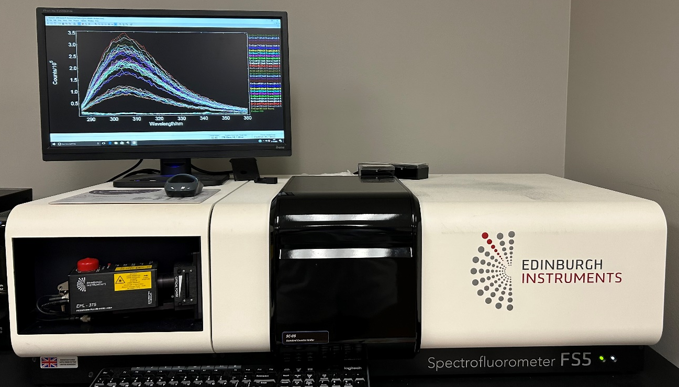
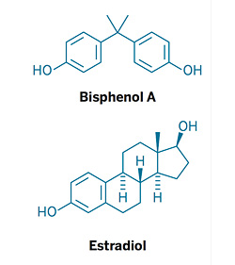
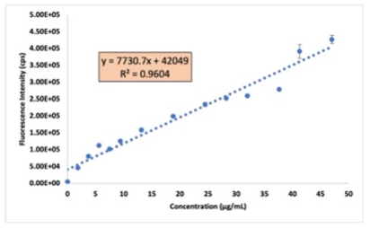
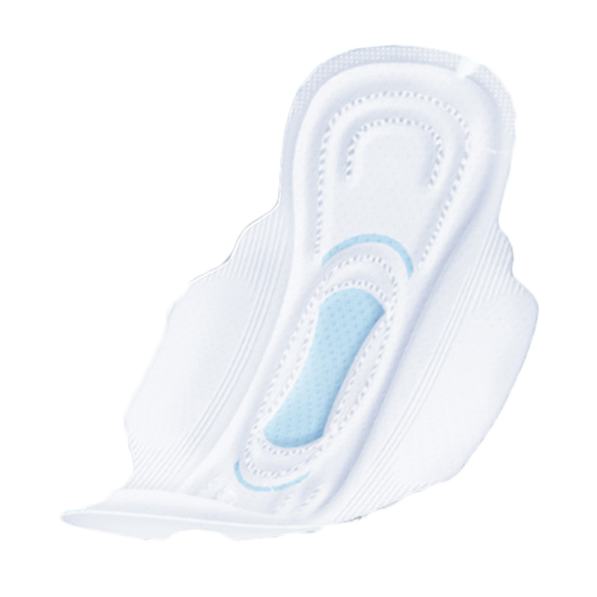
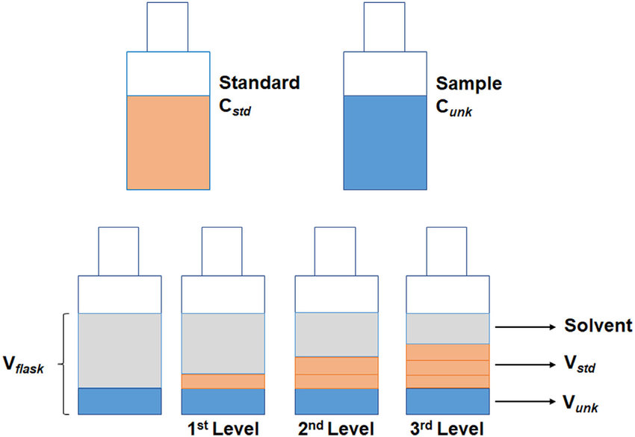
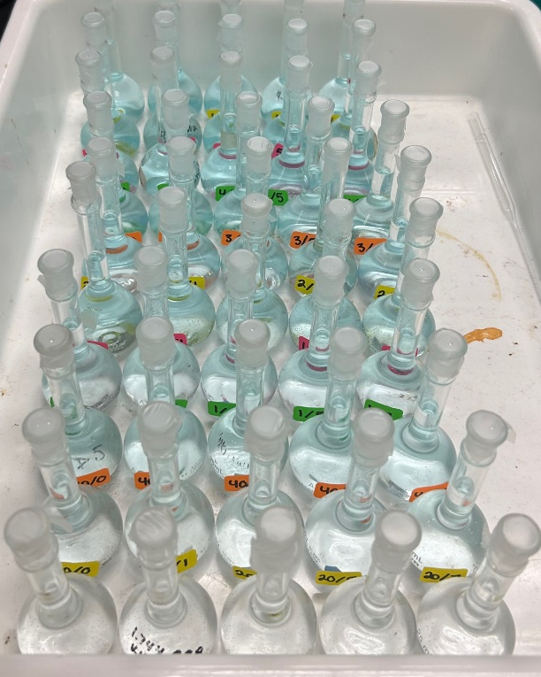
Analysis of BPA Leaching from Feminine Hygiene Products
using Fluorescence Spectrophotometry
Maryann Rettig and Sara E. Hubbard, Ph.D.
Ouachita Baptist University, Department of Chemistry, Arkadelphia, AR 71998
Goals
Results
Conclusions
Determine the amount of BPA leaching out of pantyliners and menstrual pads in a standard solvent.
Compare the leaching of BPA from feminine hygiene products from a methanol/water solution and from a simulated vaginal fluid.
Brand A (Generic) pantyliners had a slightly larger concentration of leached BPA than the Brand A menstrual pads did over the 6-hour time period. This could be due to the higher durability of the outer netting of the pantyliners compared to the pads.
Brand A (Generic) pantyliners from the summer of 2022 had higher leaching of BPA at the beginning of the leaching process. While Brand A (Generic) pantyliners from this summer had lower leaching of BPA at the beginning of the leaching process. Further experimentation is needed.
Brand B (Name) menstrual pads leached little to no BPA over the 6-hour time period. However, they did leach some non-fluorescent blue dye that was not visible on the spectrum. Therefore the Brand B (Name) pantyliners had a slightly larger amount of BPA concentration leaching from them than Brand B’s (Name) menstrual pads did.
Brand C (Luxury) menstrual pads, similar to Brand B (Name) menstrual pads, leached little to no BPA over the 6-hour time period.
Due to the lack of an increase in BPA over the 6-hour time period in Brands A and B in both their pantyliners and pads, there is not a significant difference in the amount of BPA being leached.
After a comparison of BPA concentrations between Brands A, B, and C, it can be concluded that Brand A (Generic) and Brand C (Luxury) have similar leaching patterns as well as higher concentrations of BPA compared to the Brand B (Name) menstrual pads.
Abstract
Bisphenol-A (BPA) is a chemical compound commonly used to produce several plastics and epoxy resins.
Because of a structural resemblance to estradiol, BPA can act as an endocrine disruptor.¹
BPA has been linked to several health complications such as cancer development, reduced fertility, and early puberty.¹
BPA is a fluorescent compound with excitation and emission wavelengths of 278 nm and 304 nm, respectively.
The standard addition method was used to calculate the BPA concentrations obtained from these samples due to the complex sample matrix.²
To further analyze the leaching effects, a simulated vaginal fluid will be utilized as the solvent to mimic the pH and proteins of the female vagina.³
Edinburgh Instruments FS-5 Spectrofluorometer. The Spectrofluorometer measures the wavelength by counts per second of the sample inserted into the instrument.
LOD: 0.04931 µg/mL
LOQ: 0.1643 µg/mL
Chemical structure of Bisphenol A (BPA) and Estradiol.
BPA excitation and emission spectra. This spectrum was obtained using the FS-5 Spectrofluorometer from Edinburgh Instruments to analyze the excitation and emission wavelengths at 278 nm and 304 nm.
Calibration curve of BPA stock solution. This calibration curve was obtained from the analysis of samples containing volumes varying from 0 mL-25 mL of BPA stock solution in 1:1 MeOH/H₂0 solution. The concentration of the BPA stock was 47 µg/mL.
Menstrual pad example.
BPA Conc: 6.9836 μg/mL
Future Work
Methods
Continue replicating sample data and analyze additional menstrual pad brands to establish standard BPA concentration spectra for later comparison.
Prepare the simulated vaginal fluid that mimics the pH and proteins from the female vagina.
Use the simulated vaginal fluid as a solvent to replace the 1:1 methanol/water solution for BPA leaching effects.
Further test menstrual pads to determine the amount of BPA leaching from them and run statistical analysis on the data – t-tests and ANOVA.
Three brands of menstrual pads and two brands of pantyliners were selected to analyze BPA leaching: one generic brand (A), one name brand (B), and one luxury brand (C).
Example of Standard Addition Method. This standard addition graph was obtained from the analysis of Brand B pantyliners after leaching for 20 minutes. Quantitative analysis was then conducted to determine the concentration of BPA in the sample at the 20-minute time point.
Comparison between Brand A pantyliners from last summer and this summer. The concentrations of BPA in both summers’ Brand A pantyliners are placed on the same axis to compare the BPA leaching patterns side by side.
A calibration curve was obtained to determine analytical figures of merit: linear range, limit of detection, and limit of quantitation.
The top netting layer was removed from three pantyliners or pads and placed in their corresponding beakers containing 100 mL of 1:1 methanol/water solution to soak for a specific time point.
References
Standard Addition method visual.
Comparison between Brand B pantyliners and pads. The concentrations of BPA in both Brand B pantyliners and menstrual pads were placed on the same axis to be compared side by side.
Comparison between Brand A pantyliners and pads. The concentrations of BPA in both Brand A pantyliners and menstrual pads are placed on the same axis to compare the leaching of BPA from both side by side.
1. Gao, Chong-Jin; Kannan, Kurunthachalam. Environ. Int,; (2020), 136, doi: 105465
2. Zellmer, David L. Standard Addition. California St. Univ. Sept. 2, 1998. Web. July 29, 2013.
3. Falavigna, Margherita, et al. “The Vaginal-PVPA: A Vaginal Mucosa-Mimicking in Vitro Permeation Tool for Evaluation of Mucoadhesive Formulations.” Pharmaceutics, vol. 12. no, 6, 2020, p. 568.
After varying time periods that ranged from 0 hours to 6 hours, the solution was decanted from the beakers to make the samples.
The 25-mL samples were then made using the standard addition method by adding 5 mL of the analyte, varying volumes of the BPA stock solution, and then the rest with the 1:1 methanol/water solution.
Acknowledgements
Standard Addition samples from Brand B menstrual pad analysis.
The samples were then analyzed in quadruplicate on an FS-5 Spectrofluorometer from Edinburgh Instruments at an emission wavelength range of 294 nm-314 nm and then extrapolated to determine the concentration of BPA that leached during each time period.
Thank you to the J.D. Patterson Summer Research program and to the Arkansas INBRE program, with a grant from the National Institute of General Medical Sciences, (NIGMS), P20 GM103429.
Comparison between Brand A, B, and C menstrual pads. The concentrations of BPA in Brands A, B, and C menstrual pads were placed on the same axis to compare the concentration of BPA leaching from each brand.

