Slide 1
In Vitro Bacteriophage Treatment for a S. aureus and P. aeruginosa Co-culture
By Alexis Perry

Slide 2
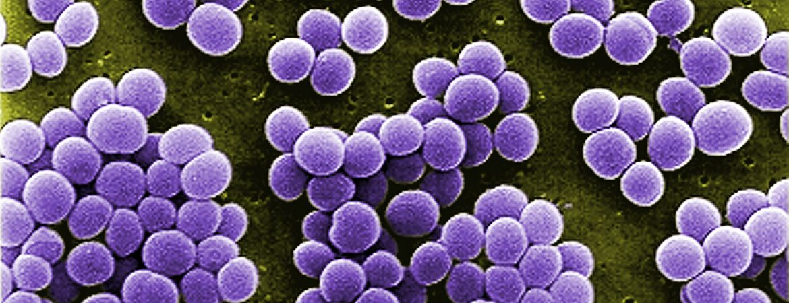
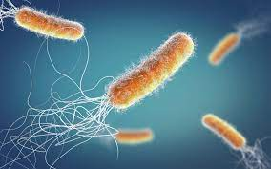
Science behind the Bacteria
Bacteria express different characteristics in planktonic versus biofilm form
  Biofilm= a slimy structure of bacteria that adheres to a surface
Polymicrobial infections, in a biofilm, are able to communicate cooperate and compete
  Communicate through quorum-sensing
Staphylococcus aureus- gram-positive bacteria
P. aeruginosa and S. aureus have been discovered in synergistic and antagonistic co-infections
  Can become more virulent in the presence of each other
    Example of quorum-sensing molecules: Autoinducer-2, LasB, rhamnolipids, phenazines
Common places the co-relationship can be discovered : wounds and Cystic fibrosis infections
Pseudomonas aeruginosa- gram-negative bacteria

Slide 3
Background of Cystic Fibrosis
Cystic fibrosis is one of the most common genetic disease that can lead to excess mucous production by lung endothelial cells
Normal timeline for Cystic fibrosis infection
  Colonized with Staphylococcus aureus (SA) since birth
  After environmental exposure, colonized with Pseudomonas aeruginosa (PA) in teenage years
  PA will outcompete the SA and create a worsened infection
However, in rare cases:
  The SA will adapt and co-exist with the PA
  Co-infection creates a more extreme and worsened health of patient
  Leads to longer hospitalizations and higher fatality

Slide 4
Effects on treatment
Since both Pseudomonas and Staphylococcus can communicate through quorum sensing and change display different genomic characteristics, polymicrobial infections are usually more malignant
  27-36% of all infections are polymicrobial
Due to higher virulence, antibiotics may no longer work in the co-infection
  Bacteriophage therapy is where a virus that can eradicate their specific targeted bacteria host
    At APT, there are bacteriophages active against of each of these bacterial isolates, but the question is if they can still be active in the presence of both bacteria
    In theory, the bacteriophages have the capabilities to adapt along with the mutating co-infection

Slide 5
Purpose
To indicate if bacteriophage can still infect and lyse the bacteria, Pseudomonas aeruginosa and Staphylococcus aureus, while in a co-culture
Relevance to APT- to further understand the impact a polymicrobial infection can make to the sensitivity of our bacteriophages

Slide 6
Experiment Outline- HRQT assessment
1st Goal: Create two 96-well plates analyzing the relationship of each bacteria put against correlating phage and the opposite bacteria filtrate
  Plate #1: For SAMD07, put against SAMD07FSΦ1 and Pa14NP filtrate
  Plate #2: For Pa14NP, put against Pa14ΦPASA16 and SAMD07 filtrate
Put into the HRQT machine to measure cellular respiration and receive results after 48 hours
2nd Goal: Successfully co-culture SAMD07 and Pa14NP and use resistant colonies
  Create an HRQT plate analyzing the phage cocktail of SAMD07FSΦ1 and Pa14ΦPASA16 against SAMD07 and Pa14NP individually and in a co-culture

Slide 7
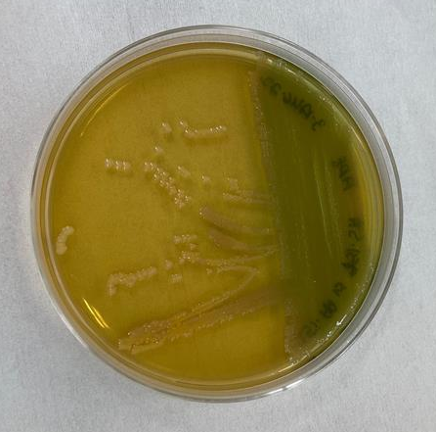
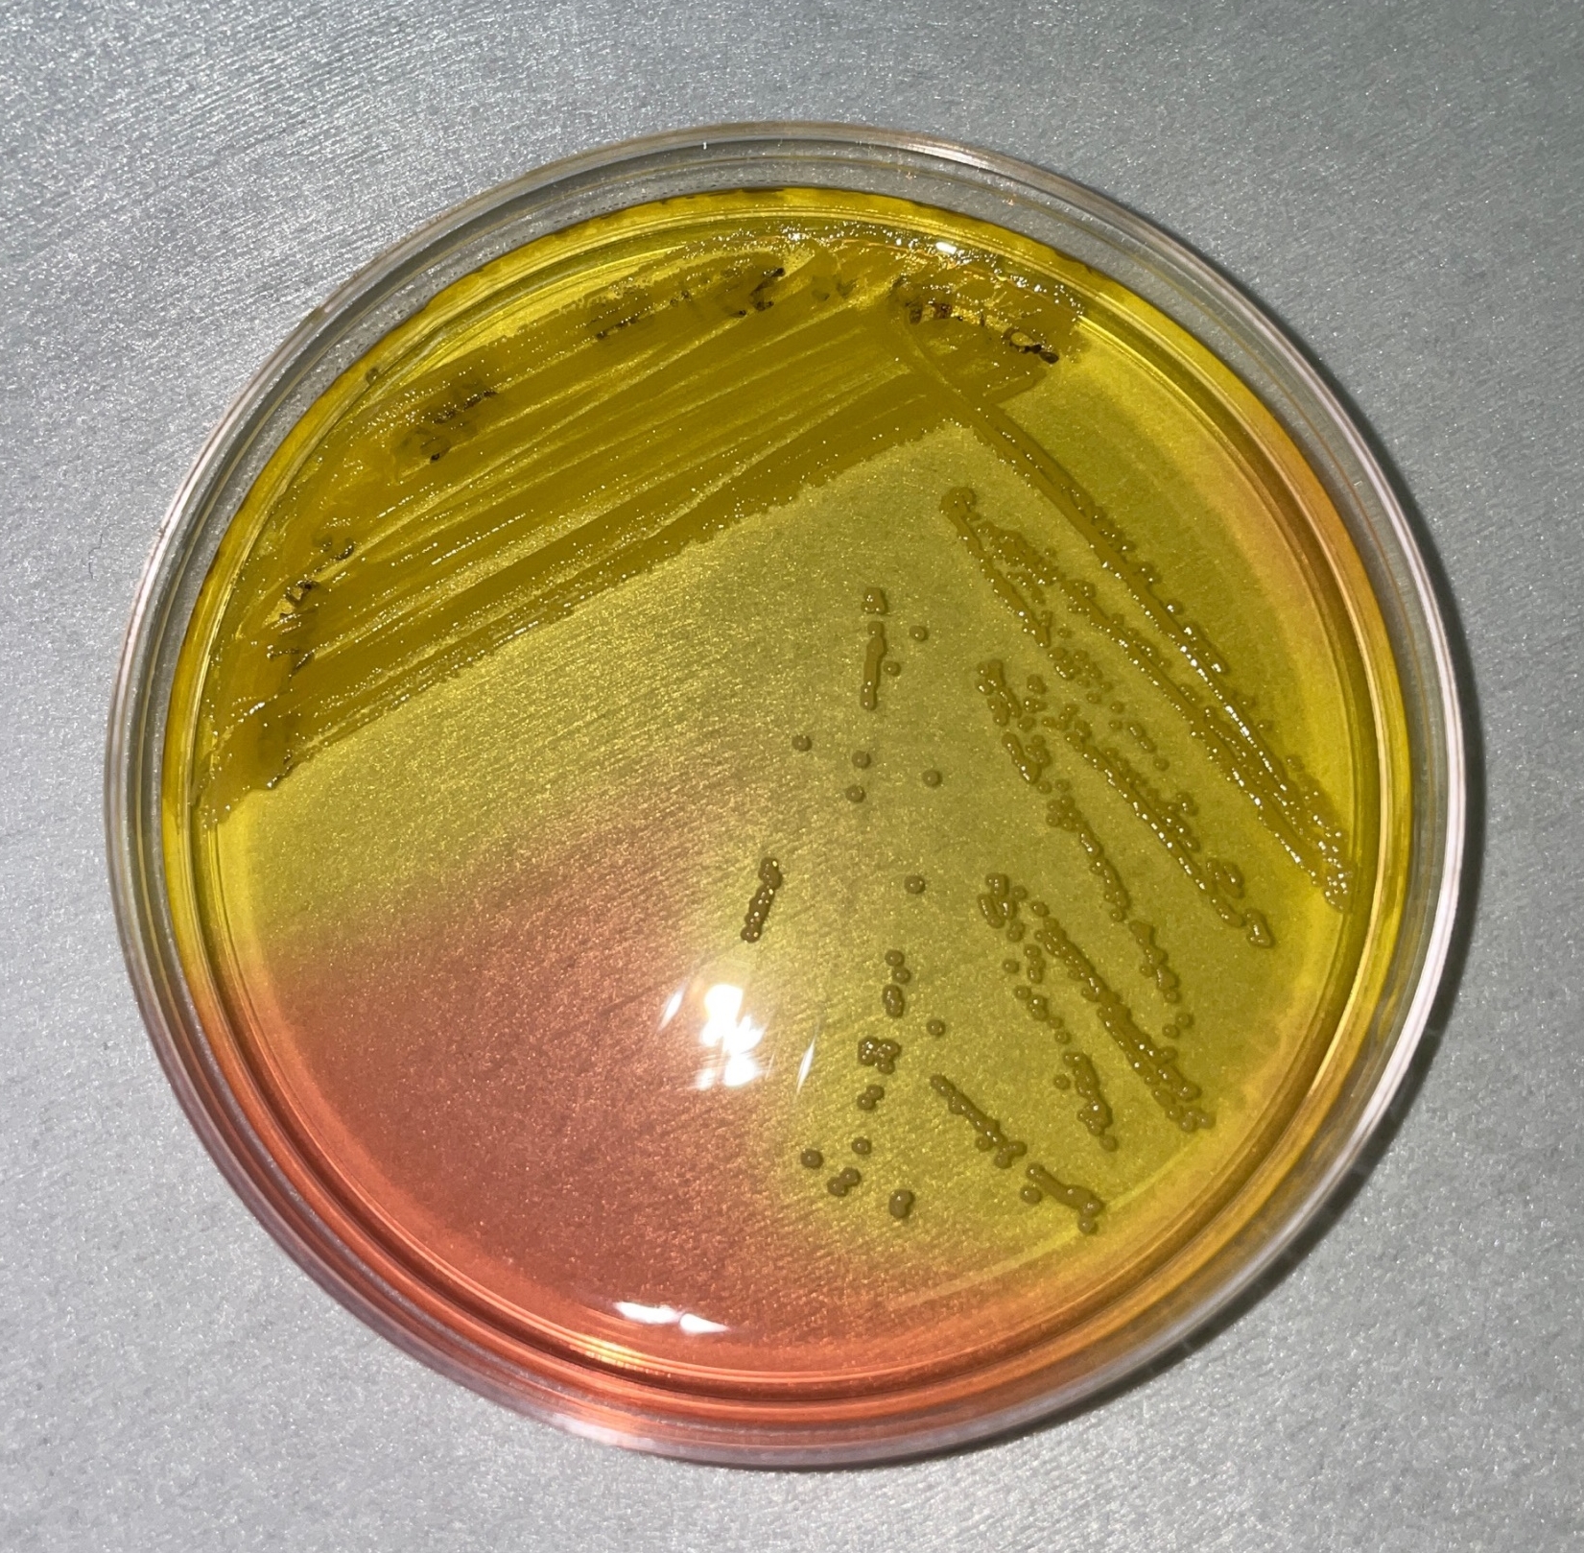
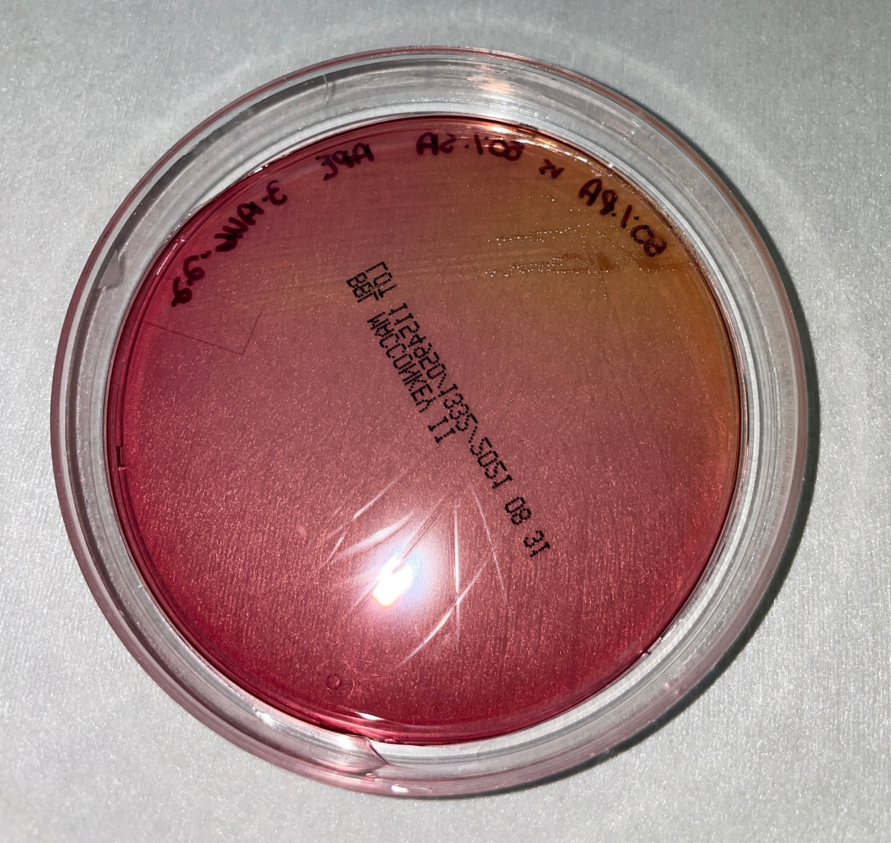
Results
TSA plate MSA plate MacConkey plate

Slide 8
1st Experiment results- Pseudomonas
PA in TSB
PA in SA filtrate
The S. aureus filtrate did have influence on the P. aeruginosa’s growth, but P. aeruginosa was still susceptible to the Pseudo phage in the filtrate
PA with Phage PASA16 in TSB
PA with Phage PASA16 in SA filtrate
Time (hours)

Slide 9
1st Experimental Results- Staphylococcus
The Staph phage can’t control the Staph aureus population in the P aeruginosa filtrate. There could be quorum sensing molecule present in the filtrate that were changing the Staph physiology and susceptibility to the phage

Slide 10
2nd Experiment Results- Co-culture
Staphylococcus cell control
Pseudomonas cell control
Co-culture cell control
Staphylococcus bacteria with phage cocktail
Pseudomonas bacteria with phage cocktail
Co-culture with phage cocktail
The phage cocktail successfully increased the hold time of the mono-cultures and the co-cultures from 6 hours to 18 hours

Slide 11
Possible future additions
Repetition
Use different combinations of bacterial strains
Perform in a planktonic and biofilm setting
Perform in better lung simulation

Slide 12


Slide 13
1st Experimental Steps
Grow both SAMD07 and Pa14NP in two 15mL bioreactors and filter with serological filters once grown
Create Tetrazolium Dye D combinations with both TSA and both filtrates
  125 uL Tz to 125 mL TSb
  60 uL Tz to 5.95 ml filtrate (2x)
Dilute both 10 uL of both bacteria into 990 uL TSB and then 6 uL of 6 dilution to 6mL Tz/TSB
Add 5 uL phage to 3 mL of correlating media

Slide 14
2nd Experimental steps

Slide 15
First HRQT Plate Set-up
1 2 3 4 5 6 7 8 9 10 11 12
Controls
Bacteria + TSB
Bacteria + Opposite filtrate
Bacteria + TSB + Phage
Bacteria + Filtrate + TSB
A
B
C
D
E
F
G
H
TSA control Filtrate Control Phage Control

Slide 16
Second HRQT Plate Set-up
1 2 3 4 5 6 7 8 9 10 11 12
Controls
Bacteria controls
SA B w/ Φ cocktail
PA B w/ Φ cocktail
SA B + PA B w/ Φ cocktail
A
B
C
D
E
F
G
H
TSA control Phage Control

Slide 17
Experiment Controls
TSA control Bacteriophage control

