Slide 1
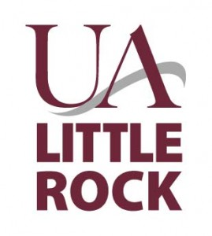
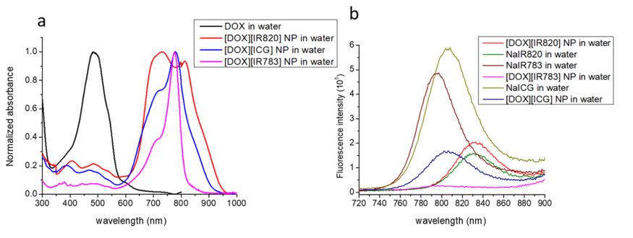
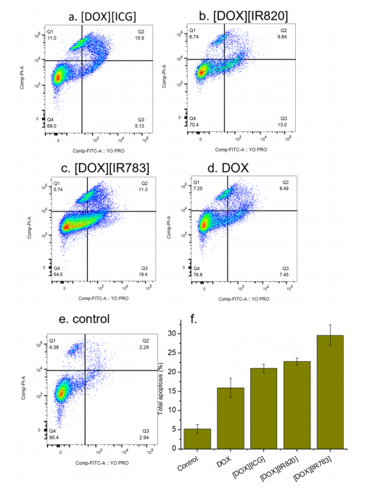
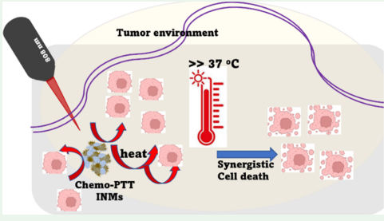
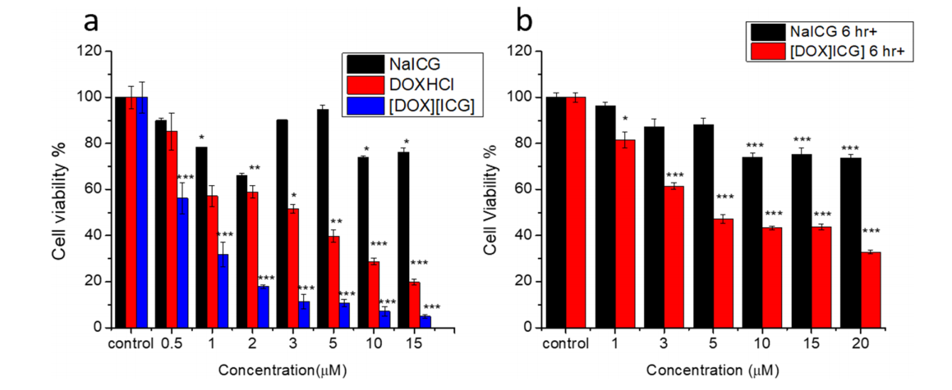
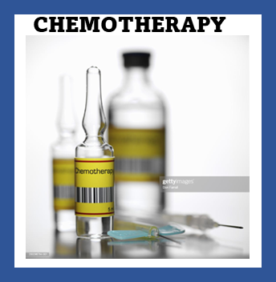
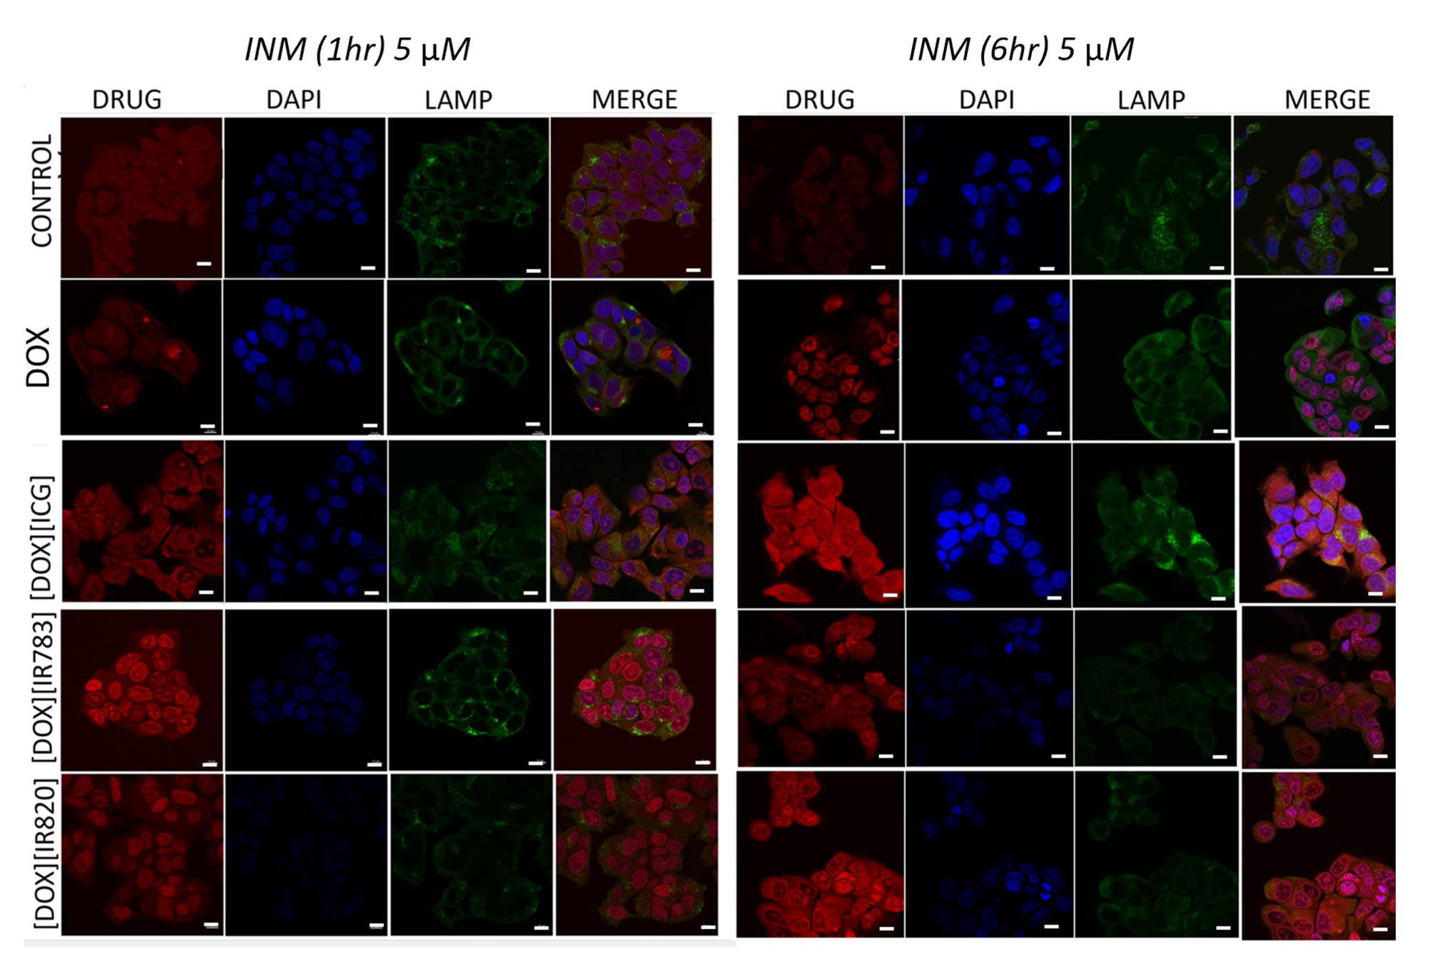
Combination nanomedicines for cancer therapy
Mujeebat Bashiru and Dr. Noureen Siraj
Department of Chemistry, University of Arkansas at Little Rock AR 72204
Abstract
Photophysical characterization
Cell death mechanism
Nanomedicines derived from combination ionic nanomaterials (INMs) offer synergistic therapy for effective treatment of cancer. This approach addresses the limitations of conventional treatment options and offers active targeting of tumors due to EPR effect
Flow cytometry using YO-PRO/PI Stainer
Limitations of conventional treatments
Invasiveness, side effects on healthy cells, multidrug resistance
Alternatives
Light mediated therapies (photothermal therapies)
Jablonski diagram
In-vitro PTT behavior of INMs
In-vitro Results- Cytotoxicity on MCF-7 cells
Introduction
Conclusion
Doxorubicin based-chemo PTT combination INMs show synergistic anticacer effects
INMs show enhanced PTT behavior leading to improved cytotoxicity compared to parent drugs.
Enhanced cellular uptake of INMs within key organelle (nucleus and lysosome) results in improved cytotoxicity
PTT
Ionic material synthesis
Future works
(FDA approved)
IC₅₀ (µM) and combination Index (CI) results
Subcellular localization of INMs
In-vivo effect of chemo-PTT INMs in mouse models, pharmacokinetics of INMs (elimination half-life)
Drugs | IC₅₀ (24 hr) | IC₅₀ (6 hr+)
DOX | 3.86+1.03 | 7.70 + 1.10
NaICG | N/D | 24.80 + 0.72
[DOX][ICG] | 0.55+0.06 | 4.57 + 0.57
NaIR783 | N/D | 37.00 + 1.50
[DOX][IR783] | 0.89+0.01 | 2.90 + 0.25
NaIR820 | N/D | 24.01 + 0.99
[DOX][IR820] | 0.74+0.01 | 11.71+0.22
References
r.t, 24 hrs
[DOX][NIR]
NaICG,
NaIR820
NaIR783
1. Tunçel, A., and Yurt, F. (2022) Chemo-Photothermal Combination Therapy of HER-2 Overexpressing Breast Cancer Cells with Dual-Ordered Mesoporous Carbon@Silica Nanocomposite. Appl. Biochem. Biotechnol.: 1904–1927.
2. Jiang, Y., Huang, C., and Luan, Y. (2020) Lactosylated IR820/dox co-assembled nanodrug for synergetic antitumour therapy. Int. J. Nanomedicine 15: 4431–4440.
3. Macchi, S., Jalihal, A., Hooshmand, N., Zubair, M., Jenkins, S., Alwan, N., El-Sayed, M., Ali, N., Griffin, R. J., and Siraj, N. (2022) Enhanced photothermal heating and combination therapy of NIR dye via conversion to self-assembled ionic nanomaterials . J. Mater.
(FDA approved)
Dissolved in water
.
Nanoparticle significance
Enhanced permeability and retention effect (EPR)
Tumor
tissues
Acknowledgements
Nanoparticles soluble drugs
(INMs) | [DOX] [ICG] | [DOX] [IR820] | [DOX] [IR783]
CI | 0.74 | 0.32 | 0.28
Siraj lab, UA Little Rock Chemistry Department
Signature Experience Award
NSF 1833004
Arkansas INBRE P20 GM103429
Normal tissues
Li, R., Zheng, K., Yuan, C., Chen, Z., & Huang, M. (2017). Be active or not: The relative contribution of active and passive tumor targeting of nanomaterials. Nanotheranostics, 1(4), 346–357. https://doi.org/10.7150/ntno.19380
Scale bar rep 10 µm

Slide 2
Nanomedicines derived from combination ionic nanomaterials (INMs) offer synergistic therapy for effective treatment of cancer. This approach addresses the limitations of conventional treatment options and offers active targeting of tumors due to EPR effect.
Nanomedicines derived from combination ionic nanomaterials (INMs) offer synergistic therapy for effective treatment of cancer. This approach addresses the limitations of conventional treatment options and offers active targeting of tumors due to EPR effect

