Slide 1
Investigations of Salvia officinalis Secondary Metabolites
Maria Ines Dow
Advisor: Dr. Chiraz Amrine
March 12th, 2022
Notes:
Secondary metabolites???

Slide 2
Salvia officinalis Medicinal Properties
Anticancer
Anti-inflammatory
Antimicrobial
Antioxidant
Antimutagenic
Seizures and tremors
Ulcers
Diabetes
Hyperglycemia
Dizziness
Mild dyspepsia
*Used in cooking
Notes:
To name a few

Slide 3
Salvia officinalis Location
Native to Middle East and Mediterranean areas
Naturalized world-wide
Europe and North America
Obtained from Ozarks

Slide 4
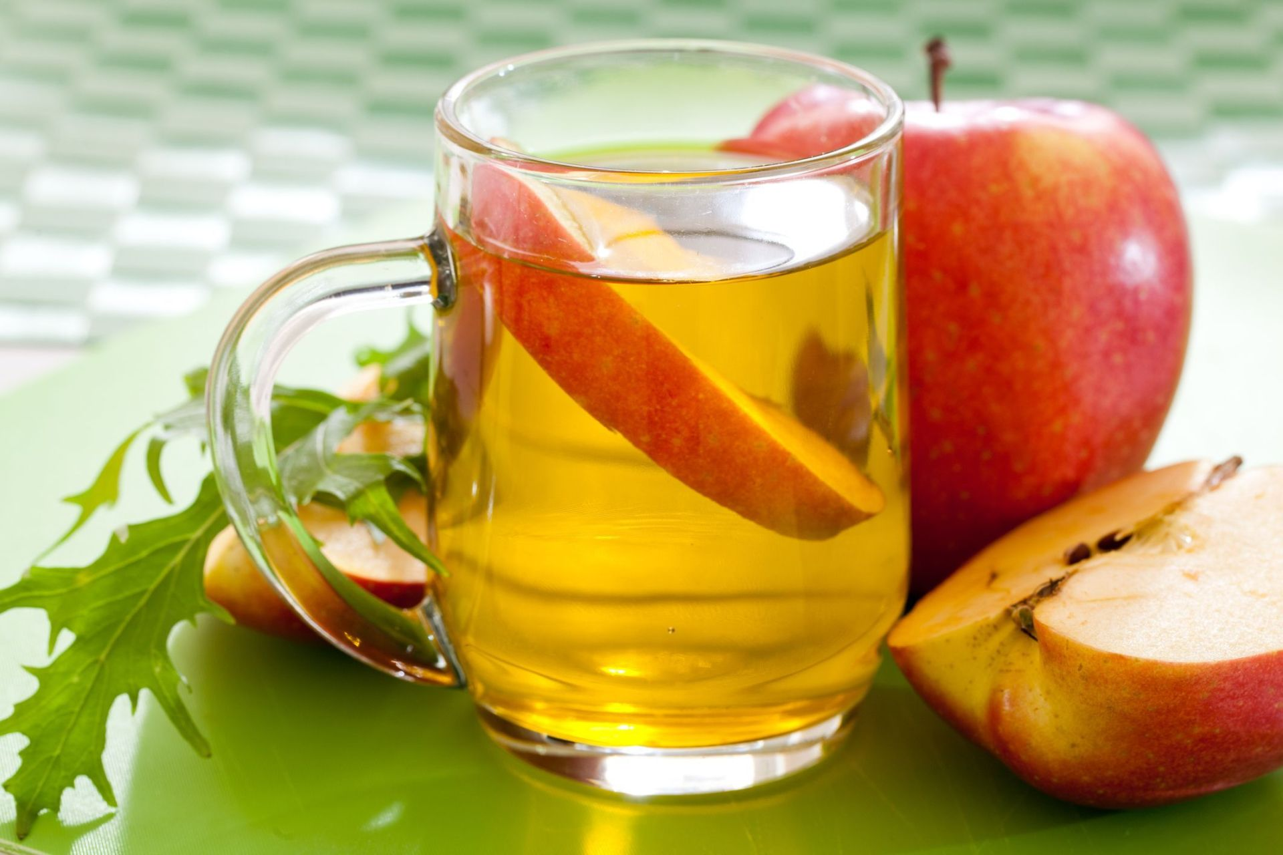
Vinegar Properties
Aids in weight loss
Reduce blood sugar levels (insulin levels in check)
Lowers cholesterol
Helps digestive system (lowering bacterial infections)
Antioxidants (free radical damage decrease)
This Photo by Unknown Author is licensed under CC BY-SA

Slide 5
Sage
(Raw + Vinegar Incubated)
Aqueous ACN:MeOH
Organic Extract Collected in Vials
Raw Sage Extract
Apple Cider Vinegar + Sage Extract
Grape Vinegar Extraction
Soxhlet Extraction (300mL EtOH)
Evaporation Liquid-Liquid Partition Separatory Funnel (2x)
Hexanes
Extraction Protocol

Slide 6
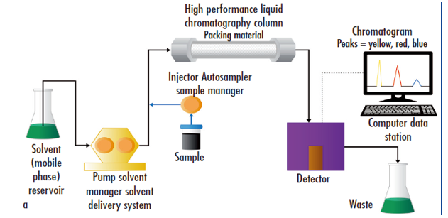
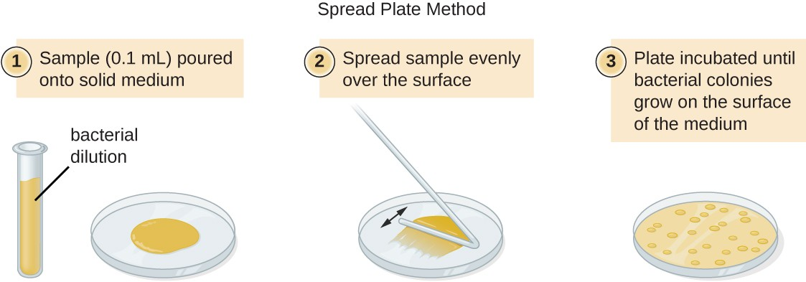
Salvia officinalis Future Goals
The samples will be subjected to high performance liquid-phase chromatography coupled with mass spectroscopy (HPLC-MS) to investigate further any new secondary metabolites. Three replicates of each extract are being tested for their antibacterial effect against a panel of gram + and gram – bacteria.
Gram-negative:
-K12 E coli.
-Serratia marcescens
-Alcaligenes faecalis
Gram-positive:
-Staphylococcus epidermidis
-Micrococcus luteus
-Bacillus subtilis
This Photo by Unknown Author is licensed under CC BY
Notes:
K12 Ecoli → UTIs, intestinal bleeding, diarrhea
Serratia marcescens → fever, dysuria, pain during voiding
Alcaligenes faecalis → swelling of eyelids, redness, permanent loss of vision
Staphylococcus epidermis → wound infection, boils, sinus infections, endocarditis
Micrococcus luteus → can act as opportunistic pathogen→ meningitis, septic arthritis, endocarditis..
Bacillus subtilis → nausea, vomiting, abdominal cramps, diarrhea

Slide 7
References
https://fcer.org/apple-cider-vinegar-benefits/
https://www.ncbi.nlm.nih.gov/pmc/articles/PMC5634728/
https://www.google.com/imgres?imgurl=https://www.creative-proteomics.com/pronalyse/upload/image/high-performance-liquid-chromatography-service-1.png&imgrefurl=https://www.creative-proteomics.com/pronalyse/high-performance-liquid-chromatography-service.html&tbnid=2hKcX7bi184mYM&vet=1&docid=QQt4ziRXiDWUpM&w=631&h=307&hl=en-us&source=sh/x/im

