Slide 1
A brief discussion of Gasdermin D’s function in multiple sclerosis
By Amie Brint
Mentored By Dr. Shanzhi Wang

Slide 2
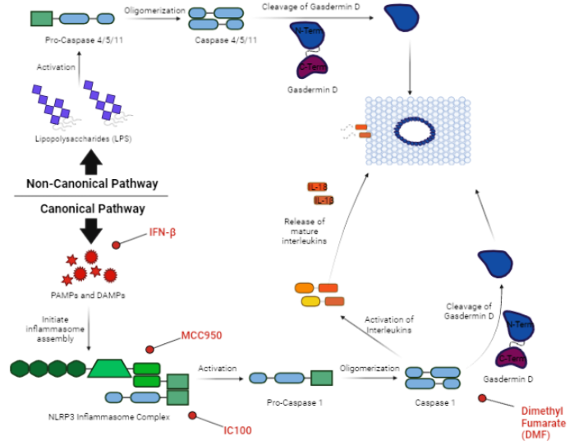
Pyroptotic Pathways: big picture

Slide 3
Method of validation

Slide 4
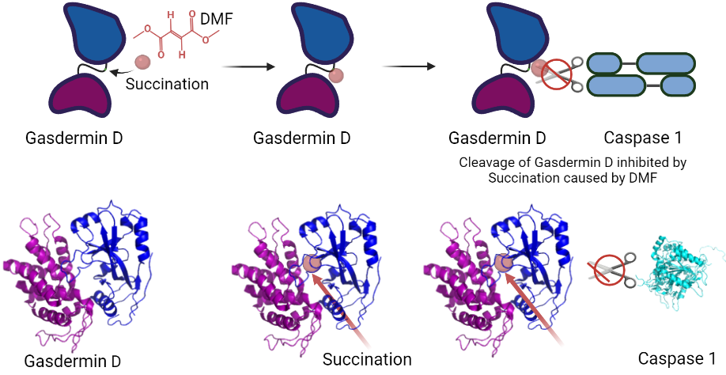
Dimethyl fumarate mechanism validation

Slide 5
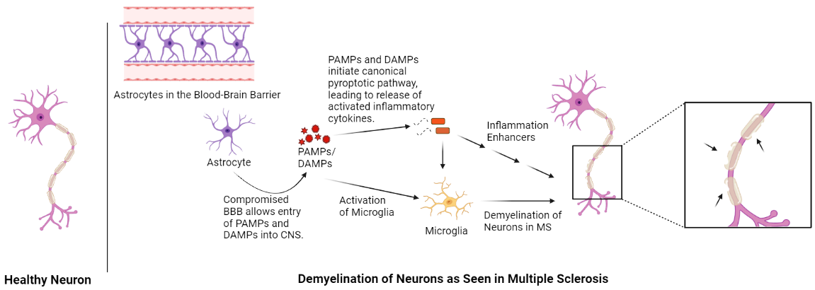
Connecting ms and gsdmd

Slide 6
Future research
Potentially Useful Treatment in Other Inflammatory Diseases
Sepsis
Alzheimer’s
HIV
Gout
Same Method Applied to Other Treatment Mechanisms
Apply Modeling to Determine Conformation Changes
ACKNOWLEDGEMENTS
Dr. Shanzhi Wang
UALR Chemistry Department
UALR Signature Experience Grant
Ouachita Baptist University Virtual Women in STEM Conference
Contact: aabrint@ualr.edu

