Slide 1
Influence of temperature on passage rate in Sceloporus consorbinus, with comparison to congeners
Allison R. Litmer and Steven J. Beaupre
University of Arkansas
Acknowledgements: Morgan Pelley, Max Carnes-Mason, Jason Ortega, and Larry Kamees

Slide 2
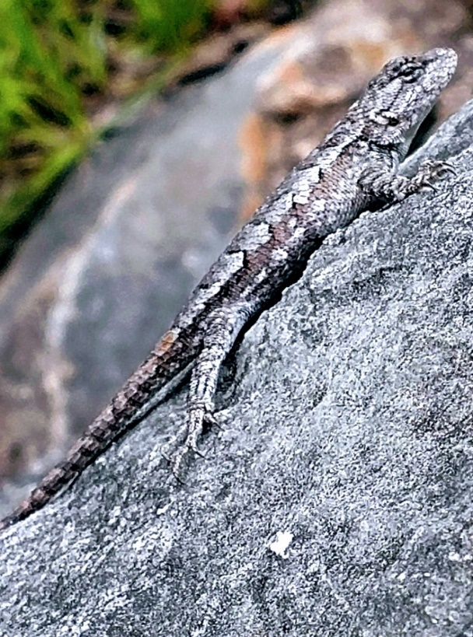
Introduction
Climate models often assume that related organisms respond similarly to climate
Various factors can cause varying population responses
Objectives
1) Quantify influence of temperature on digestive passage rate in prairie lizards
2) Compare digestive passage rate among related lizards
Prairie lizard
(Sceloporus consobrinus)

Slide 3
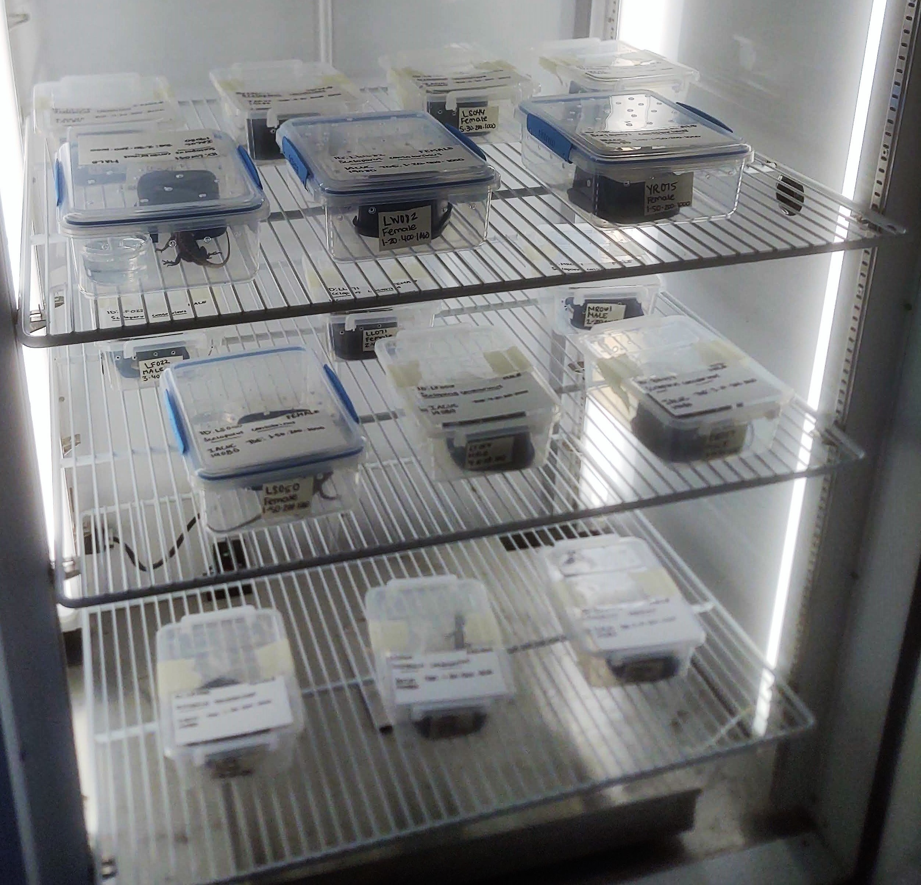
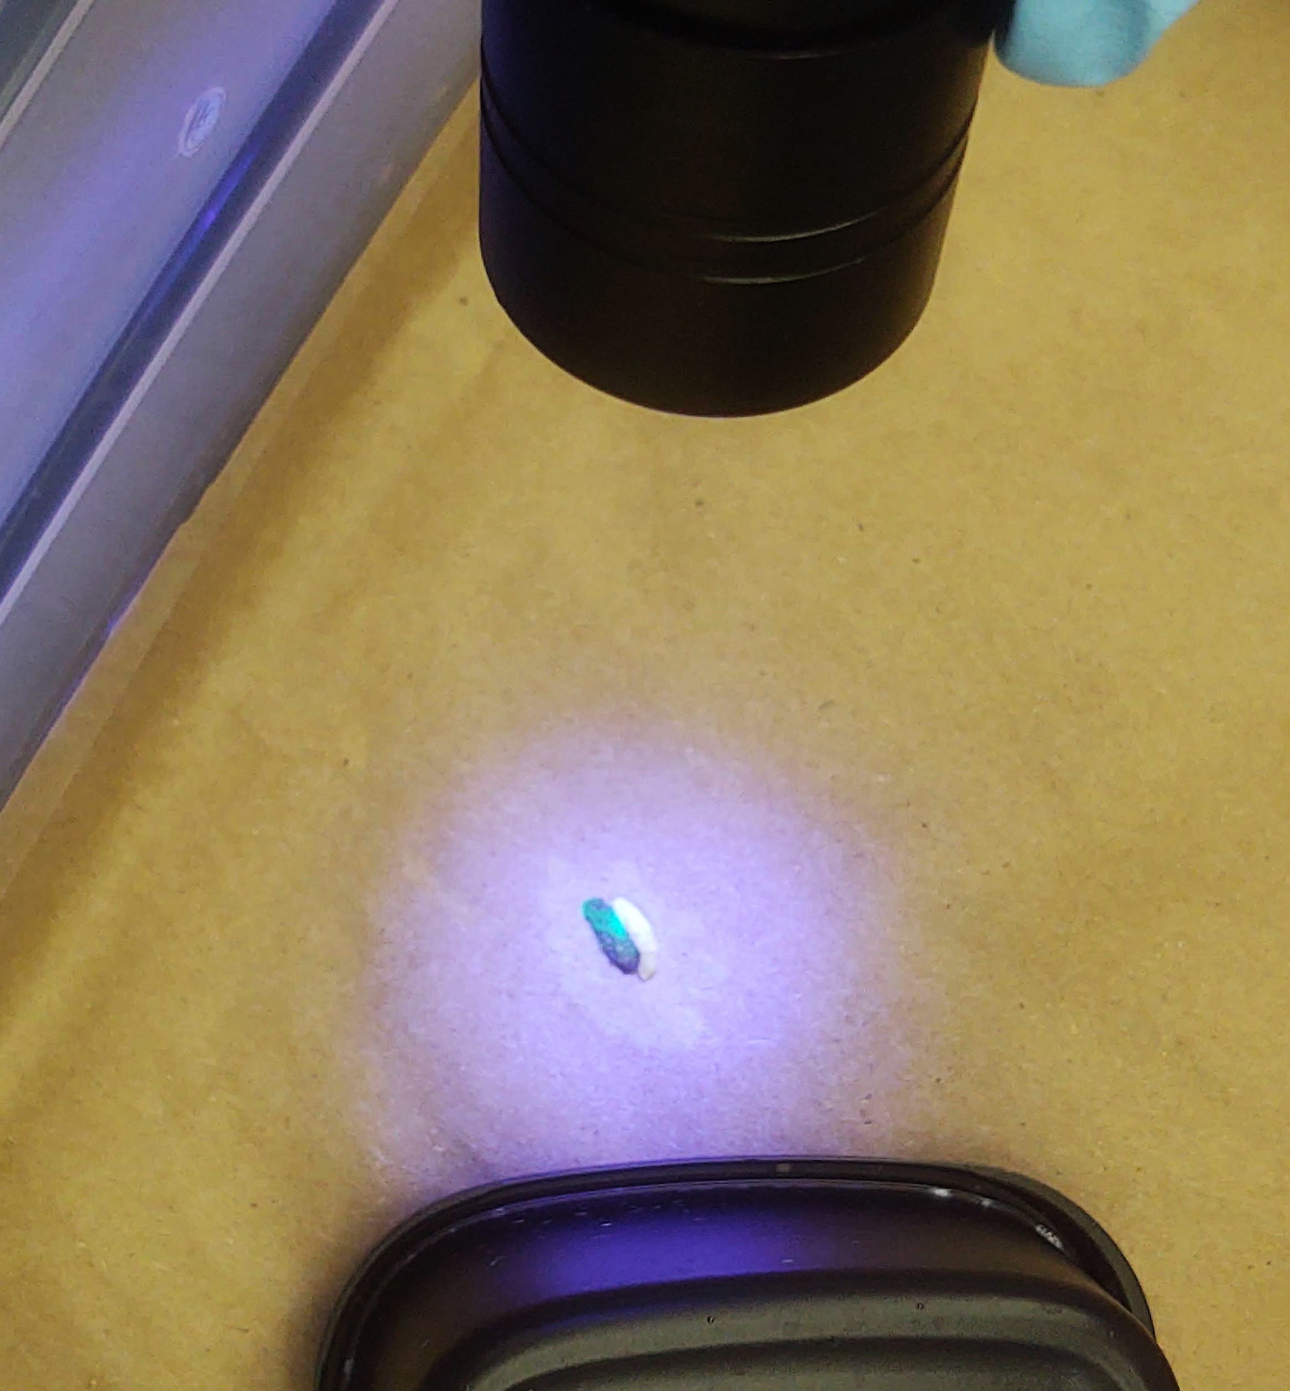
Methods
Adult prairie lizards collected in Arkansas in 2020
Data gathered from Angilletta (2001) on passage rate of fence lizards (Sceloporus undulatus) for comparison
Three temperature treatments:
30ºC, 33ºC, and 36ºC
Lizards fed a marked cricket and tanks monitored every 4-6 hrs for marked feces
Angilletta, Jr., M. J. 2001. Thermal and physiological constraints on energy assimilation in a widespread lizard (Sceloporus undulatus). Ecology 82:3044 – 3056.

Slide 4
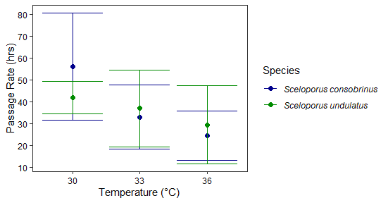
Results

Slide 5
Discussion
Digestive passage rate quickens as temperatures rise
Prairie and fence lizards respond similarly to temperature with regards to digestive passage rate
Prairie lizards pass food slightly quicker than fence lizards at warmer temperatures

Slide 6
Future Directions
Conclusion
Populations may vary in response to climate change despite being related
Direct species comparisons are important for understanding nuances of climate modeling
Determine how energy assimilation is influenced by temperature
Compare energy assimilation between species

