Slide 1
SYNTHESIS & CHARACTERIZATION OF PORPHYRIN-FULLERENE DYADS FOR APPLICATION IN DYE – SENSITIZED SOLAR CELL (DSSCs)
MAVIS FORSON
(GRADUATE STUDENT; UNIVERSITY OF ARKANSAS AT LITTLE ROCK)

Slide 2
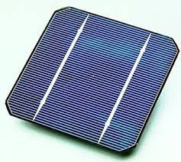
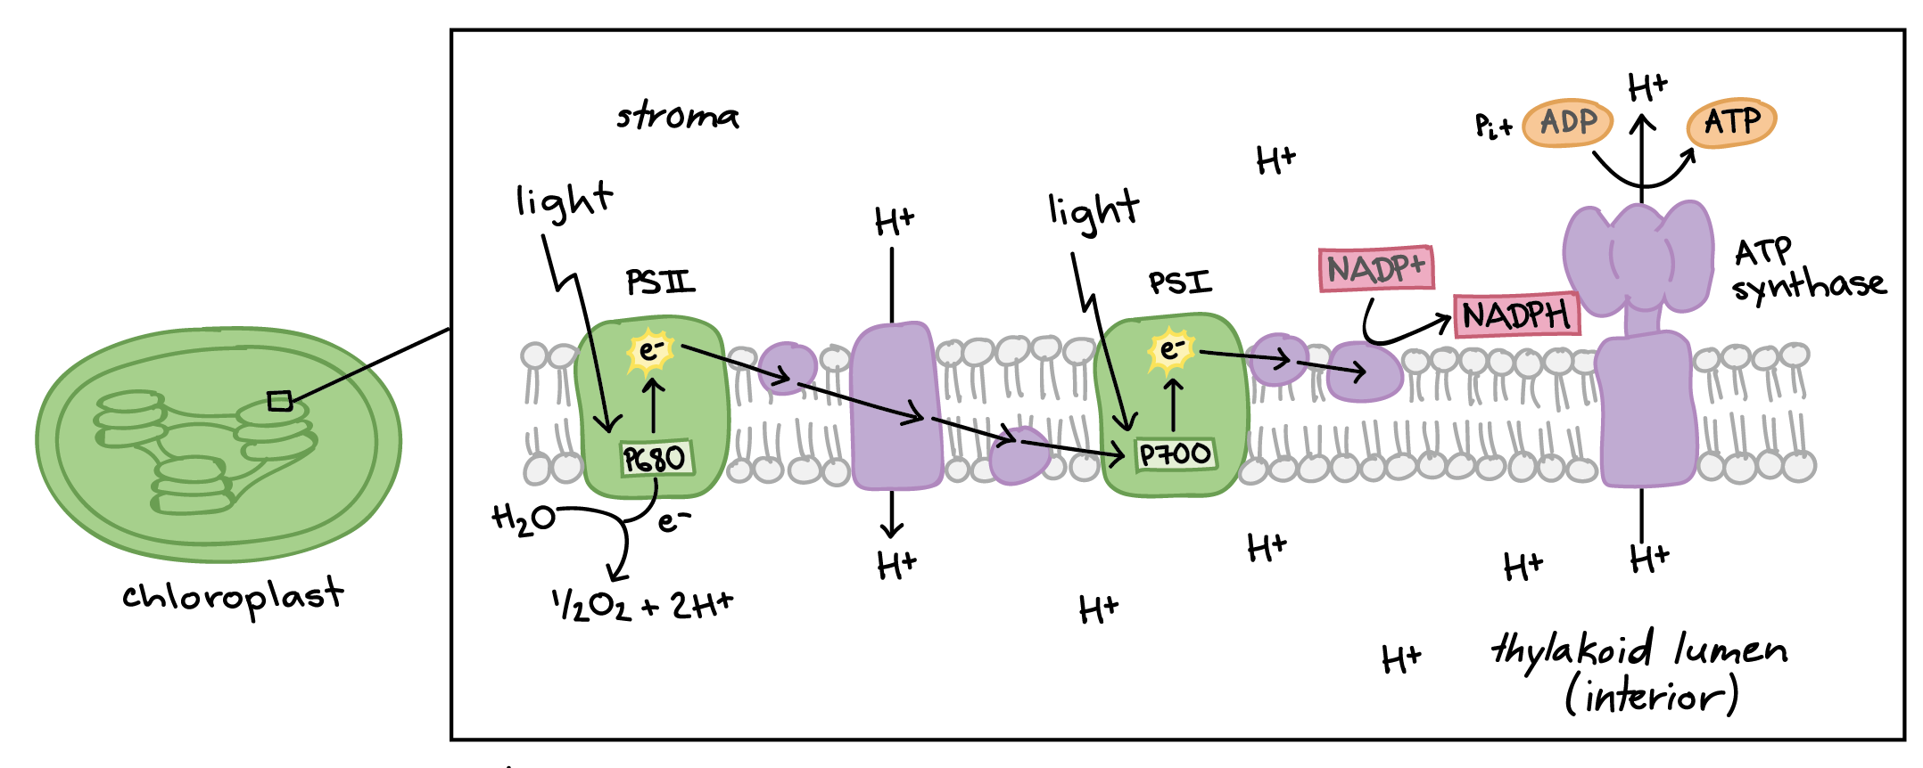
INTRODUCTION

Slide 3
SYNTHESIS OF DYADS
Dyad 1
Zn-Dyad 1
Dyad 2
Zn-Dyad 2
Synthesis of dyads was confirmed with
NMR
Mass Spectrometer
FT-IR

Slide 4
Photophysical Characterization

Slide 5
Photophysical Characterization
Table 1. Molar Absorptivity and Fluorescence quantum yield of dyads in Benzonitrile.
Table 2. Fluorescence lifetimes recorded at 390 nm excitation/650 nm emission in Benzonitrile.
 | λ_{max} (nm) | ε (Lmol⁻¹cm⁻¹) | Φ_{F}
Dyad 1 | 422 518 | 3.71 x 10⁵ 1.20 x 10³ | 12.37
Zn-Dyad 1 | 430 560 | 4.86 x 10⁵ 1.50 x 10⁴ | 2.46
Dyad 2 | 422 517 | 3.69 x 10⁵ 1.80 x 10⁴ | 17.45
Zn-Dyad 2 | 430 560 | 4.73 x 10⁵ 1.80 x 10⁴ | 1.25
 | τ₁ (ns) | α₁ | τ₂ (ns) | α₂ | χ²
Dyad 1 | 1.52 | 0.9293 | 4.35 | 0.0707 | 1.65
Zn-Dyad 1 | 0.359 | 0.9657 | 5.26 | 0.0343 | 1.42
Dyad 2 | 2.10 | 0.9345 | 6.56 | 0.0655 | 1.51
Zn-Dyad 2 | 0.253 | 0.9444 | 4.42 | 0.0556 | 1.59

Slide 6
Conclusion:
We successfully synthesized two dyads with different bridge chain and their Zn metallated versions.
Photophysical characterization shows promising results.
References
(1) Peng, H.-Q.; Niu, L.-Y.; Chen, Y.-Z.; Wu, L.-Z.; Tung, C.-H.; Yang, Q.-Z. Chem. Rev. 2015, 115, 7502.
(2) Chung, C.-L.; Chen, C.-H.; Tsai, C.-H.; Wong, K.-T. Org. Electron. 2015, 18, 8.
(3) Imahori, H.; Tkachenko, N. V; Vehmanen, V.; Tamaki, K.; Lemmetyinen, H.; Sakata, Y.; Fukuzumi, S. J. Phys. Chem. A. 2001, 105, 1750.
Acknowledgements:
Dr. Brain Berry and Dr. Noureen Siraj
Ashley Anderson
Samantha Macchi
Dr. Siraj’s Research Group
UA Little Rock Chemistry Department
Future Work:
Perform photoelectrical studies for device fabrication.

