Slide 1
ROOM TEMPERATURE PHOSPHORESCENT MATERIAL FOR USE IN LOW-COST LIGHTING TECHNOLOGY
Mujeebat Bashiru, Samantha Macchi, Noureen Siraj
UALR, Chemistry Department

Slide 2
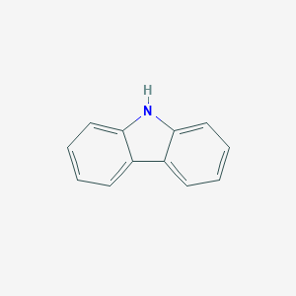
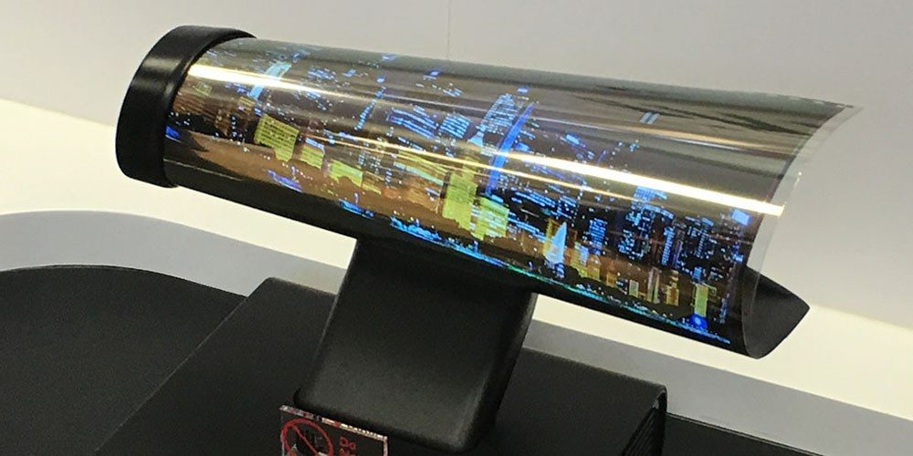
Introduction
Carbazole derivatives: Excellent luminescence properties such as room temperature phosphorescence, Thermally activated delayed fluorescence (TADF)
Ease of modification
Substitution on the N- position to form a donor- acceptor dyads
OLEDs (Organic Light emitting diodes) ongoing efficiency and stability challenges
Emitters(Red, Green and blue)
Aim at designing, optimizing new materials for brighter displays with high stability
carbazole
Flexible OLED display phone

Slide 3
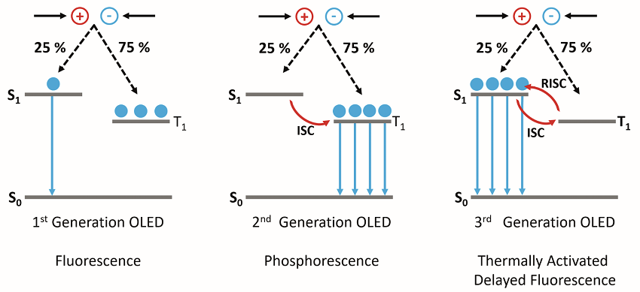
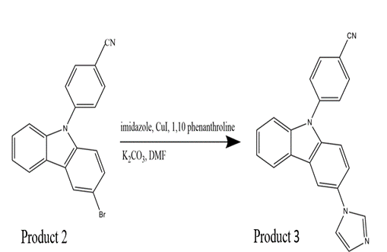
Methods
Synthesis of Carbazole Derivatives
∆ƐST
The operating mechanism behind the first, second and third generation of OLEDs
Characterization via FTIR, NMR, Mass spectrometry were done to confirm the products synthesized
∆
Product 1: 4-(9H-Carbazol-9-YL) benzonitrile, Product 2: 4-(3- bromo-9H- carbazole-9yl) benzonitrile, Product 3: 4-(3-imidazolium-9H-carbazole-9yl) benzonitrile
Product 4: 3-methylimidazolium iodide -9H-carbazole-9yl) benzonitrile
https://www.edinst.com/identifying-thermally-activated-delayed-fluorescence-tadf-using-an-fs5-spectrofluorometer/

Slide 4
Photophysical characterization
Normalized absorbance graph using 12.5 uM carbazole derivatives in dichloromethane
Emission of carbazole derivatives in dichloromethane at 292nm excitation wavelength

Slide 5
Fig 5: Phosphorescence of carbazole derivatives at 292nm excitation at 0.1ms DT
Fig 6: Photoluminescence of carbazole derivatives at 77K
Derivative | Λmax (nm) | Ɛ (M⁻¹cm⁻¹) | S₁(eV) | T₁(eV) | ∆ƐST(eV) =1240/Λ(nm)
Carbazole | 292 | 3002 | 3.63 | 3.18 | 0.45
Product 1 | 292,329,338 | 3680,4742,4967 | 3.50 | 3.13 | 0.37
Product 2 | 298,325 | 16915,14613 | 3.43 | 3.12 | 0.31
Product 3 | 298,305 | 31838,27626 | 3.41 | 3.17 | 0.24
Table 1: Absorbance maxima, molar absorptivity value, energy gap for the different derivatives

Slide 6
Conclusion
References
1. Lv, A. et al. Room-Temperature Phosphorescence from Metal-Free Organic Materials in Solution: Origin and Molecular Design. J. Phys. Chem. Lett 10, 36 (2019).
2. Klán, P. & Wirz, J. Photochemistry of organic compounds : from concepts to practice. (Wiley, 2009).
3. He, Y., Cheng, N., Xu, X., Fu, J. & Wang, J. A high efficiency pure organic room temperature phosphorescence polymer PPV derivative for OLED. Org. Electron. 64, 247–251 (2019).
4. Siraj, N. et al. Carbazole-Derived Group of Uniform Materials Based on Organic Salts: Solid State Fluorescent Analogues of Ionic Liquids for Potential Applications in Organic-Based Blue Light-Emitting Diodes. (2014). doi:10.1021/jp410784v
Organic materials with electroluminescent property was synthesized and their photophysical property was investigated.
Their energy gap (∆ƐST) was calculated which indicates their potential for use as an electroluminescent material for optoelectronic application.
In the future, we plan to use these synthesized material as organic material for device fabrication.
∆ƐST(eV)
∆ƐST(eV)
∆ƐST(eV)
∆ƐST(eV)
ST(eV)
Acknowledgement
Dr Noureen Siraj
Siraj Group
UALR Chemistry Department
NSF
NASA-EPSCoR

