Slide 1
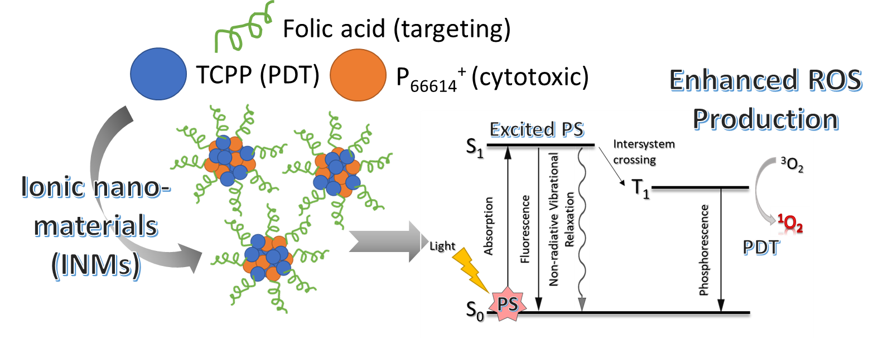
Combination chemo-PDT ionic nanomedicines as enhanced therapeutics for cancer
Samantha Macchi
Mentor: Dr. Noureen Siraj

Slide 2
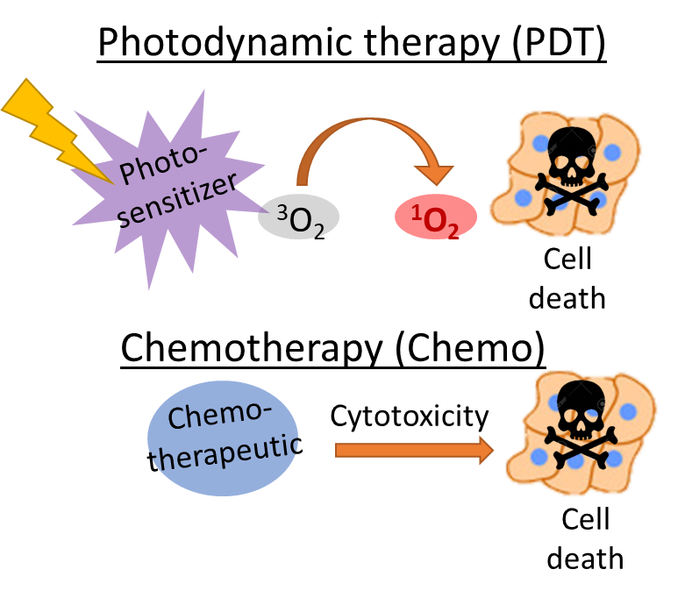
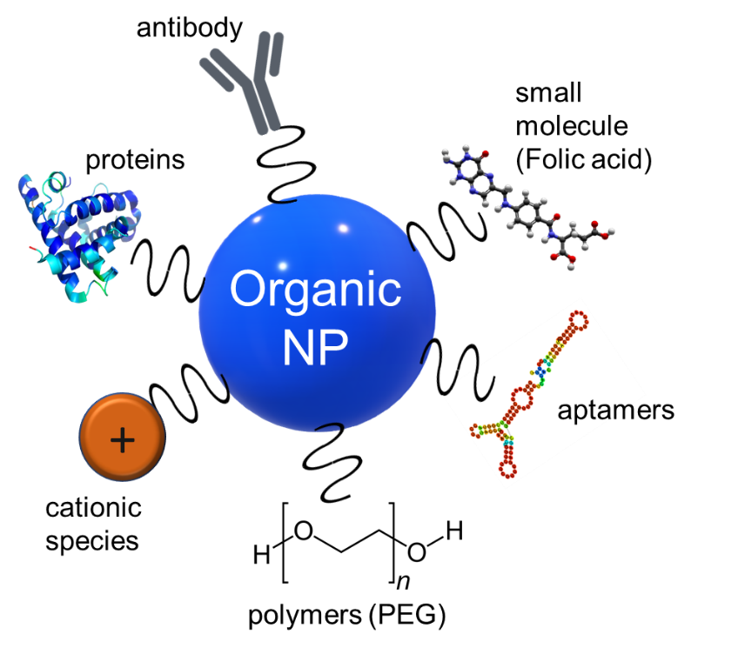
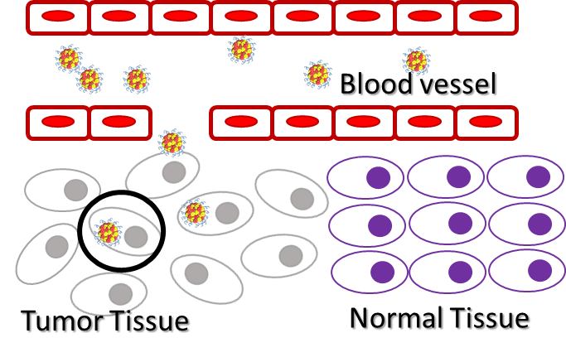
Combination nanomedicines
Less traditional light therapies like photodynamic therapy have grown in popularity
Lessened side effects
Greater targeting
Potential for synergy with chemo—combination therapy
Nanomedicines allow selective targeting of drugs to the tumor site
INMs
Passive targeting
Active targeting

Slide 3
Synthesis of ionic nanomedicine (INMs)
Ionic medicine (IM)
INMs

Slide 4
Improved ROS production
PDT drugs work by producing reactive oxygen species (ROS) in the cell
Enhanced ROS quantum yield can indicate potential for better treatment
Solvent | TCPP | [P₆₆₆₁₄]₄[TCPP]
Ethanol | 14% | 28% (IM)
Water | 19% | 97% (INMs)
Owing to enhanced photophysical properties

Slide 5
Improved cytotoxicity
Toxicity of a) TCPP and b) [P₆₆₆₁₄]₄[TCPP] INMs after 4 hr incubation in MCF-7 cells under light irradiation, 0.14 W/cm² (+) or in dark (-)
(* p<0.05, ** p<0.01, *** p<0.005). MTT assay done 24 hr post PDT treatment

Slide 6
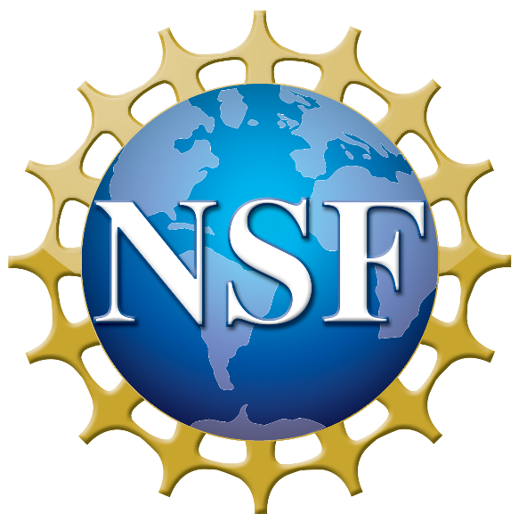
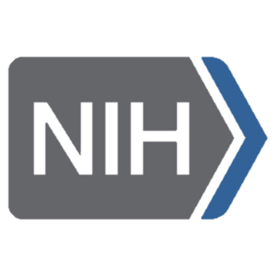
Conclusions
Combination INMs show enhanced ROS production
Cytotoxicity results suggest INMs are a promising cancer therapeutic
Acknowledgements
Future work
UALR Chemistry department
Dr. Siraj Lab
Investigate the cell death mechanism of INMs
Determine their selectivity

