Slide 1
Surface Area Enhancement Of supercapacitor Materials Via Freeze-pore Methodology
Iris Denmark, Tito Viswanathan, Noureen siraj

Slide 2
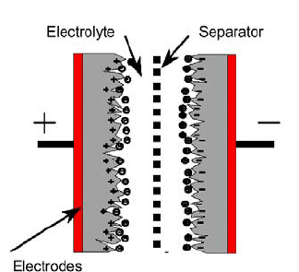
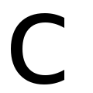
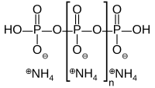
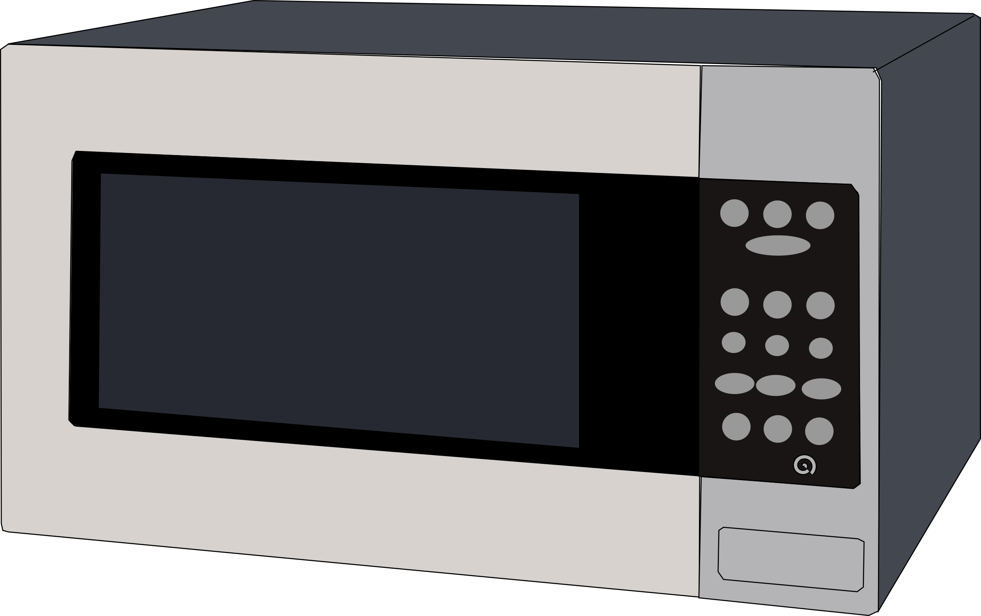
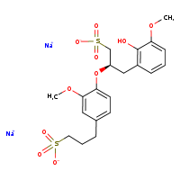
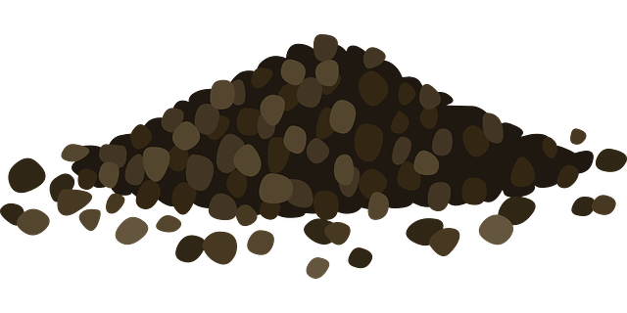
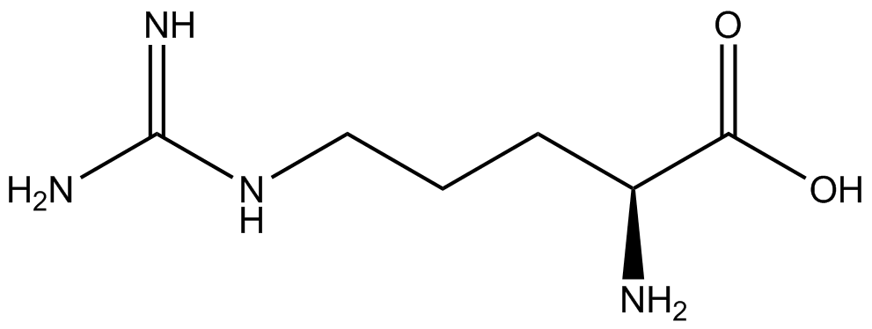
Introduction
Surface Area Optimization of Supercapacitor Materials
Porosity and high surface area are pertinent for double layer formation to occur, which can affect supercapacitor performance.
High surface area provides ‘active sites’ for EDLC formation.
Higher EDLC area, which suggests higher capacitance.
Post-freeze Protocol
1) Conductive PNDC is suspended in 5 mL DI water and sonicated for 15 minutes. Water is thereafter filtered out via gravity filtration on cellulose nitrate filter paper.
2) Material is frozen at -20° C overnight. Thereafter, material is removed from freezer and set to melt to RT (~15-30 minutes) and dried for 2 hours thermally at 70° C to make final PNDC.
30 mins
Ammonium Polyphosphate
Lignosol
L-Arginine

Slide 3
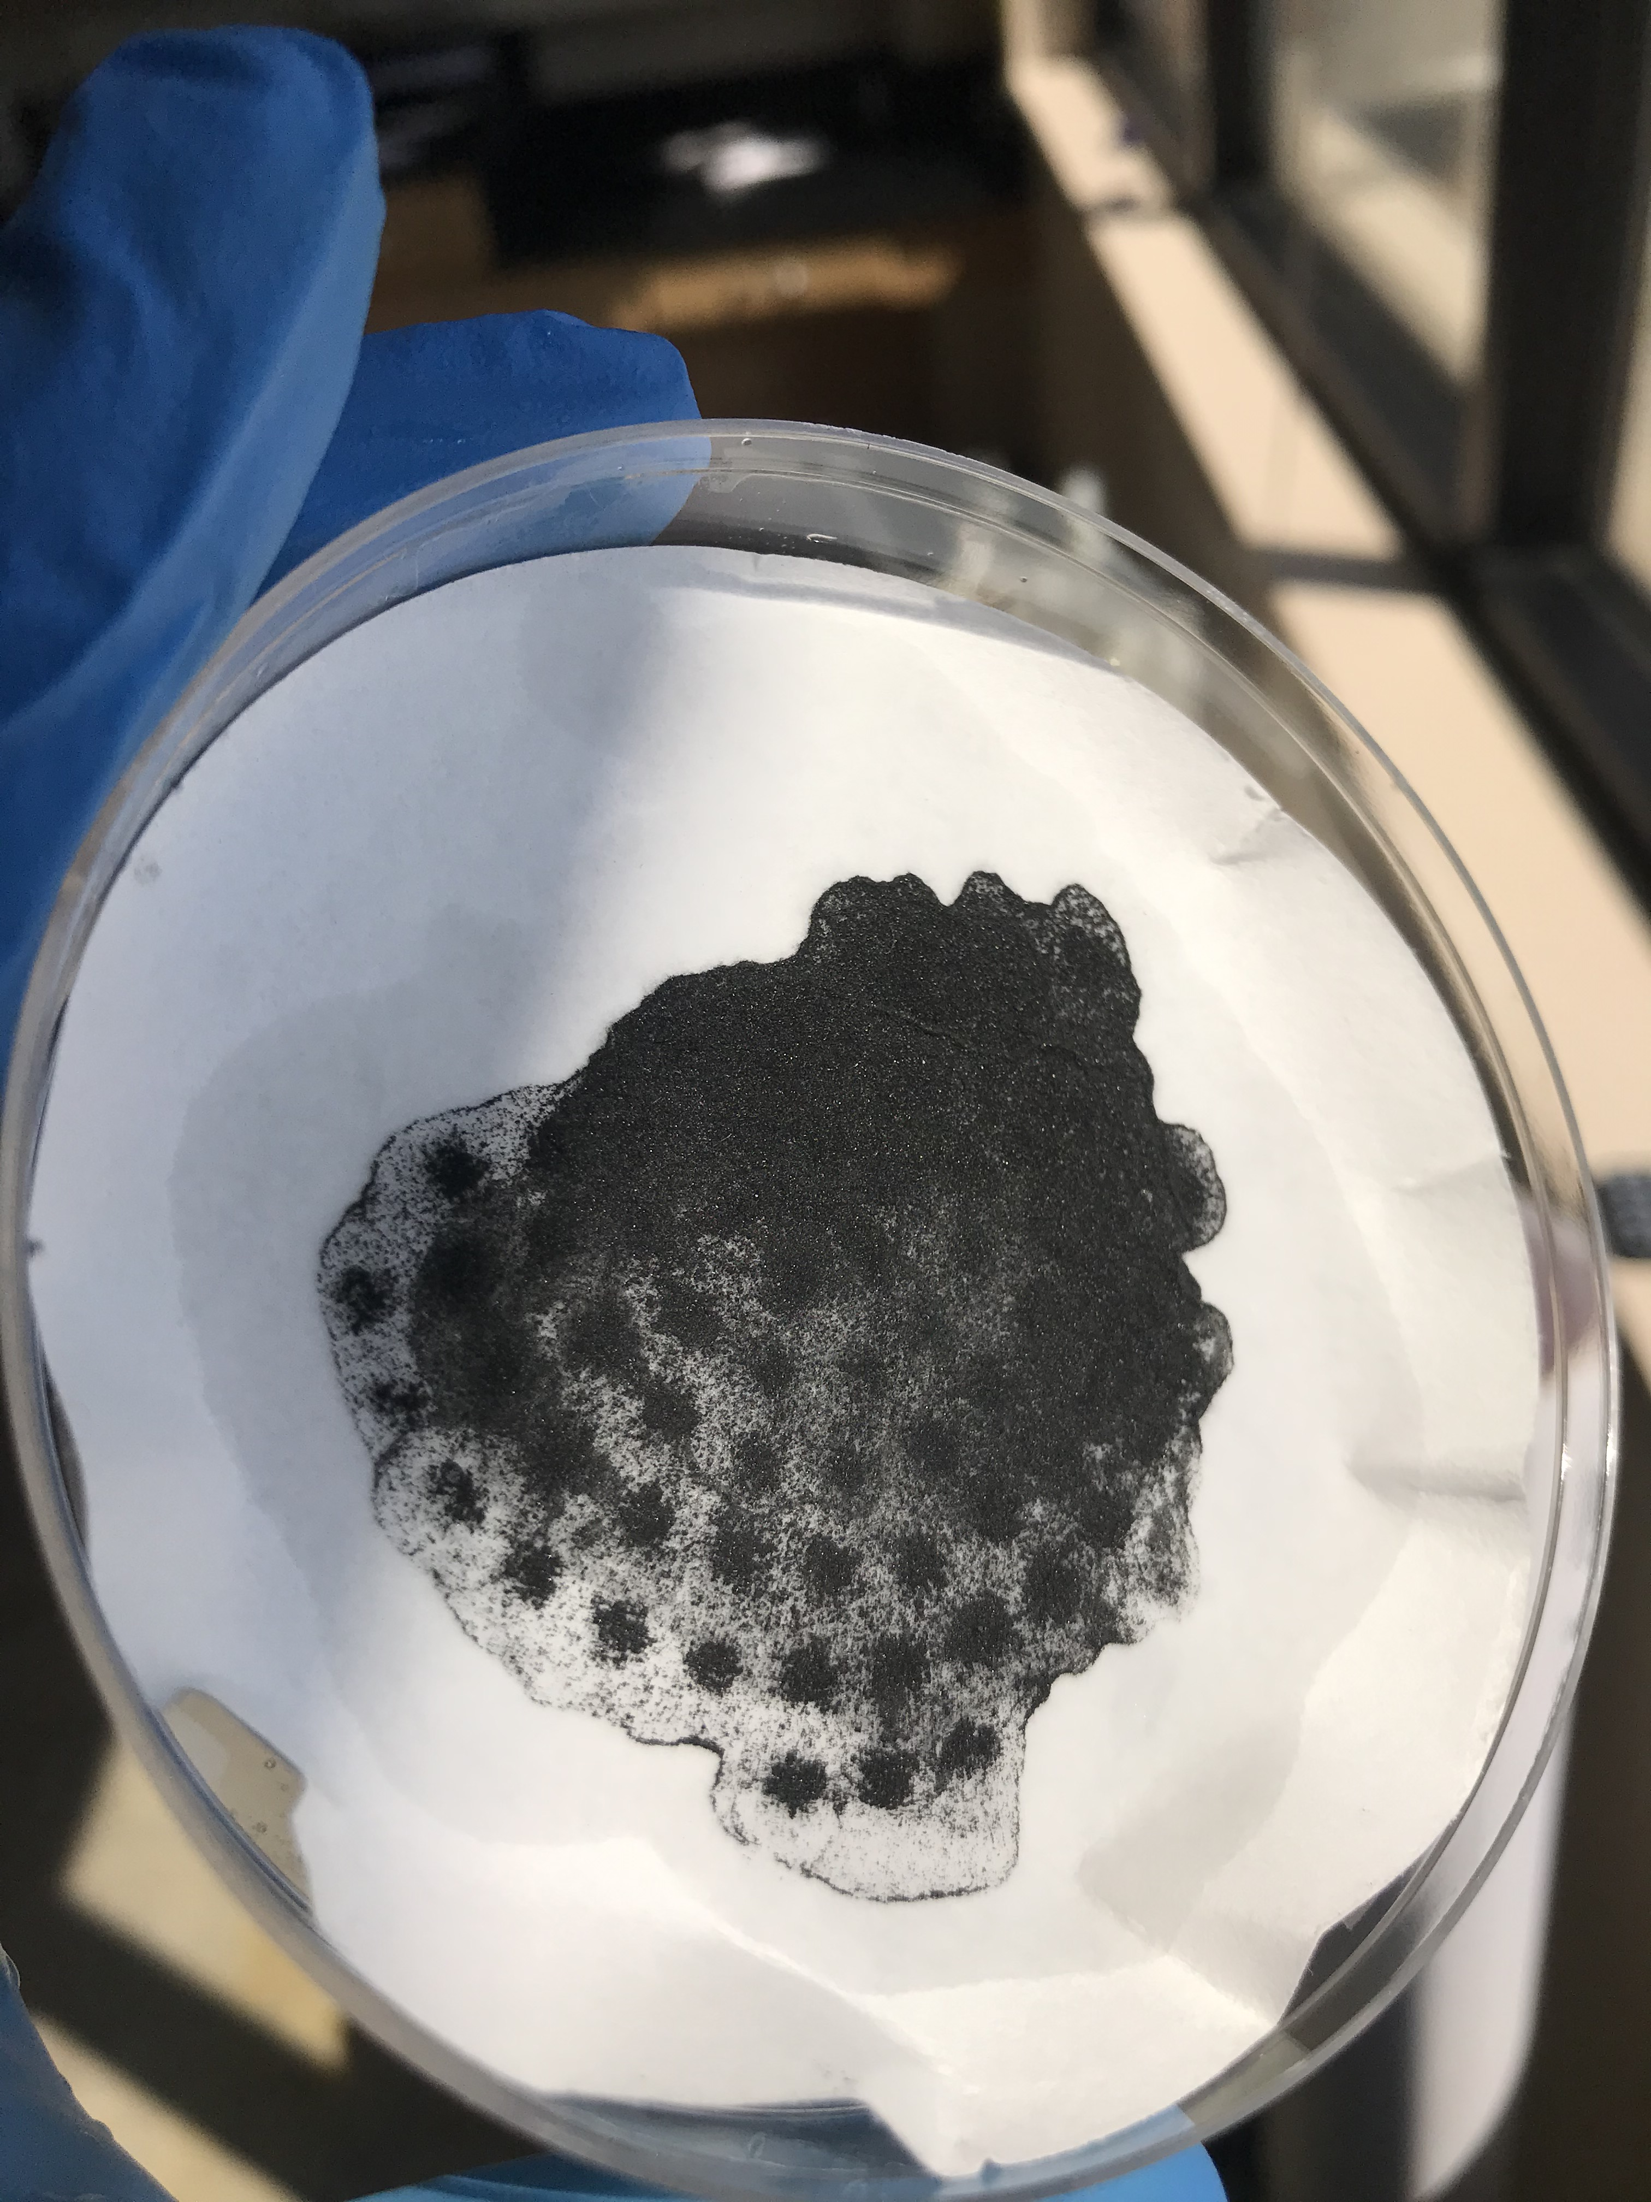
Protocol continued
Two materials being compared
Pre-frozen PNDC: Tested directly after doping via irradiation. No contact with water.
Post-frozen PNDC: Tested after being suspended, frozen, thawed and oven-dried. Set to cool for ~10 minutes prior to further handling.
Material | Amt. Lignosol (g) | Amt. APP (g) | Amt. Arginine (g)
1 | 1 | 0.5 | 0.5

Slide 4
Electrochemical observation vis cyclic voltammetry
1:0.5:0.5 Lig:APP:Arg
I_{avg} = |(I_{a} + I_{c})| ÷ 2
C_{s} = I_{avg} ÷ (m × ν)
 |  | Specific Capacitance (SC) (F/g)
Condition | Material | SC_{H2SO4} | SC_{KOH}
pre-freeze | 1:0.5:0.5 Lig:APP:Arg | 80.03 | 198.03
 | 1:0.5 Lig:Arg | 26.28 | 59.17
post-freeze | 1:0.5:0.5 Lig:APP:Arg | 242.45 | 245.50
 | 1:0.5 Lig:Arg | 29.50 | 50.86
 | SA_{BET} | Micropore volume (m²/g) | Mesopore volume (m²/g)
prefreeze | 360.94 | 202.88 | 158.06
postfreeze | 772.74 | 398.64 | 371.24

Slide 5
Conclusions/Future Directions
We have developed a method that enables us to successfully increase the surface area of porous carbons by effectively increasing the pore size via a safe, simple and bio-friendly freeze-pore method.
From here, I plan to observe the stability of these materials utilizing cyclic voltammetry for support on the effectiveness of this new method for the enhancement of electrochemical properties of biomass-based supercapacitor materials via increasing of surface area.
Furthermore, these materials will be characterized for their physical and chemical properties using methods of spectrometry, topographical observation and spectroscopy.

Slide 6
Acknowledgements
Signature Experience grant
UALR Dept of Applied Science: Chemistry
UALR Center for integrated nanotechnology
Siraj Lab
References:
Hui, S., Ying, Z., Lin, X., Sun, J., Wang, Y., Fu, Q., & Li, J. (2020). Novel scalable freezing-pore-forming strategy for constructing hierarchically porous carbon materials for supercapacitors. Journal of Alloys and Compounds, 846, 156235.
Silvestre-Albero, A. M., Juárez-Galán, J. M., Silvestre-Albero, J., & Rodríguez-Reinoso, F. (2012). Low-pressure hysteresis in adsorption: an artifact?. The Journal of Physical Chemistry C, 116(31), 16652-16655.
Marcì, G., & Palmisano, L. (Eds.). (2019). Heterogeneous Photocatalysis: Relationships with Heterogeneous Catalysis and Perspectives. Elsevier.
https://doi.org/10.1016/B978-0-444-64015-4.00004-3

