Slide 1
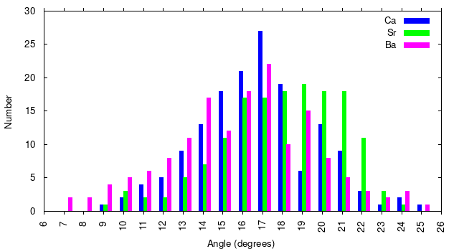
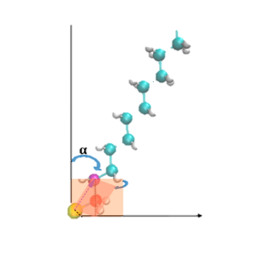
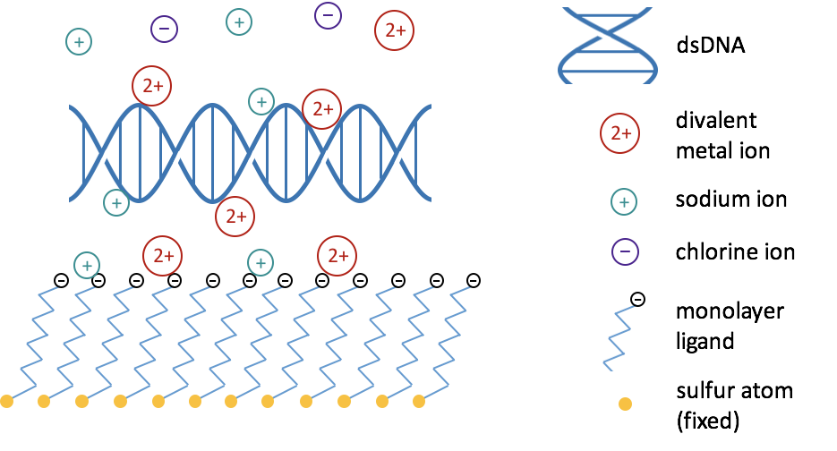
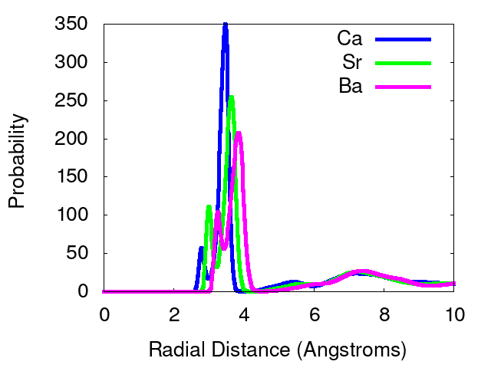
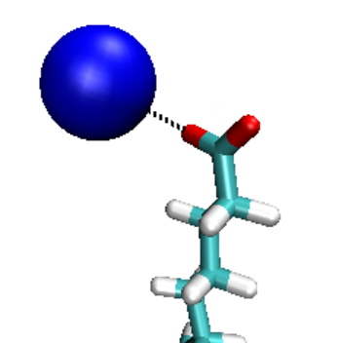
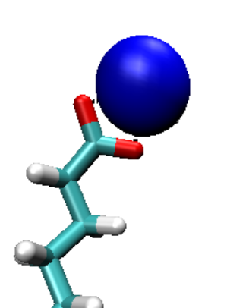
Modeling the Interactions of Divalent Metal Cations with a Monolayer
Lacey R. LaBee and Makenzie Provorse Long
Department of Chemistry, University of Central Arkansas, Conway, Arkansas, 72035
Introduction
Results
Conclusions
DNA-based nanodevices are used in biosensing, imaging, catalysis, and energy conversion. Divalent metal ions facilitate DNA binding to monolayers, but the precise mechanism is unknown. Computational methods are used to model the movement and interactions of divalent metal cations with DNA and an 11-mercaptoundecanoic acid (MUA) monolayer to improve DNA-based nanodevices.
Ca²⁺ and Ba²⁺ behave similarly in relation to tilt angles, but Sr²⁺ causes a larger tilt angle. The reason for this is not clear and more analysis will be required to explain why this happens.
Direct binding is more probable in ions with larger atomic nuclei than indirect binding. This can be explained by the more flexible solvation shells of larger ions.
Monodentate binding is more likely to happen than bidentate binding, especially in smaller ions. The larger the atomic nuclei of an ion the more probable that bidentate binding will occur.
References
Figure 1. Tilt Angles of Ca²⁺, Sr²⁺ and Ba²⁺. Inset shows tilt angle α on hydrocarbon chain$.^{1}$
1. The Journal of Physical Chemistry C 2017 121 (47), 26340-26349
2. Theochem 946 (2010) 83–87
Methods
GROMACS 2018
Classical molecular dynamics simulations
Production runs of 600 ns at 300 K
Specific forcefields were used to model the behavior of different species:
Simulations were validated by reproducing the tilt angle of a monovalent metal ion of 26 degrees$.^{2}$
Tilt angles according to Figure 1 :
Calcium = 17 degrees
Strontium = 17 degrees
Barium = ~ 19 - 21 degrees
Acknowledgements
Special thank you for funding provided by Arkansas NSF EPSCoR CASE SEED (Track 1, OIA-1457888) and the University of Central Arkansas
Component | Force Field
MUA | CGenFF
Ca²⁺, Sr²⁺, or Ba²⁺ | Merz
Na⁺ and Cl– | CHARMM
Water | TIP3P
Future Work
MUA monolayer will be enlarged to include a DNA strand to analyze the interactions of divalent metal cations with DNA and MUA monolayer.
In Figure 2, the first, smaller peaks are bidentate binding; second, larger peaks are monodentate binding
Figure 2. Bindings of Ca²⁺, Sr²⁺ and Ba²⁺ to the carbon of the carboxylate group. Insets show monodentate (left) and bidentate (right) binding.

