Slide 1
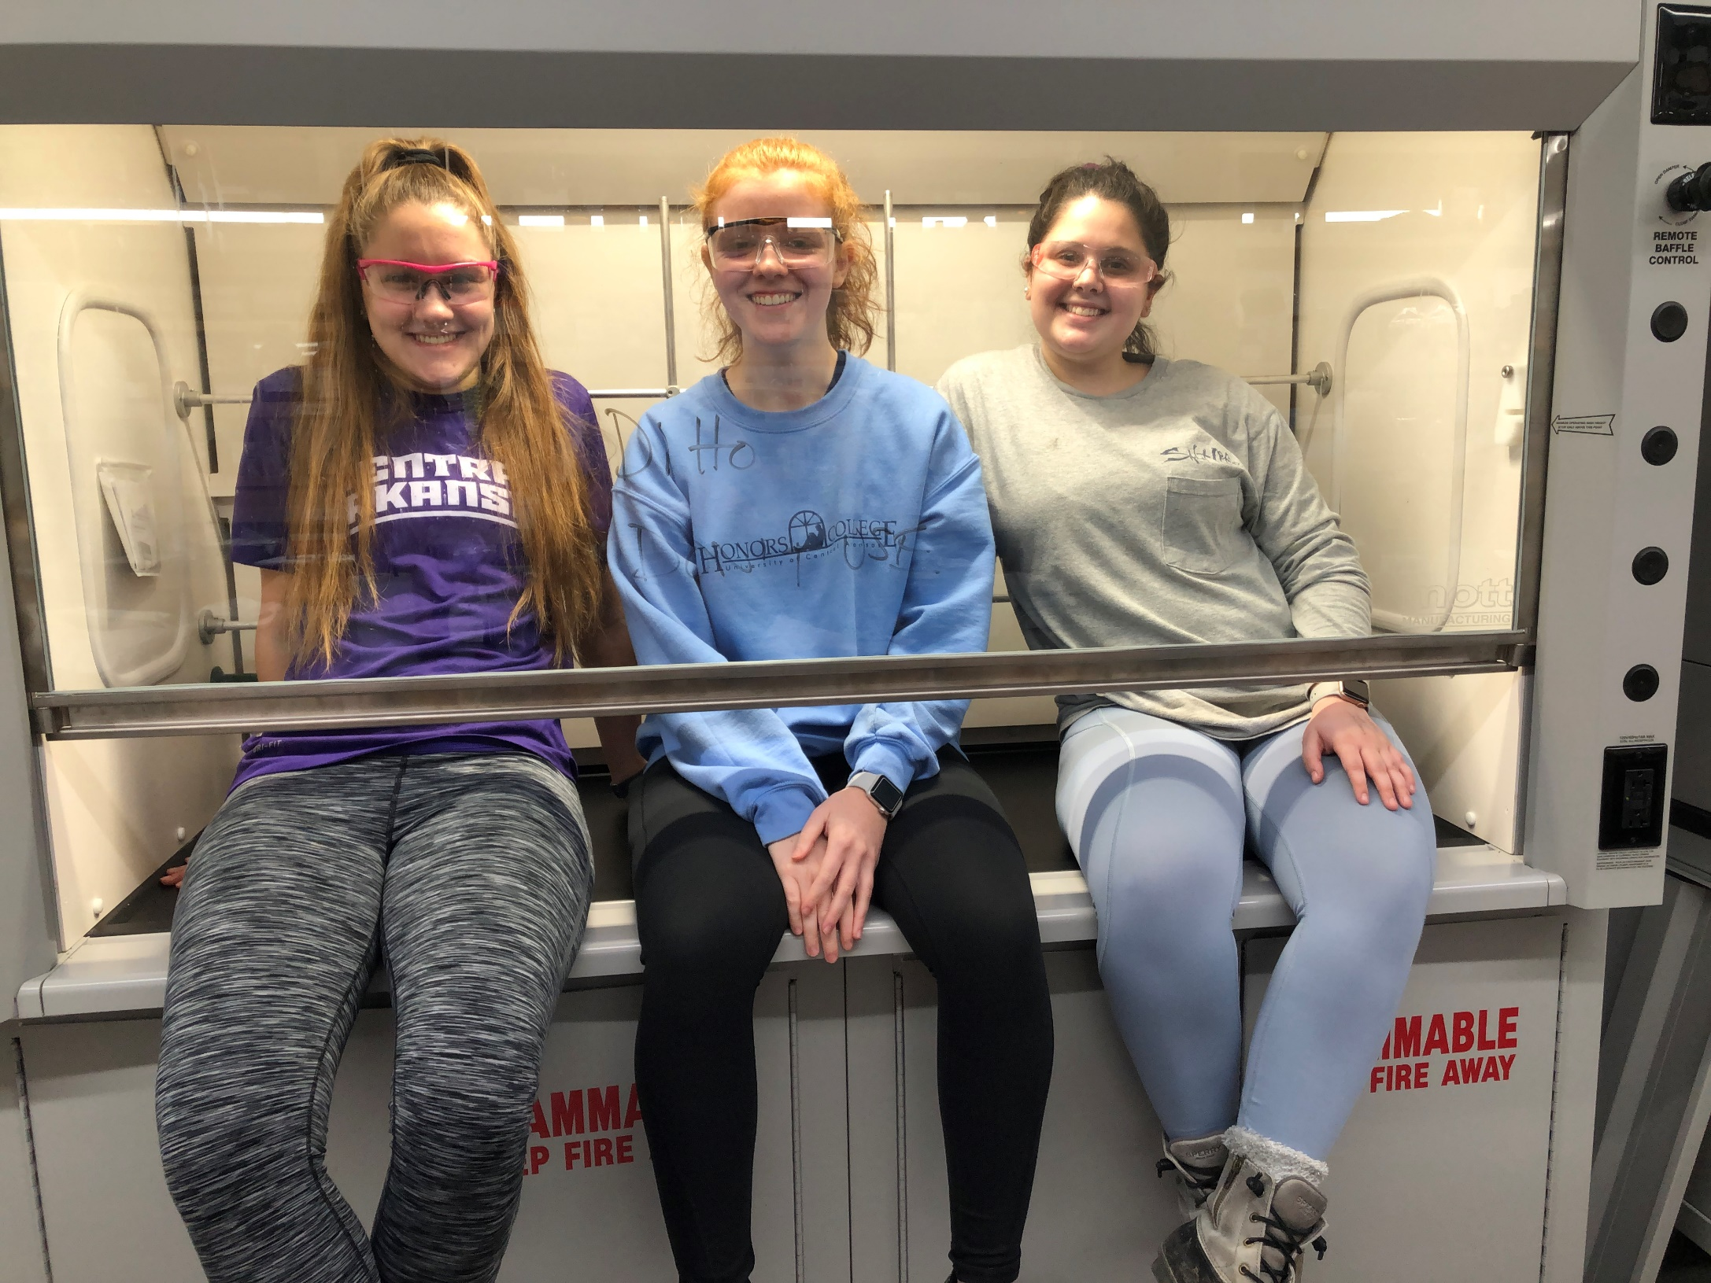
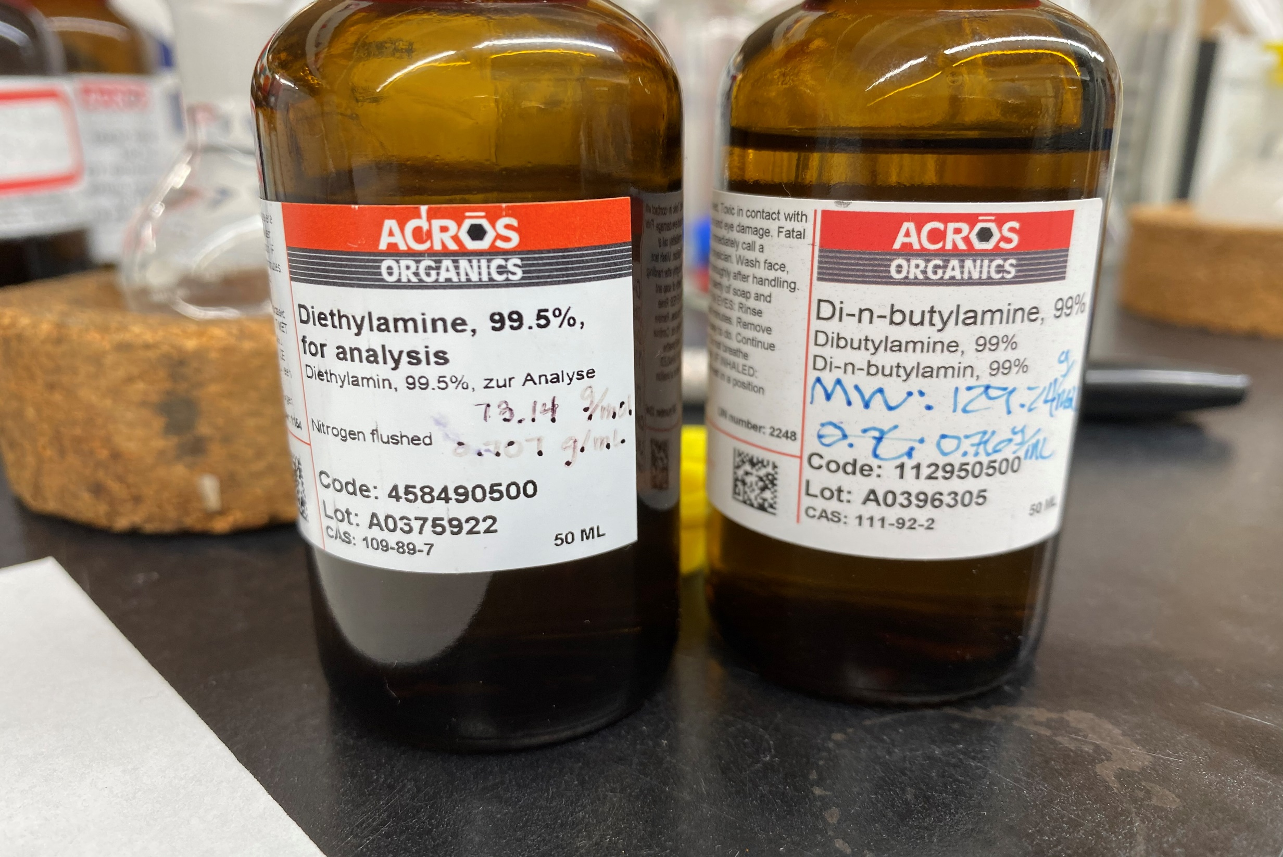
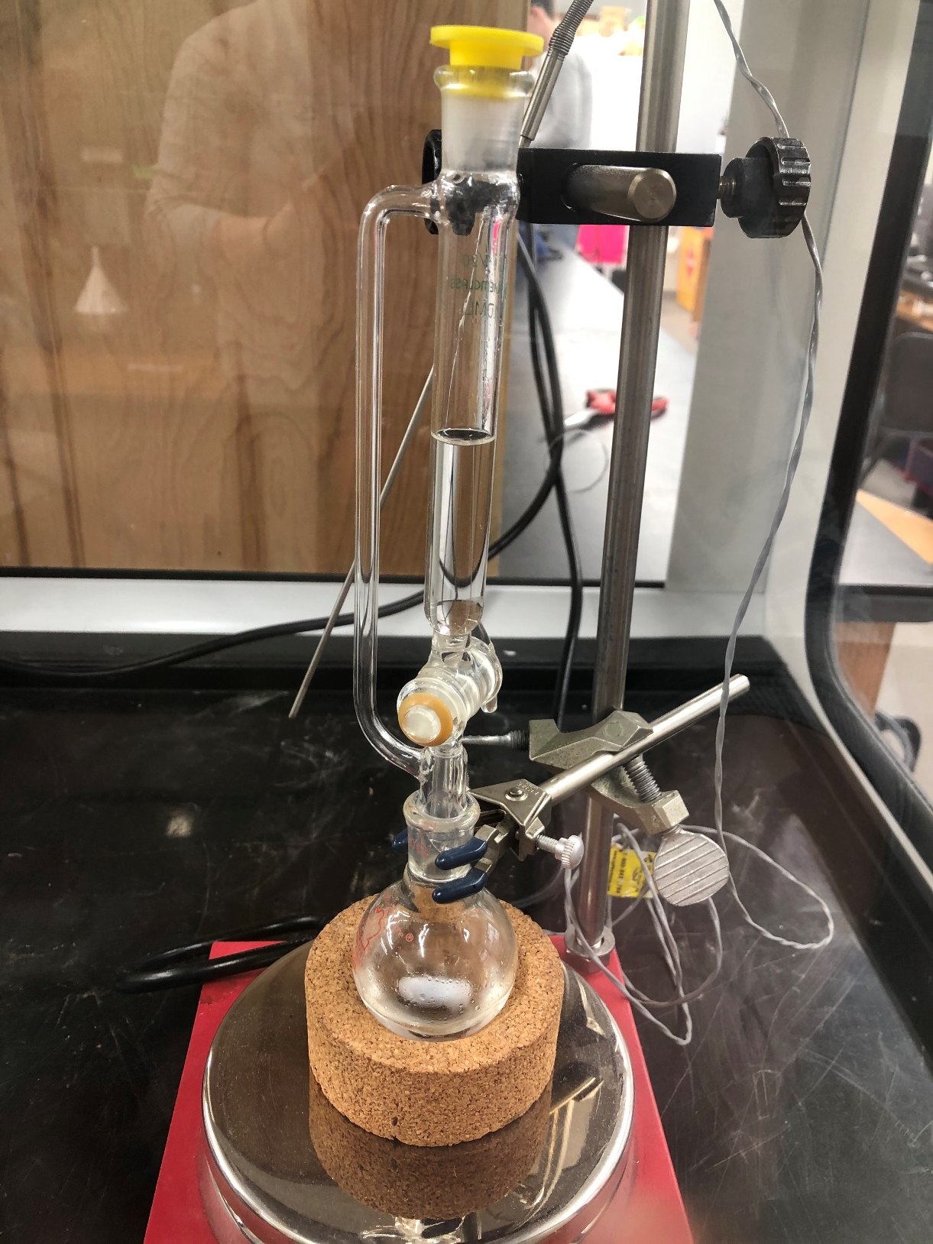
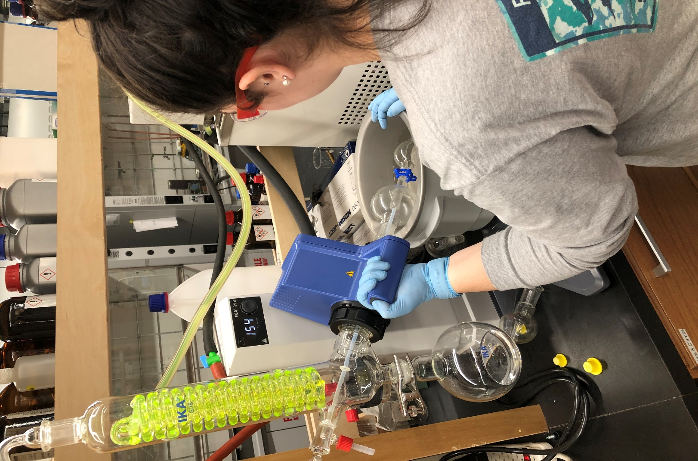
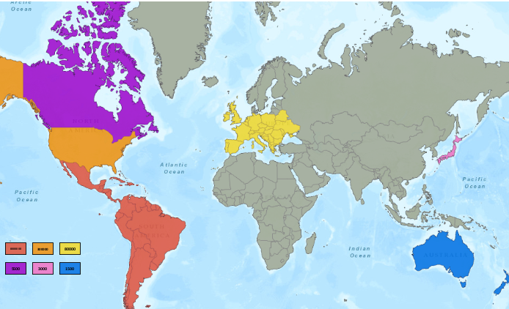
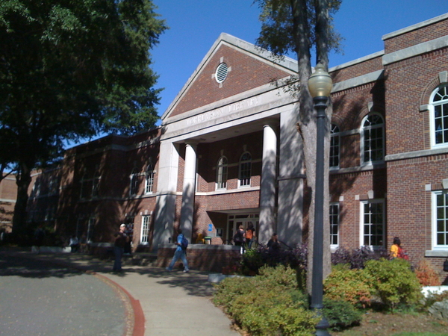
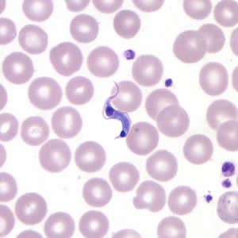

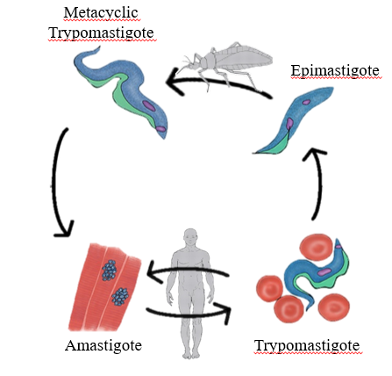

Lowering the cost and raising the efficiency of a cure to Chagas disease
Madeleine C. Peters and Gregory R. Naumiec
Department of Chemistry and Biochemistry, University of Central Arkansas, Conway, AR 72035
Introduction
Methods
Conclusion
Neglected tropical diseases (NTDs) are a worldwide crisis that affects nearly two billion people. One of the major NTDs is Chagas disease, a parasitic infection prevalent in Central and South America, and is now encroaching on the United States (which is ranked 7th in the world for diagnosed cases).
This disease, which currently has no vaccine, is caused by the parasite Trypanosoma cruzi and has only one FDA-approved medication -- benznidazole. This treatment is expensive, has harsh side effects, and is nonfunctional in the chronic phase of the illness. Therefore, Chagas disease does not have an effective, inexpensive, or safe cure, and the presence of only one approved medication is leading to treatment failures.
This research focuses on the creation of an inexpensive and effective anti-Chagastic drug library from a class of compounds called disquaramides. These drug targets can be synthesized inexpensively and have been found to puncture holes in the cell membrane of T. cruzi, thereby killing the parasite. Therefore, the simple and low-cost synthesis, as well as the potential of high effectiveness, allows the facile creation of a diverse and comprehensive drug library to aid in the search for a new viable treatment for Chagas disease.
(Insert Pictures here)
In this research, many disquaramides have been successfully synthesized and characterized with relatively high yields. This indicates that the synthesis of these compounds is rather efficient, thus allowing a potential to save costs.
These compounds were made from inexpensive starting materials and innocuous organic solvents using only room temperature. The combination of cheap compounds as well as the simple synthesis, allowed for these compounds to be created inexpensively. This research hopes that at least one of these compounds will be an effective treatment option for Chagas Disease.
Future Work
1. Complete drug library:
3. Screen against T. cruzi:
Results
X | Y | % Yield
 |  | 93%
 |  | 82%
 |  | 83%
 |  | 77%
 |  | 75%
 |  | 61%
 |  | 56%
 |  | 71%
 |  | 84%
 |  | 69%
 |  | 75%
X | Y | % Yield
 |  | 65%
 |  | 67%
 |  | 59%
 |  | 79%
 |  | 82%
 |  | 27%
 |  | 81%
 |  | 73%
 |  | 78%
 |  | 88%
 |  | 50%
X | Y | % Yield
 |  | 64%
 |  | 11%
 |  | 86%
 |  | 54%
 |  | 87%
 |  | 31%
 |  | 86%
 |  | 30%
2. Send off for testing:
4. Second generation drugs:
References
Center for Disease Control and Prevention - Chagas Disease.
  https://www.cdc.gov/parasites/chagas/index.html (accessed Dec 31, 2019).
Centers for Disease Control and Prevention. CDC - DPDx - American Trypanosomiasis.
  https://www.cdc.gov/dpdx/trypanosomiasisamerican/index.html (accessed Jan 29, 2020).
Clipart Library . Parcel Delivery Cliparts #2707373 (License: Personal Use). http://clipart-
  library.com/clipart/2071479.htm (accessed Jan 29, 2020).
Exeltis. The first FDA-approved treatment for Chagas disease. https://www.benznidazoletablets.com/en/
  (accessed Dec 31, 2019).
Olmo, F.; Rotger, C.; Ramírez-Macías, I.; Martínez, L.; Marín, C.; Carreras, L.; Urbanová, K.; Vega, M.;
  Chaves-Lemaur, G.; Sampedro, A.; Rosales, M. J.; Sánchez-Moreno, M.; Costa, A. Synthesis and Biological Evaluation Of N, N′-Squaramides with High in Vivo Efficacy and Low Toxicity: Toward a Low-Cost Drug against Chagas Disease. Journal of Medicinal Chemistry 2014, 57(3), 987–999.
University of Central Arkansas. Torreyson Library.https://www.librarything.com/venue/38870/Torreyson-
  Library (accessed Jan 29, 2020).
123RF. Medical Symbol Caduceus with snakes and wings.
  https://www.123rf.com/photo_35459605_stock- vector-medical-symbol-caduceus-with-snakes-and-wings.html (accessed Jan 29, 2020).

