Slide 1
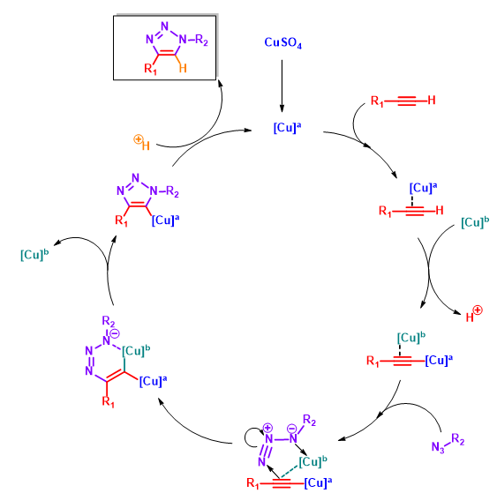
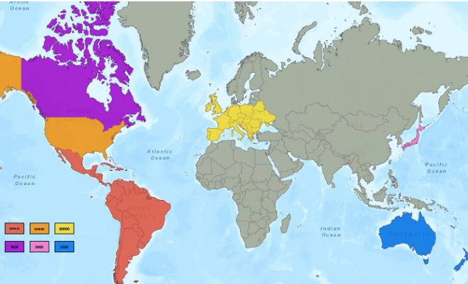
The fight against Chagas disease: creating an efficient and inexpensive cure
Jessica M. Allred and Gregory R. Naumiec
Department of Chemistry and Biochemistry, University of Central Arkansas, Conway, AR 72035
Introduction
Future Works
Chagas disease is caused by the parasite Trypanosoma Cruzi and plagues nearly 10 million people in the Americas. While this disease is not widely researched, it is an epidemic that is ravaging the desolate nations of Central and South America.
Unfortunately for patients diagnosed with this disease, the two cures available are expensive, harmful to the patient, and are becoming alarmingly more ineffective due to drug resistances. Because of this, it is crucial that new chemical entities can be identified, created, and tested in search of a novel cure. In this research, viable drug targets from the squaramides class of compound are created from diethyl squarate in two high yielding and quick synthetic steps. Two classes of compounds have been synthesized: 1) those with two squarate cores and 2) those with one squarate core but using large amino side chains. These compounds are designed to interact with the parasite that causes Chagas disease, by puncturing holes within the membrane, killing the T. cruzi, thus ultimately curing the infected individual of this parasitic infection. This experimentation has found that the double squarate compounds are significantly lower in yield than those with different bulky side arms. The eighteen compounds with one squarate core and large amino side chains have an average percent yield of 68.8%, which is larger than the average percent yield of 40.7 for the eight compounds with two squarate cores. In future experimentation, the compounds created will be sent to the Drugs for Neglected Disease Initiative to test their efficiency against the parasite itself, giving insight into the most effective compounds in each class.
X | Y | Percent Yield
 |  | 94.8
 |  | 96.4
 |  | 95.6
 |  | 90.1
 |  | 90.8
 |  | 54.0
 |  | 102.0
Reaction Scheme/ Results
Conclusion
In this research, several classes of disquaramides have been successfully synthesized and characterized with relatively high yields. This indicates that the synthesis of these compounds is rather efficient, thus allowing a potential cost-savings.
These compounds were made from inexpensive starting materials and innocuous organic solvents using methods that were kept at room temperature. The combination of cheap compounds as well as the simple synthesis, allowed for these compounds to be created inexpensively. This research hopes that at least one of these compounds will lead be an effective treatment option for Chagas Disease.
References
Olmo, F.; Rotger, C.; Ramírez-Macías, I.; Martínez, L.; Marín, C.; Carreras, L.; Urbanová, K.; Vega, M.;
  Chaves-Lemaur, G.; Sampedro, A.; Rosales, M. J.; Sánchez-Moreno, M.; Costa, A. Synthesis and Biological Evaluation Of N, N′-Squaramides with High in Vivo Efficacy and Low Toxicity: Toward a Low-Cost Drug against Chagas Disease. Journal of Medicinal Chemistry 2014, 57(3), 987–999.

Slide 2
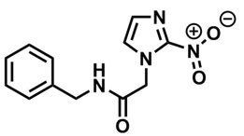
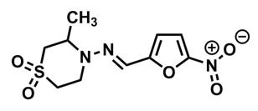
Introduction
Benznidazole
Nifurtimox
Chagas disease – an NTD
South and Central America
Drug Resistance

Slide 4
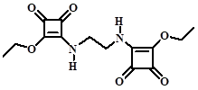













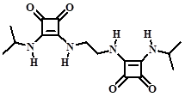

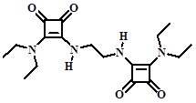





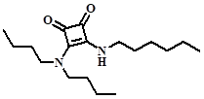


Compound Name | IUPAC Name | Compound Structure | Percent Yield
JA1 | 3-(2-(2-ethoxy-3,4-dioxocyclobut-1-enylamino)ethylamino)-4-ethoxycyclobut-3-ene-1,2-dione |  | 65.1%
JA2 | 3-(2-(2-(butylamino)-3,4-dioxocyclobut-1-enylamino)ethylamino)-4-(butylamino)cyclobut-3-ene-1,2-dione |  | 25.7%
JA3 | 3-(3-(2-ethoxy-3,4-dioxocyclobut-1-enylamino)propylamino)-4-ethoxycyclobut-3-ene-1,2-dione |  | 54.7%
JA4 | 3-(5-(2-ethoxy-3,4-dioxocyclobut-1-enylamino)pentylamino)-4-ethoxycyclobut-3-ene-1,2-dione |  | 36.5%
JA5 | 3-(4-(2-ethoxy-3,4-dioxocyclobut-1-enylamino)butylamino)-4-ethoxycyclobut-3-ene-1,2-dione |  | 51.7%
JA7 | 3-(2-(2-(isobutylamino)-3,4-dioxocyclobut-1-enylamino)ethylamino)-4-(isobutylamino)cyclobut-3-ene-1,2-dione |  | 23.4%
JA10 | 3-(2-(2-(isopropylamino)-3,4-dioxocyclobut-1-enylamino)ethylamino)-4-(isopropylamino)cyclobut-3-ene-1,2-dione |  | 40.7%
JA11 | 3-(2-(2-(diethylamino)-3,4-dioxocyclobut-1-enylamino)ethylamino)-4-(diethylamino)cyclobut-3-ene-1,2-dione |  | 28.0%
JA9 | 3-ethoxy-4-(hexylamino)cyclobut-3-ene-1,2-dione |  | 92.2%
JA12 | 3-(3-(dimethylamino)propylamino)-4-(hexylamino)cyclobut-3-ene-1,2-dione |  | 54.0%
JA13 | 3-(butylamino)-4-(hexylamino)cyclobut-3-ene-1,2-dione |  | 87.5%
Compound Name | IUPAC Name | Compound Structure | Percent Yield
JA14 | 3-(hexylamino)-4-(isobutylamino)cyclobut-3-ene-1,2-dione |  | 95.6%
JA15 | 3-(hexylamino)-4-(propylamino)cyclobut-3-ene-1,2-dione |  | 96.4%
JA16 | 3-(hexylamino)-4-(isopropylamino)cyclobut-3-ene-1,2-dione |  | 79.3%
JA17 | 3-(hexylamino)-4-(pentylamino)cyclobut-3-ene-1,2-dione |  | 94.8%
JA18 | 3-(tert-butylamino)-4-(hexylamino)cyclobut-3-ene-1,2-dione |  | 64.9%
JA19 | 3-(decylamino)-4-hydroxycyclobut-3-ene-1,2-dione |  | 97.8%
JA20 | 3-(sec-butylamino)-4-(hexylamino)cyclobut-3-ene-1,2-dione |  | 13.1%
JA21 | 3-(tert-pentylamino)-4-(hexylamino)cyclobut-3-ene-1,2-dione |  | 52.0%
JA22 | 3-(4-aminobutylamino)-4-(hexylamino)cyclobut-3-ene-1,2-dione |  | 23.0%
JA23 | 3-(decylamino)-4-(hexylamino)cyclobut-3-ene-1,2-dione |  | 102%
JA24 | 3-(3-amino-2,2-dimethylpropylamino)-4-(hexylamino)cyclobut-3-ene-1,2-dione |  | 71.5%
JA26 | 3-(diethylamino)-4-(hexylamino)cyclobut-3-ene-1,2-dione |  | 90.1%
JA28 | 3-(diisopropylamino)-4-(hexylamino)cyclobut-3-ene-1,2-dione |  | 28.0%
JA29 | 3-(dibutylamino)-4-(hexylamino)cyclobut-3-ene-1,2-dione |  | 5.2%
JA30 | 3-(2-(diethylamino)ethylamino)-4-(hexylamino)cyclobut-3-ene-1,2-dione |  | 90.8%

Slide 5
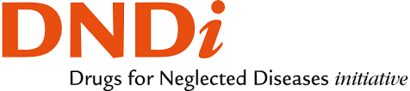
Future Works
1.) Finish drug libraries
2.) Triazole ring-based anti-parasitic compounds using click chemistry
3.) Testing efficacy of compounds with DNDi collaborators
Dndi.org

Slide 6
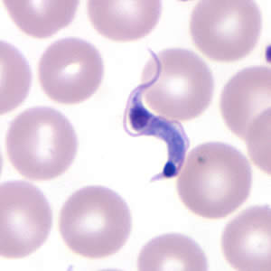
Conclusions
Moderate to high yields
Inexpensive compounds
Quick, simple synthesis
www.CDC.gov

