Slide 1
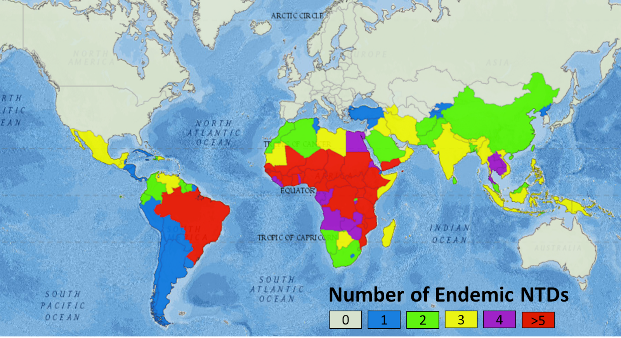
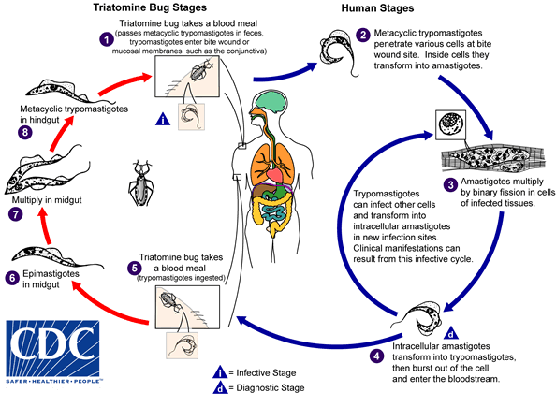
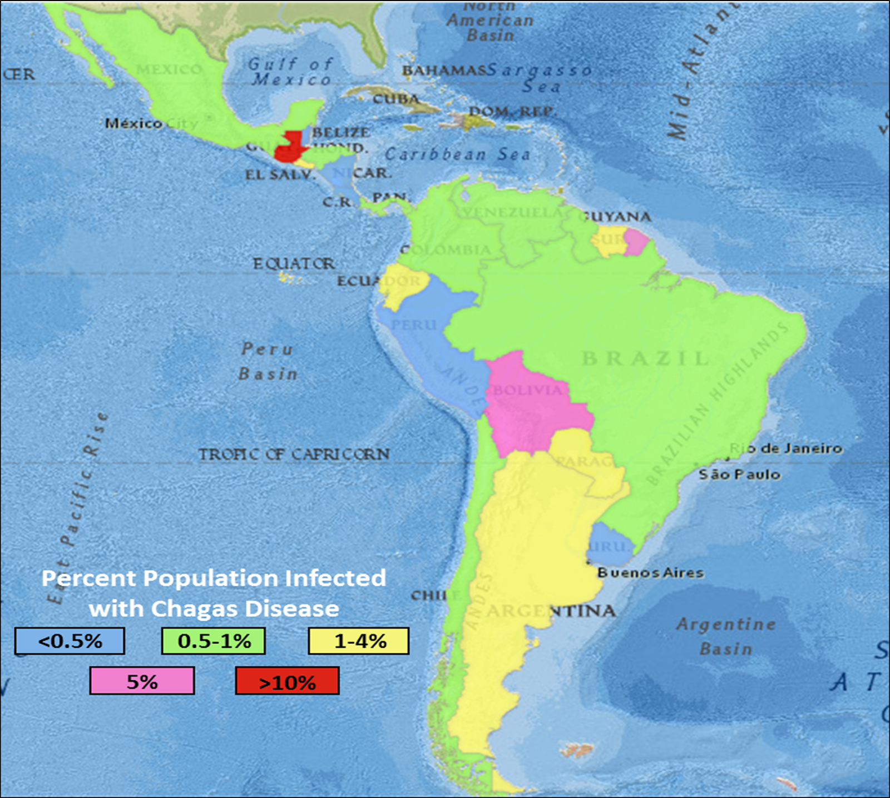
An inexpensive and efficient approach to cure Chagas disease
M. Johanna Lasiter and Gregory R. Naumiec
Department of Chemistry, University of Central Arkansas, Conway AR 72035
Introduction
Neglected Tropical Diseases (NTDs) pose an enormous threat to those in poverty-stricken regions of the world such. NTDs have affected the lives of nearly 2 billion people worldwide. With limited funds and resources, research on NTDs is lacking.
Chagas disease, one such NTD, is a parasitic infection that is now becoming widespread throughout the southwest United States. Chagas disease is caused by the parasite, Trypanosoma cruzi, carried by an insect known as the “kissing bug”. Once infected, the insect passes parasites through their feces and can eventually cause “Chagas heart disease,” resulting in death.
There are currently two drugs in the market for treating Chagas, benznidazole and nifurtimox. Benznidazole is the only drug of the two that is FDA-approved, and both drugs have severe side effects along with alarming reports of treatment failures due to drug resistance in T. cruzi. We aim to make a new class of anti-Chagastic compounds using disquaramide structural motifs. Disquaramides have shown to have anti-parasitic activity and are facile and cost-efficient to synthesize. The focus of this research is to create inexpensive drugs to aid in the fight against Chagas disease.
Current and Target Drugs
Conclusion/Future Works
We have begun synthesizing our target compound (insert target compound structure here). It is easy to synthesize and low in cost to make. Our goal is to create a drug library of similar compounds and test our drugs against the T-cruzi parasite with collaboration with the DNDi. Our hope is to create a drug library that shows great promise against T. cruzi and will help in the fight against Chagas disease.
Benznidazole
Nifurtimox
Target Drug
Synthesis of Target Drugs
Nucleophilic Addition-Elimination Mechanism of Squaramide Synthesis
References
Groupil, L; McKerrow, J. Chem.Rev.2014, 114, 11131-11137
Shi, P; Smith, P; Diagana, T. ACS Infectious Diseases. 2015, 1, 76-78
Chagas Disease.unitingtocombatntds.org (11/02/2018)
Rassi, A.; Marin-Neto, J.; Chagas Disease. The Lancet. 2010, 375(9723), 1388-1402.
Olmo, F. et al. J.Med.Chem. 2014,27,987-999
The Fight Against Neglected Tropical Diseases. https://www.scoopnest.com/user/AFT/854510800672702464 (10/20/2019)
Chagas Disease Progress. https://unitingtocombatntds.org/reports/5th-report/chagas-disease-progress/ (10/20/2019)
Fungal Cell Structure and Targets. https://drfungus.org/knowledge-base/antifungal-pharmacology/ (10/20/2019)
CDC - Chagas Disease - Biology. https://www.cdc.gov/parasites/chagas/biology.html (accessed Mar 13, 2021).

