Slide 1
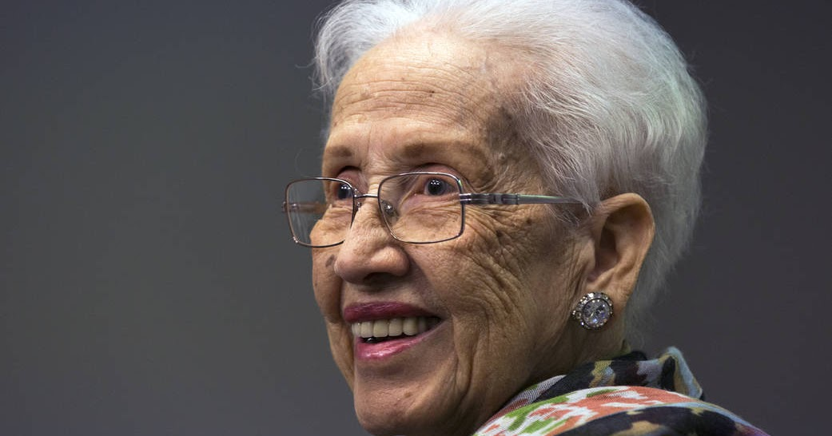
Katherine Johnson
Achievements
Katherine was born August 26, 1918, in White Springs, West Virginia her mother and father were Joylette and Joshua. At the age of 14 she graduated from high school. Katherine had a daughter named
Constance Goble; with her husband
James Goble. Katherine had a brain tumor and passed away on February 24, 2020.
American mathematician whose calculations of orbital mechanics as a NASA employee were critical to the success of the first U.S. spaceflight, that John Glenn orbited around the earth in 1962. She was awarded a Presidential Medal of Freedom in 2015 from Barack Obama, and in 2019 she was awarded the Congressional Gold Medal. Johnson received her B.S. degree in French and mathematics in 1932 from West Virginia State to University, she was one of the first African Americans to enroll in the mathematics program.
The Apollo 11 flight to the moon was calculated by her also in1969. Katherine Johnson retired from NASA in 1986 after 35 years of service. NASA noted her role as historical because she was one of the first African American women to work as a NASA scientist.
Photo/Drawing – select one of the words for a title or remove this title entirely
Find a photo, drawing, or painting of your woman in STEM and include it here.
This Photo by Unknown Author is licensed under CC BY-ND
Google Wikipedia www. Katherine Constance A Johnson
References
By: Dyandra

