Slide 1
The Survivors
A Novella by Abigale Ralston

Slide 2
Content of Presentation
Preface
Abstract
Excerpt
Process of Writing the Novella
Acknowledgments

Slide 3
Preface

Slide 4
Abstract
Set over 100 years in the future, this story follows the lives of teenagers Alex, Leon, and Paige. The world has been destroyed. In order to survive, humanity has had to learn how to survive in space, in a vehicle called simply the Ship. Lately, however, Alex and his friends have noticed problems occurring on the Ship, indicating a disaster may be imminent. Alex, Leon and Paige are now tasked with finding the causes of the problems and saving the last of humanity from extinction.

Slide 5
Conversation
I will be reading a conversation between the three main characters: Alex, Leon, and Paige.
This conversation reflects the personalities of the characters.

Slide 6
Process of Writing the Novella
Idea
Getting approval
Finding readers
Making a plan
Creating the setting
Creating the characters
Inspiration during the writing
Editing
Submission

Slide 7
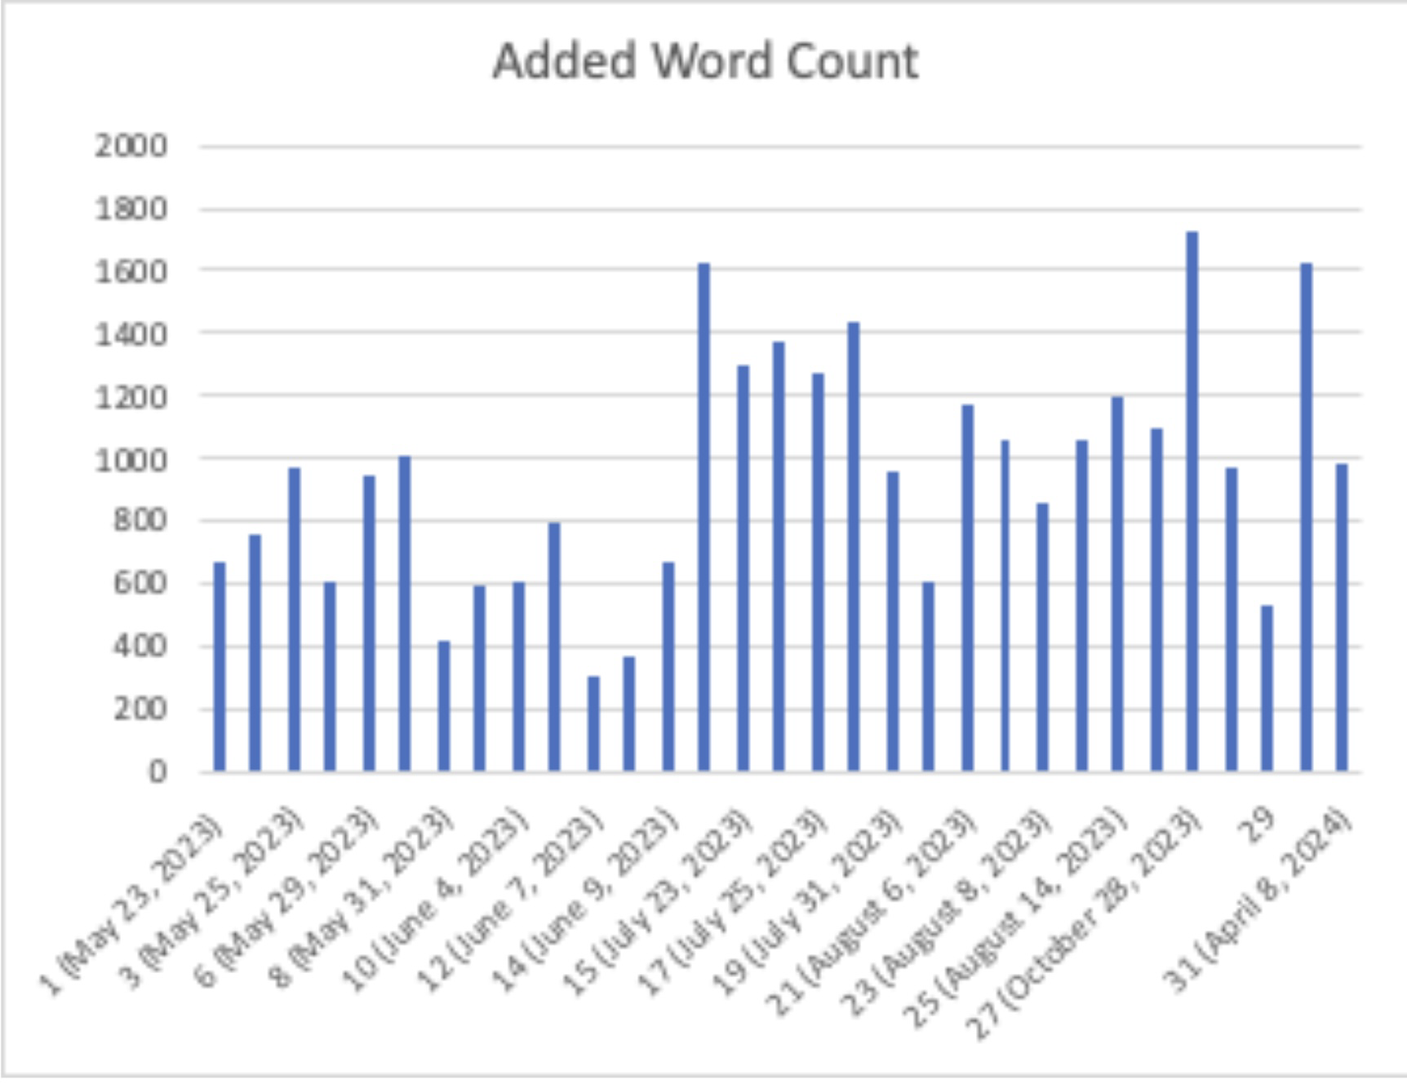
Words Added Each Day
Total Word Count: 30,037

Slide 8
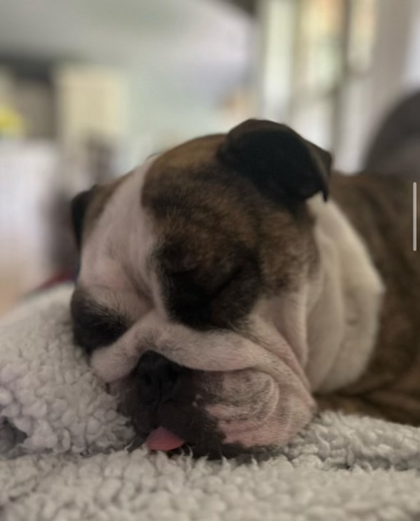
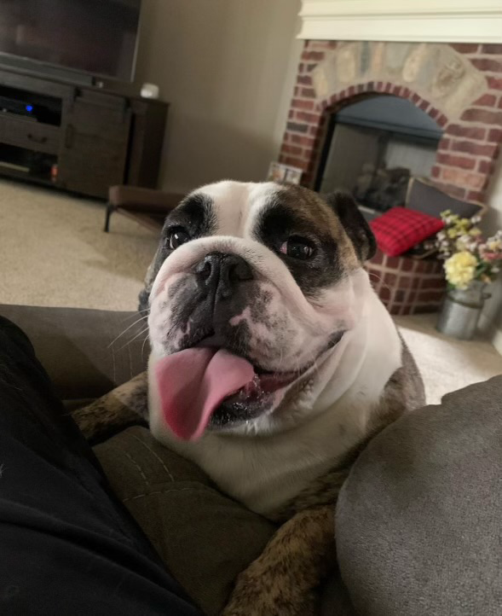
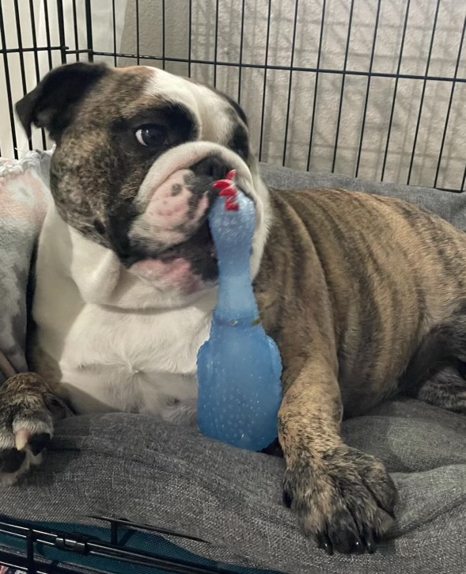
The Dog I Was Watching When I Came Up With the Idea
Her name is Bella Sue. The photos were taken by my neighbor, Tyler Hobson.

Slide 9
Acknowledgments
I would like to acknowledge many people who helped me during the process of writing this novella. I would like to thank my family and friends, who supported me during this process. I would also like to thank those who edited my book and helped me make it the best it could be. The people involved in editing my novella include Dr. Utter, my thesis director, Dr. Knight, my second reader, and Dr. Doroga, my third reader. I would also like to thank Dr. Pemberton, the director of the Carl Goodson Honors Program, who helped make this possible.

