Slide 1
Sensory Safe Rooms
Maggie George, Bailey Martin, Chloe Schnaitman
Intellectual Disabilities
Dr. Allyson Phillips

Slide 2
Table of contents*
1.
2.
3.
4.
5.
6.
Introduction
MSE use
Components of room
Introduction of a sensory safe room
Who is the target audience, where is MSE used
What elements go into this room and for what use
Background
Proposed Solution
Conclusion
Why do college students need a sensory safe room?
What can Ouachita do to obtain a sensory safe room?
Conclusion of the proposal of a sensory safe room

Slide 3
1.
Introduction*
Introduction of a sensory safe room
Notes:
Maggie

Slide 4
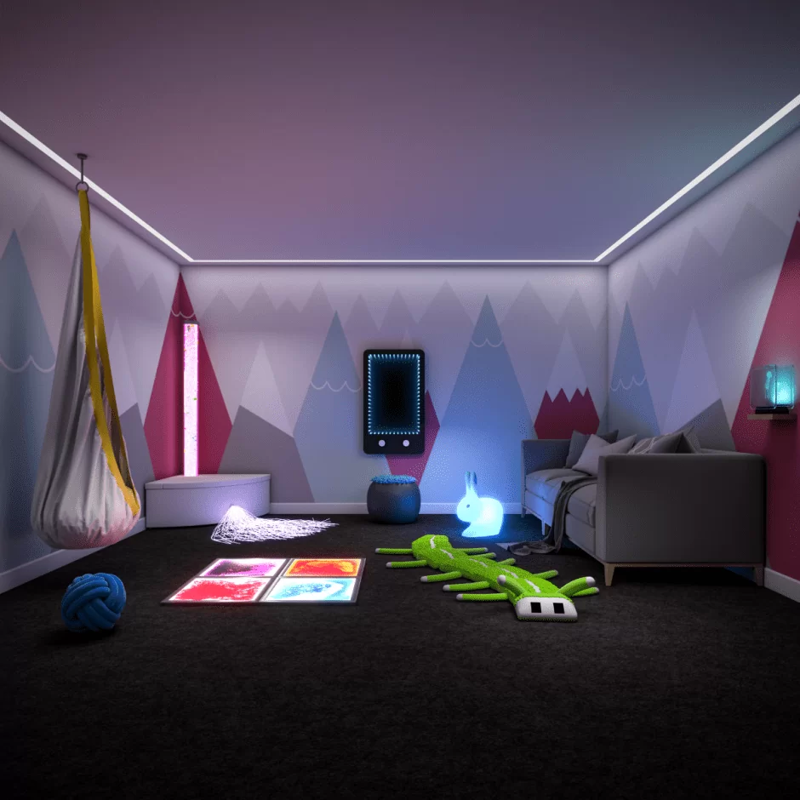
Sensory Safe Room*
This is an example of what a sensory safe room could look like…
Notes:
Maggie

Slide 5
Introduction*
The idea of a multi-sensory safe room is to provide individuals with intellectual disabilities an alternative activity, providing them comfort and redirection (Cameron et al., 2020).
Notes:
Maggie

Slide 6
What is MSE?
The use of MSE is targeted to children and adults with severe and/or multiple disabilities (Unwin, 2020). It has been shown in past research studies that MSE has been widely used with autistic individuals and that there is clear evidence-based research that supports this use (Unwin, 2020). The research that has been conducted has led researchers to the conclusion that it would pave the way for improved learning environments and opportunities for individuals with intellectual disabilities.
The idea of the Multi-sensory safe room was developed in the 1970s (Cameron et al., 2020). The goal of these rooms are to provide sensory materials that would give the user stimulation in visual, auditory, tactile, olfactory, and proprioceptive satisfaction. The environment that is created through a multi-sensory environment (MSE) is aiming to create feelings of safety and stimulation through light, sound, touch, and smell (Cameron et al., 2020).
Notes:
Maggie

Slide 7
Multi-Sensory Environments*
Over-Stimulation in ASD
1. | Aggression
2. | Irritability
3. | Sensitivity
4. | No interactions
5. | Extreme discomfort
Elements of environment
1. | Swings
2. | Multi-colored lighting
3. | Furniture and Seating
4. | Sound machine
5. | Aromatherapy
Benefits of environment
1. | Improve processing
2. | Coping
3. | Stimulation
4. | Socialization
5. | Improved focus
Notes:
Maggie

Slide 8
Current Findings*
Research
Draining components
There is a need for research and work to be done with college students with autism amongst other disabilities that could benefit from the use of MSE.
Research has found that there are a multitude of components that work to drain students. These could look like fluorescent lighting, bright colors, and disorganization.
Notes:
Maggie

Slide 9
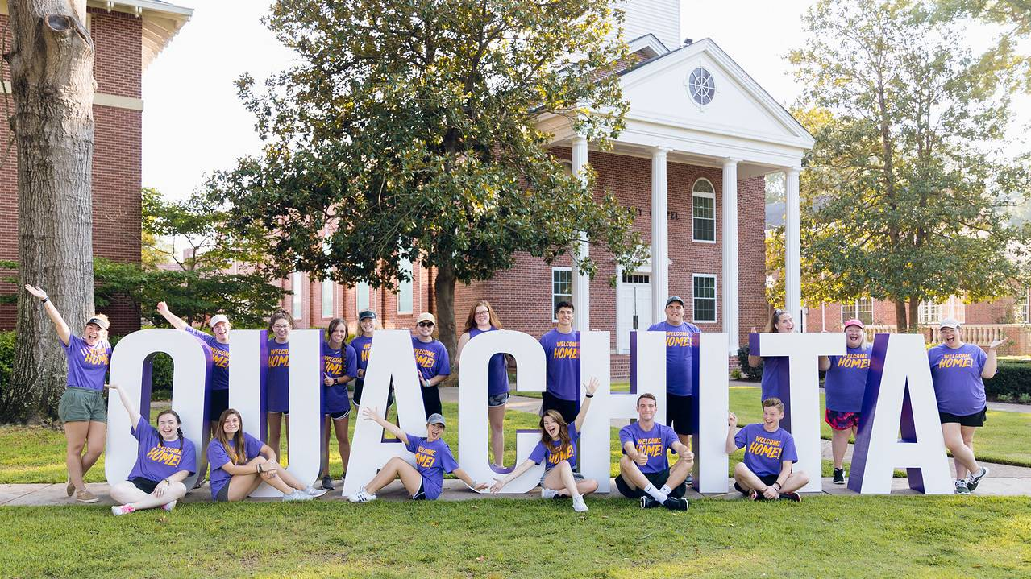
Why Ouachita Needs MSE*
Due to high rates of college students with autism and the implications this can have inside the classroom, it is crucial that steps be taken to help create…
A more inclusive environment for all students
A better support system for students with ASD
A more welcoming environment for all students
This is a small step on the right path to make college campuses more inclusive to those with intellectual disabilities.
Notes:
Maggie

Slide 10
2.
MSE Use*
Who is the target audience, where is MSE used
Notes:
Maggie

Slide 11
Who is the target audience?*
Children
Research has proven that MSE is typically used for school-age children.
Individuals with ASD
Individuals with intellectual disabilities
The research that has been conducted thus far is typically targeting children with ASD, but MSE is not limited to this group.
MSE is an environment that provides stimulation for individuals with a sensory triggered diagnosis.
Notes:
Maggie

Slide 12
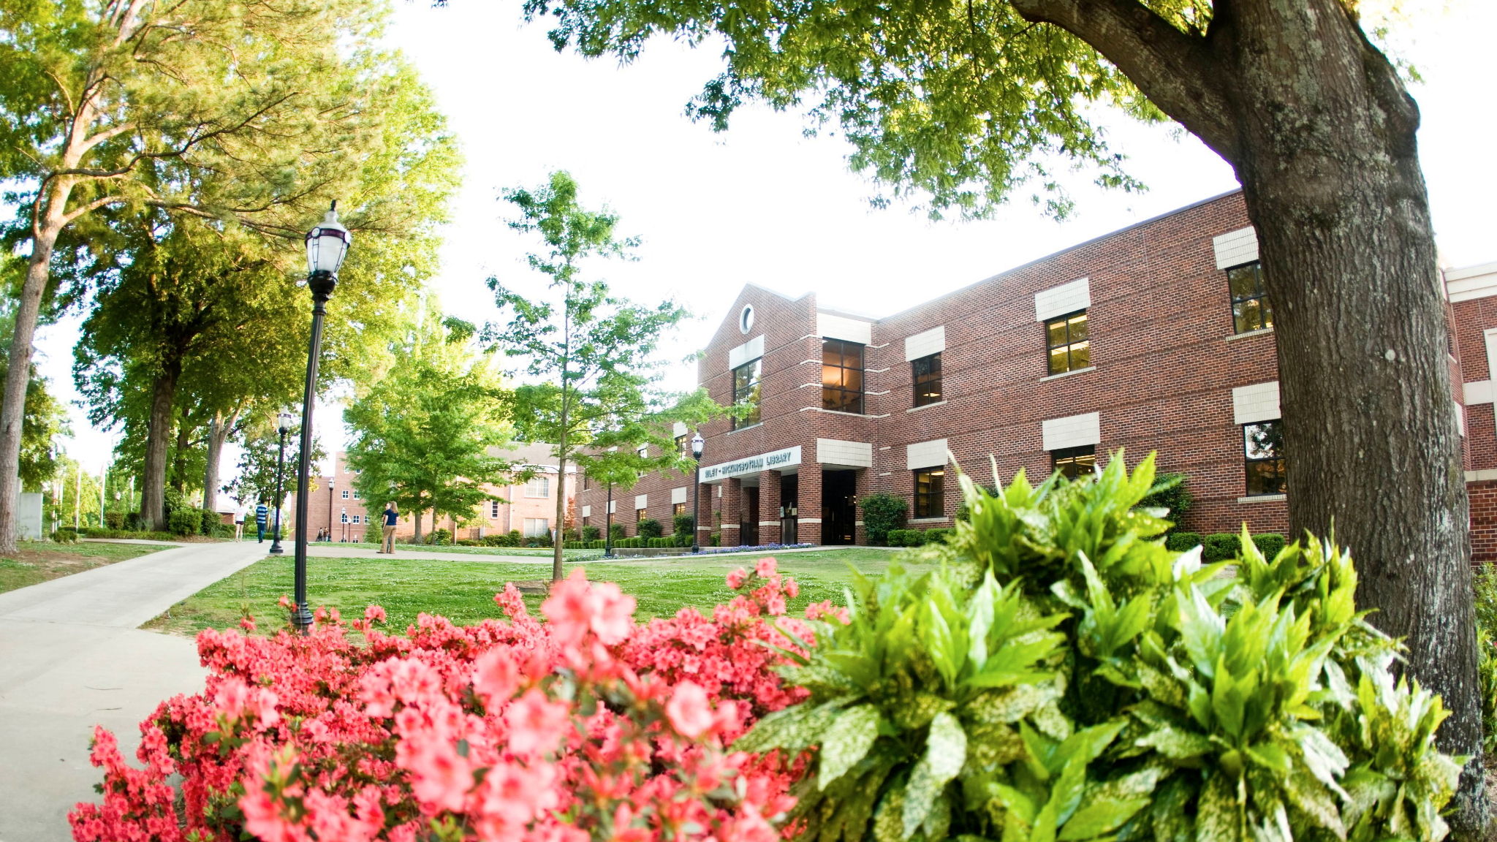
Where is MSE used?
MSE has become popular in special schools, serving the targeted population (Unwin, 2020). This environment can be created and/or seen in an area like a large room or an open space that can contain multiple components while also providing enough space for people to spread out in this area. One way this can be implemented on a campus like Ouachita Baptist University is by building a room like this in a central location that is easily located by anyone who will need it. On Ouachitas’ campus that could look like the library.
Notes:
Maggie

Slide 13
3.
Components of Room*
What elements go into this room and for what use
Notes:
Maggie

Slide 14
Elements of a Sensory Room*
Visual | Auditory | Tactile
Bubble Tube | MP3 Player | Interactive Wall Boards
Fiber Optic Sprays/Lighting | Stereo/Sound Machine | Sensory Activity Bins
Seating | Olfactory | Proprioceptive
Bean bag Chairs | Aromatherapy Diffuser Kit | Weighted Blanket
Rocking Chairs | Smell Jars | Weighted Medicine Balls
Notes:
Maggie

Slide 15
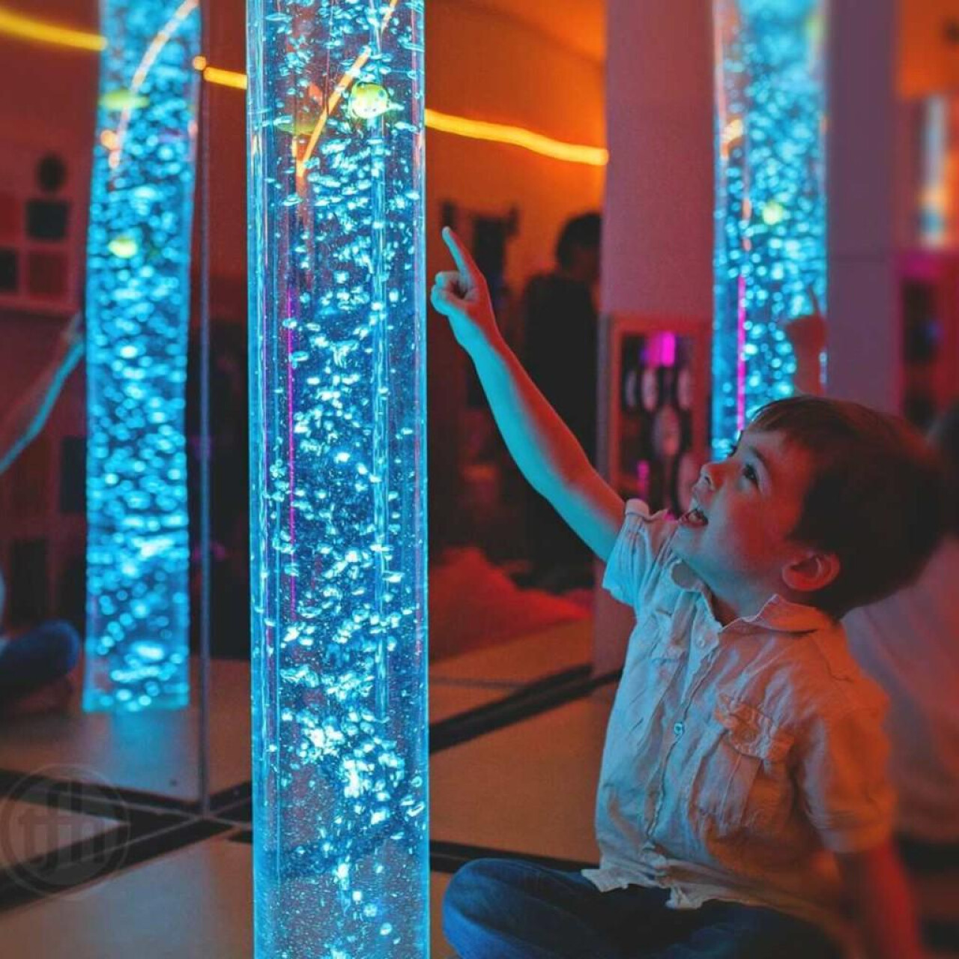
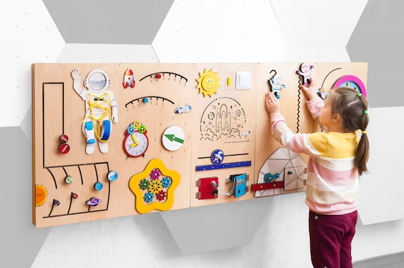
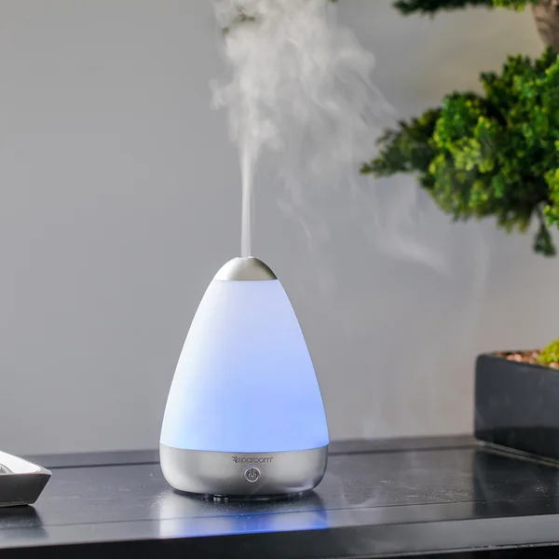
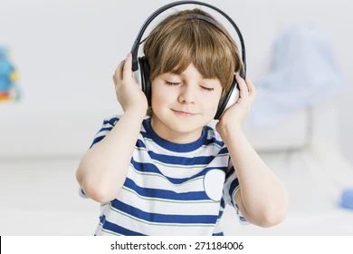
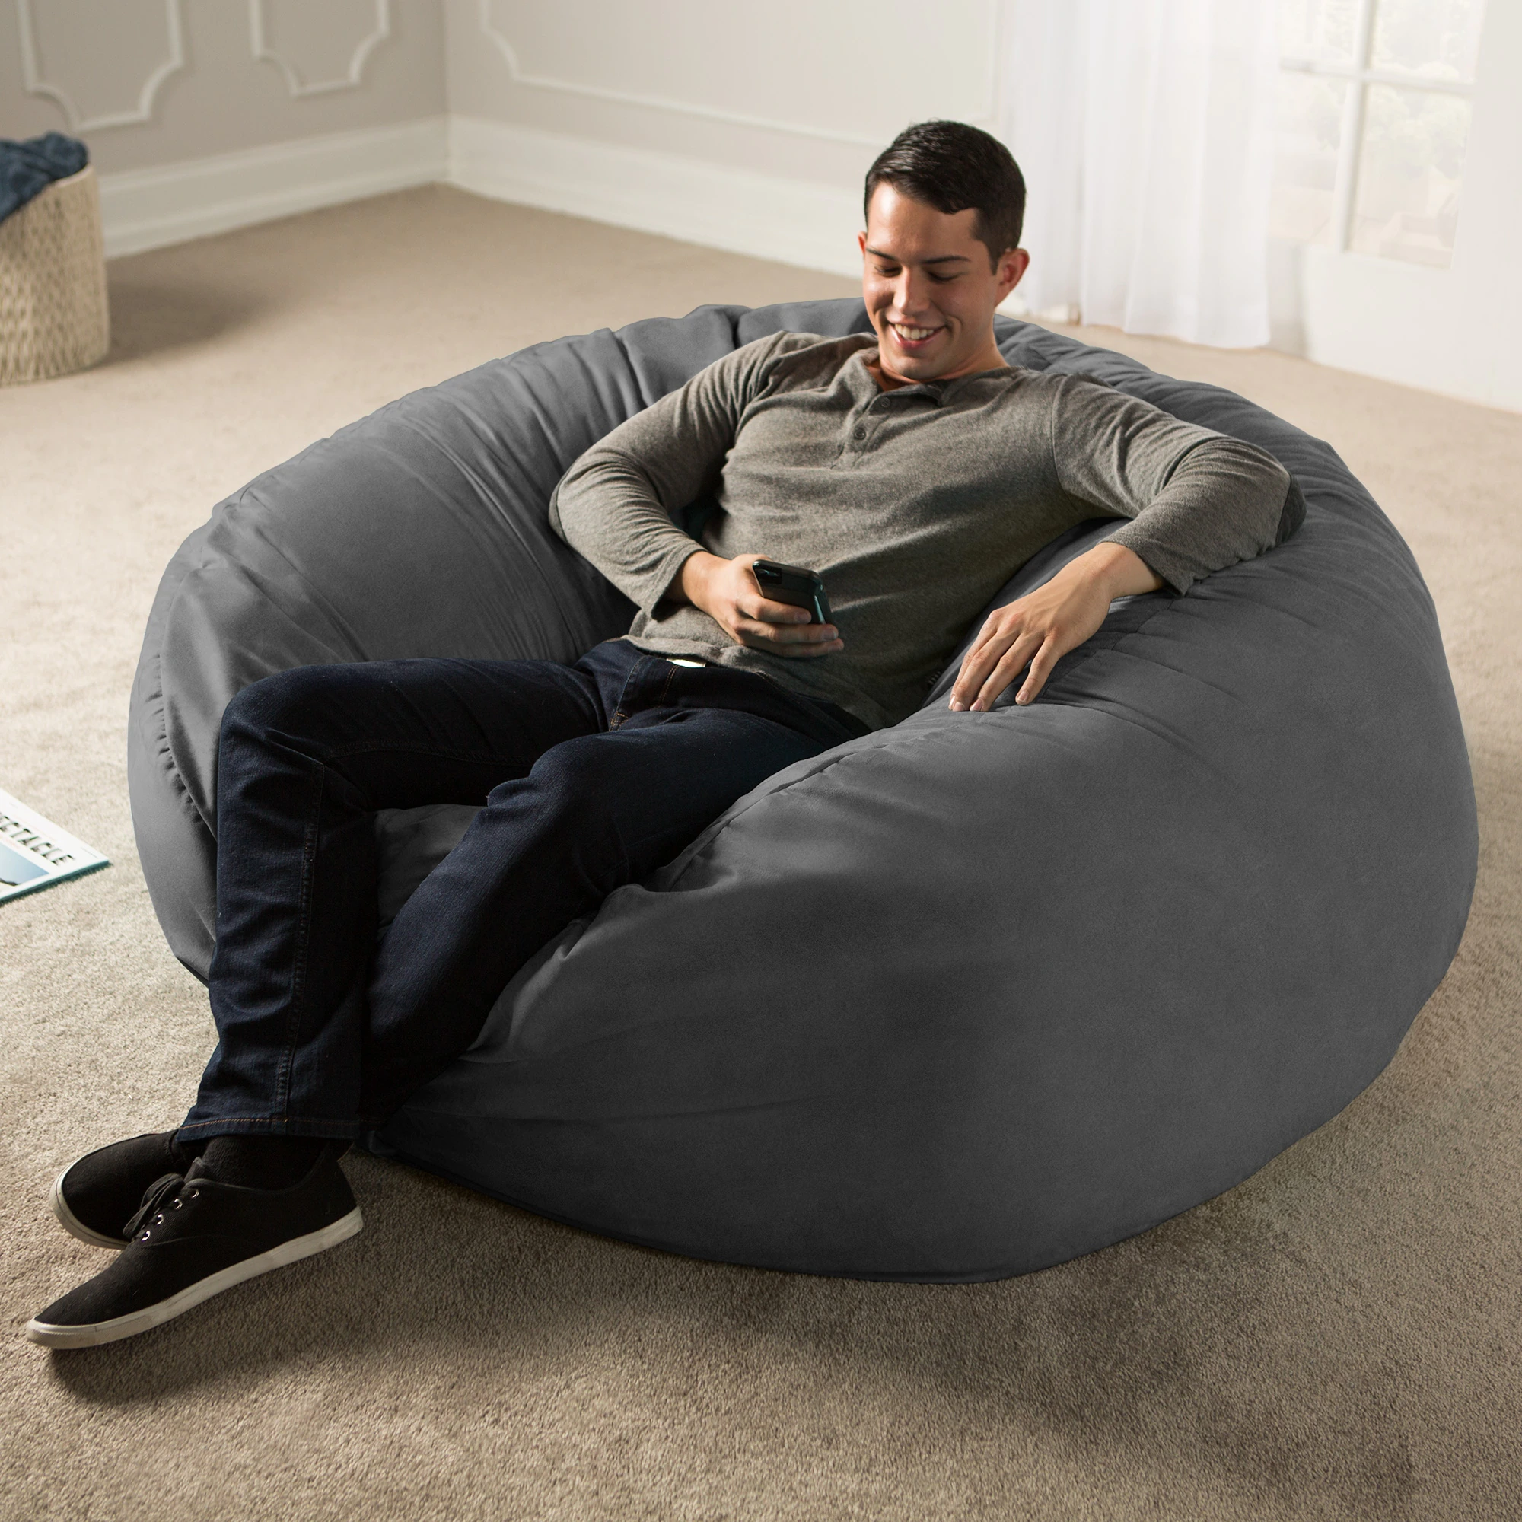
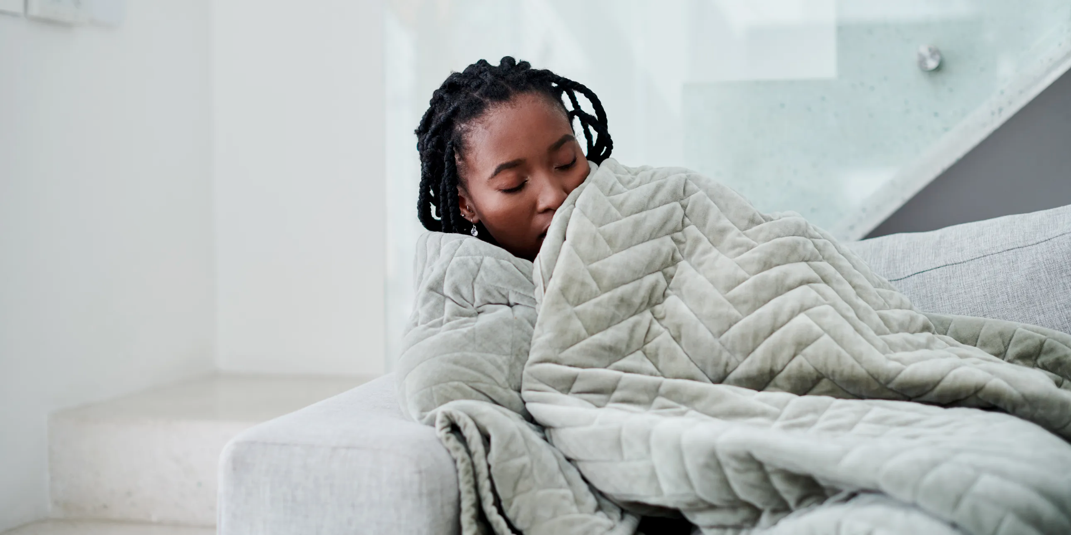
Notes:
Maggie

Slide 16
4.
Background*
Why do college students need a sensory safe room?
Notes:
Chloe

Slide 17
Autism in Adulthood
There is a higher prevalence of autism in college aged students and adults than most people would expect. When examining research about autism, much of the research is focused on toddlers and adolescents. This is a great disservice to the autism community as autism does not stop in early childhood, it merely develops and changes across the lifespan.
The overall prevalence rate of college students with autism is hard to estimate, as students with ASD often choose to not disclose their diagnosis to faculty or staff at their university. However, the number of college students with autism has increased significantly over the last several year (Elias & White, 2017). Bolourian et al. found that almost two percent of the student body on any college campus could meet the criteria for ASD.
Notes:
Chloe

Slide 18
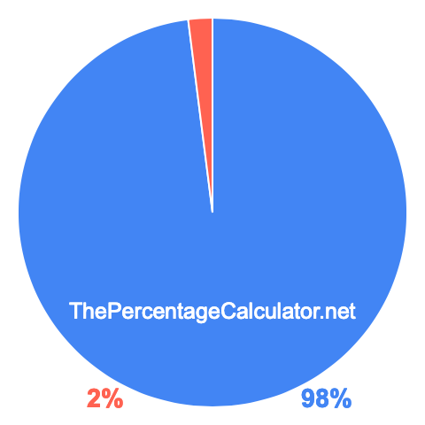
2%
This is the representation of a student population that could meet the diagnostic criteria for ASD. Another reason this number could potentially be larger on any given college campus but is not is because of the timeline of being diagnosed. It is safe to say that many students are unaware they have autism, or they do not get diagnosed until they are receiving postsecondary education (Elias & White, 2017).
Notes:
Chloe

Slide 19
Reasons for MSE in college*
Relationships
It can be hard for students with ASD to form relationships (for example with a professor or classmates) which is vital.
Social Activity
Students who act on a social life can be overwhelmed, this will only be heightened for students with ASD.
Classroom Dynamic
The classroom is ever changing and requires students to collaborate or move around, which could be triggering for a student with ASD.
Routine
A college routine can change easily from day to day which would be hard on a student with ASD.
Notes:
Chloe

Slide 20
—College student interviewed about ASD*
“Sensory overload.”
Notes:
Chloe

Slide 21
Listening to the Students
Researchers like Bolourian, Zeedyk, and Blacher (2018), set out to hear directly from students with autism on college campuses across the world to be more inclusive of the ASD population. Students had many responses that fell under the theme of “self-awareness in the present” which essentially meant that these students with ASD felt they were constantly comparing their abilities to the abilities of their typically developing peers.
Notes:
Chloe

Slide 22
What can be done about the classroom?
The layout, visual design, and overall features of a classroom have an impact on all students in a classroom, but especially those students with autism. The Classroom Sensory Environment Assessment was developed to help understand the impact of the sensory environment on student behavior (Kuhaneck & Kelleher, 2015).
This assessment was developed to aid classroom teachers and occupational therapists plan and develop their classrooms, aided by the findings of the assessment. Assessments such as the CSEA look at different sensory inputs, such as visual, auditory, and tactile (Kuhaneck & Kelleher, 2015). Although this research is based on elementary children, it can still be applied to college classrooms.
Notes:
Chloe

Slide 23
Sitting in this classroom, I’m sure each of you could name an issue you have with your surroundings right now.
Think about how you feel, then think about how it would affect neurodivergent students.
Notes:
Chloe

Slide 24
Classroom settings
In the top list of most frequently reported sensory experiences, fluorescent lighting and sound level of moving objects were frequently reported as a “high” sensory experience. This is an indicator for all those involved in classroom management and setup that items like fluorescent lighting can be a major factor in the student’s experiences in the classroom, especially for those students with autism (Kuhaneck & Keheller, 2015).
It would make sense that fluorescent lighting would be one of the most distracting or overstimulating components of a classroom for students with autism as people with autism often display a higher level of sensitivity to light (Gaines et al., 2014). Changes in behavior can be seen more frequently in classrooms with fluorescent lighting, overstimulating colors and patterns, and lack of organization (Gaines et al., 2014).
This can help designers and teachers plan for how to develop their classroom, or even a sensory room, to be more welcoming and less stimulating for students with autism.
Notes:
Chloe

Slide 25
5.
Proposed Solution*
What can Ouachita do to obtain a sensory safe room?
Notes:
Bailey

Slide 26
The solution we set forth for Ouachita Baptist University to be more inclusive to those with autism on campus is to create sensory safe rooms. *
Notes:
Bailey

Slide 27
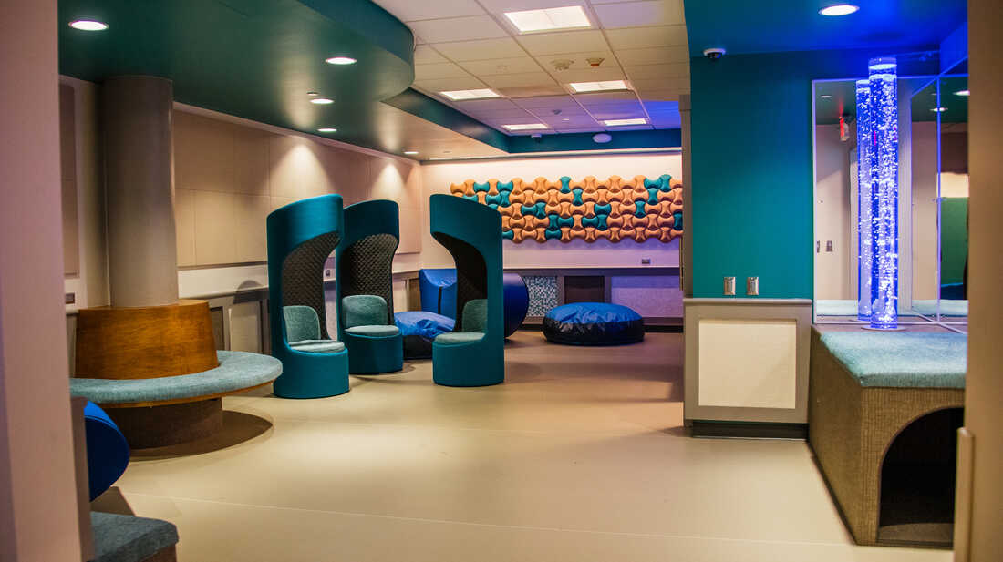
Details for the solution*
When considering this solution, there are many factors that must be considered to achieve this goal. Financials, personnel, and location are some factors that come to mind that must be addressed when taking on a project to make Ouachita a more inclusive space for neurodivergent students and faculty. Although, ideally, Ouachita could eventually have multiple sensory safe rooms, we need to first focus on establishing one and seeing how well it is received across campus.
Notes:
Bailey

Slide 28
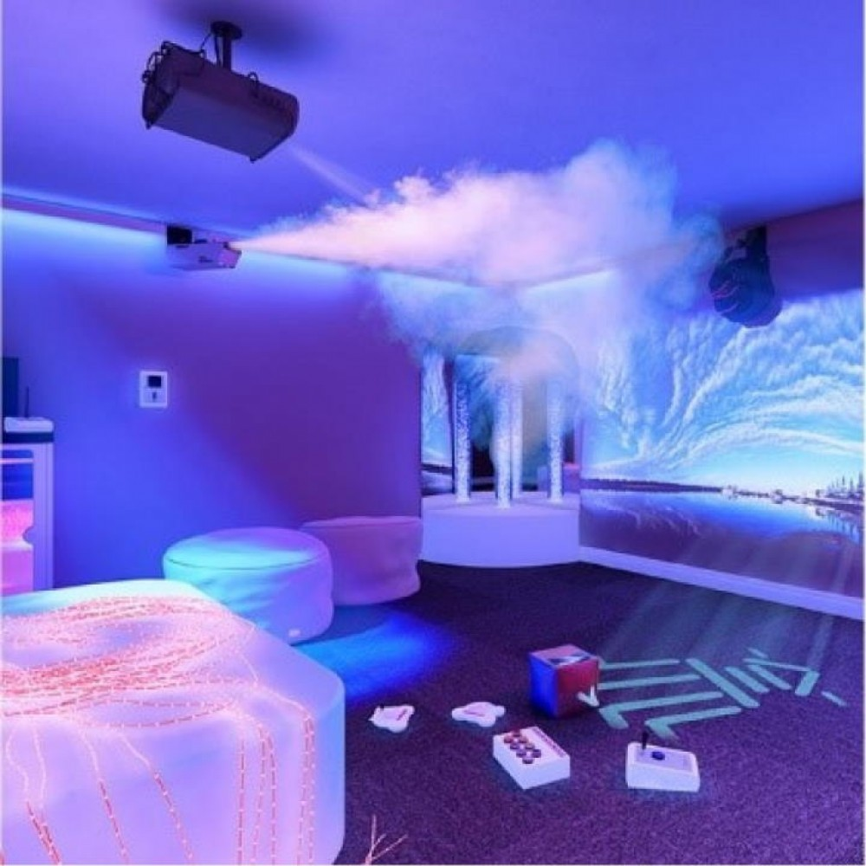
Typical aspects of a sensory room*
Typically, most sensory rooms are painted white as this allows projectors to put up different visual effects and colors on the walls that can accommodate to each individual’s preferences (National Autism Resources, 2023). These projectors provide a major significance in the sensory safe rooms as they are able to provide common themes or even lessons to accommodate the individual in the room (National Autism Resources, 2023).
Notes:
Bailey

Slide 29
Around $8,000-$15,000
For funding, we would apply for a Kluck Service Enrichment Grant. The Kluck Service Enrichment Grant funds projects on campus that helps organizations and projects that have a service component. The typical amount awarded for this is $300-$500 per grant. We think that this would be perfect funding for our project. This grant would be a great way to start the process of creating a sensory safe room on campus, as the amount of the grant would largely cover the estimated cost of the sensory safe room. These funds will be used to purchase light covers, paint for the walls, light fixture with multiple settings, and small fidget items. This small list could make a major difference on our campus.
This is the average amount for a well equipped MSE. We could budget better for less expensive components and be able to spend within the grant allowance.
Notes:
Bailey

Slide 30
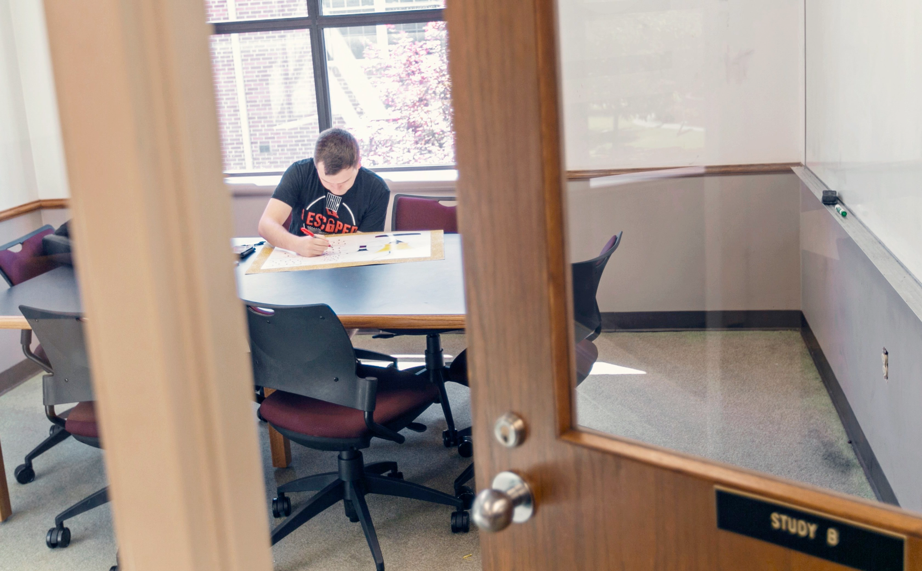
Location*
Location is a major roadblock for projects like our proposed sensory safe room. Luckily, Ouachita’s faculty and staff are extremely receptive to supporting student projects and supporting those on campus who can benefit from proposals, such as a sensory safe room. Our proposed location for Ouachita’s first MSE is a space in the Riley-Hickingbotham library. We spoke with Dr. Wu and Kristi Smith, who were open to the idea of including the MSE in the library.
Main concerns that come from this proposal is the lack of space that is available in the library. Our proposal for this specific issue is to indicate that, a study room or allotted space, can be a sensory safe room, as long as it is not being occupied by a student who is using the space to regulate, this is could be used by a student who simply needs a space to study.
Notes:
Bailey

Slide 31
Final concerns*
1.
2.
3.
4.
Hours of availability
Limited to the operating hours of the library already set in place.
Rules and expectations
Operating under the rules and regulations of the library.
Regulation of use
Available for any student, hoping to work under ethics and understanding.
Staff monitoring and involvement
Staff would have to regulate until a better idea is proposed. Potentially having ID card regulation.
Notes:
Bailey

Slide 32
6.
Conclusion*
Conclusion of proposal and how we can move forward

Slide 33
Think about how you would feel on a campus not designed for you.
Although there is limited research that has been provided about college aged individuals with autism, there has been plenty of research to prove this is an excellent idea for younger children.
Notes:
Bailey

Slide 34
Take into consideration what you can do to give back to those around you.
We think this proposal and project would be an excellent start to giving back to every student on campus. It would also put Ouachita as one of the first college campuses with a sensory safe room in the United States.
Notes:
Chloe

Slide 35
We want to make a change and be a change.
We wanted to propose this idea to help be an advocate for students that cannot advocate for themselves and make this campus feel more like home for them just as much as it does for us.
Notes:
Maggie

Slide 36
We hope that you will join us on this journey.
Thank you for your time.

Slide 37
References*
Accardo, A. L., Bean, K., Cook, B., Gillies, A., Edgington, R., Kuder, S. J., & Bomgardner, E. M. (2019). College access, success and equity for students on the autism spectrum. Journal of Autism and Developmental Disorders, 49(12), 4877–4890. https://doi.org/10.1007/s10803-019-04205-8
Bolourian, Y., Zeedyk, S. M., & Blacher, J. (2018). Autism and the university experience: Narratives from students with Neurodevelopmental Disorders. Journal of Autism and Developmental Disorders, 48(10), 3330–3343. https://doi.org/10.1007/s10803-018-3599-5
Camacho, R., Anderson, A., Moore, D. W., & Furlonger, B. (2014). Conducting a function-based intervention in a school setting to reduce inappropriate behaviour of a child with autism. Behaviour Change, 31(1), 65–77. https://doi.org/10.1017/bec.2013.33
Cameron, A., Burns, P., Garner, A., Lau, S., Dixon, R., Pascoe, C., & Szafraniec, M. (2020). Making sense of multi-sensory environments: A scoping review. International Journal of Disability, Development and Education, 67(6), 630-656.
Crane, L., Davidson, I., Prosser, R., & Pellicano, E. (2019). Understanding psychiatrists' knowledge, attitudes and experiences in identifying and supporting their patients on the autism spectrum: Online survey. BJPsych Open, 5(3). https://doi.org/10.1192/bjo.2019.12
Elias, R., & White, S. W. (2017). Autism goes to college: Understanding the needs of a student population on the rise. Journal of Autism and Developmental Disorders, 48(3), 732–746. https://doi.org/10.1007/s10803-017-3075-7
Gaines, K., Curry, Z., Shroyer, J. A., Amor, C., & Lock, R. H. (2014). The Perceived Effects Of Visual Design And Features On Students With Autism Spectrum Disorder. Journal of Architectural and Planning Research, 31(4).
Kuhaneck, H. M., & Kelleher, J. (2015). Development of the classroom sensory environment assessment (CSEA). The American Journal of Occupational Therapy, 69(6). https://doi.org/10.5014/ajot.2015.019430
Unwin, K. L., Powell, G., & Jones, C. R. (2022). The use of Multi-Sensory Environments with autistic children: Exploring the effect of having control of sensory changes. Autism, 26(6), 1379-1394.

