Slide 1
Paul and Seneca on the Immanence of God
Mason Campbell

Slide 2
The players
Paul
Seneca
“Hebrew of Hebrews” who converted to Christianity
Prominent Leader of Early Christianity
Wrote much of the New Testament
Member of the Roman Elite
Nero’s Tutor, held much influence over the Roman Empire for a time
Prominent Stoic Philosopher

Slide 3
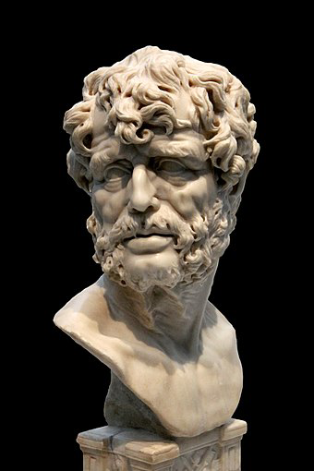
“God is near you, he is with you, he is within you… A holy spirit indwells within us, one who marks our good and bad deeds, and is our guardian. As we treat this spirit, so are we treated by it.”
- Seneca

Slide 4
Perceptions of the divine

Slide 5
Seneca’s perception of the divine
Jupiter possesses all things, but he has surely given over the possession of them to others…
And among the other reasons for marveling at the genius of the Divine Creator is, I believe, this,—that amid all this abundance there is no repetition…
Now God, who is the Father of us all, has placed ready to our hands those things which he intended for our own good…
Do we ask what cause is? It is surely Creative Reason,—in other words, God.
“It is Nature,” you say, “who supplies me with these things.” But do you not understand that, when you say this, you merely give another name to God? For what else is Nature but God and the Divine Reason that pervades the whole universe and all its parts?

Slide 6
Paul
Seneca
Monotheistic/Trinitarian
Views God as being three distinct persons
God is personal
God is central to his writings
Much of his writing focuses on theology
(Mostly) Pantheistic
Uses a variety of terms for the divine
“god” is impersonal
The divine is not his primary concern
Focuses more of his attention on Fortuna

Slide 7
Perceptions of the Self

Slide 8
Paul
Seneca
The self is a secondary concern
Monist view of the self
Made in the image of God, yet humanity is separate from God
Humans have a sinful nature
Humans should seek a relationship with God
The self is his chief concern
Dualistic view of the self
The soul is a divine spark, therefore the soul is divine
The soul is inherently good
Humans should seek to live in accordance with nature

Slide 9
Perceptions of immanence

Slide 10
Paul
Seneca
God is both transcendent and immanent
God is immanent through the Holy Spirit
The Holy Spirit ≠ human spirit
The Holy Spirit comes to live within a believer at the moment of conversion
The divine is wholly immanent
The divine is immanent through the human soul
”holy spirit” = human spirit
The “holy spirit” lives within every human being at all times

Slide 11
conclusion

Slide 12

THANK YOU!

