Slide 1
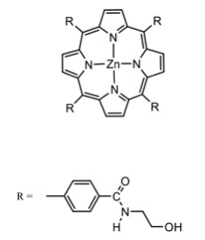
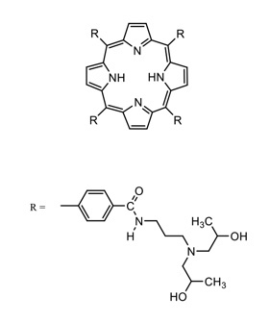
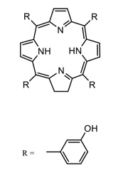
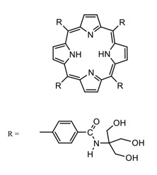
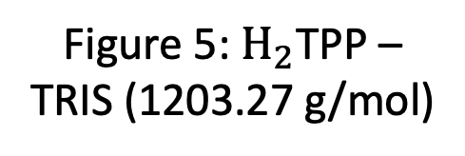
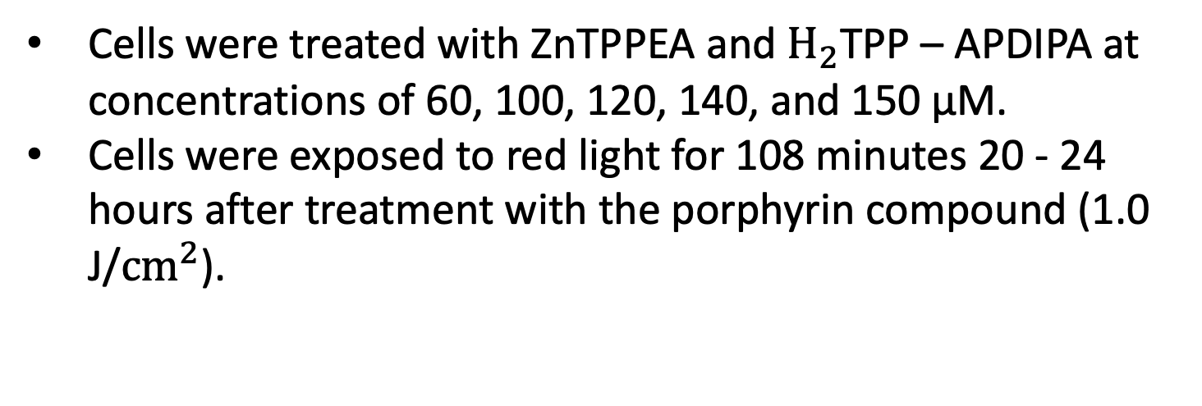
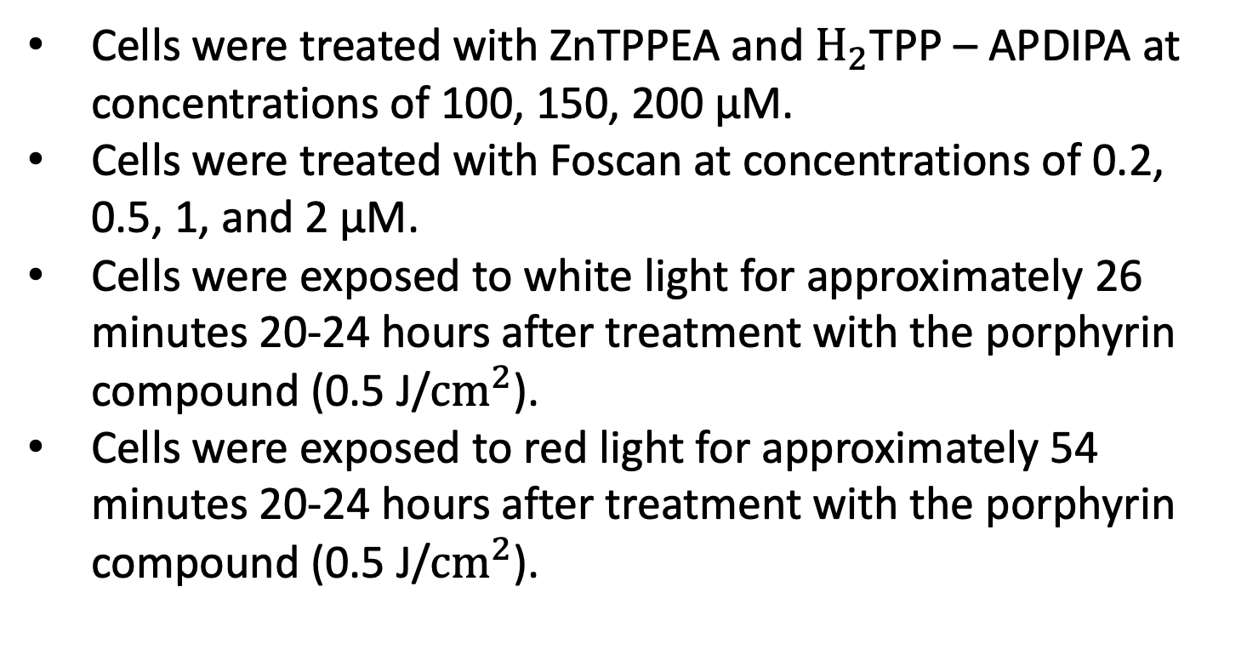
Investigating Three Novel Porphyrins for the Possible Treatment for Lung Cancer using Red and White Light
Emmy Hipps & Dr. Joseph E. Bradshaw
Ouachita Baptist University Department of Chemistry, Arkadelphia, AR 71998-0001
Abstract
Porphyrins Used
Experiment 3
Experiment 6
Photodynamic therapy (PDT) is a treatment method for various illnesses including cancer that uses a special drug, called a photosensitizer (PS). When a patient is injected with a PS, over time the PS is absorbed by the cancerous tumor. Light is then applied to area for treatment. The light then causes the drug to be activated, and singlet oxygen is produced that kills the cells. The PS in partnership with light causes cancer cells to undergo apoptosis. This research focuses on testing three novel water-soluble porphyrins, ZnTPPEA, H₂TPP – TRIS, and H₂TPPADIPA, as potential photosensitizing agents. All three novel photosensitizing agents were tested on the A549 human lung carcinoma cell line using MTT assays to determine cell viability using red light, white light, and dark conditions.
Cells were treated with ZnTPPEA and $H_{2}$TPP – APDIPA at concentrations of 60, 100, 120, 140, and 150 μM.
Cells were exposed to red light for 108 minutes 20 - 24 hours after treatment with the porphyrin compound (1.0 J/${cm}^{2}$).
Cells were treated with $H_{2}$TPP – TRIS at concentrations of 1, 3, 10, 30, 100 μM.
Cells were exposed to red light light for approximately 54 minutes 20-24 hours after treatment with porphyrin compound (0.5 J/${cm}^{2}$).
Figure 2: ZnTPPEA (1026.43 g/mol)
Figure 3: $H_{2}$TPP-APDIPA (1395.20 g/mol)
Figure 1: Standard Porphyrin Core Structure (Unsubstituted)
Experiment 4
Experiment 7
Figure 4: Temoporfin / Foscan (680.75 g/mol)
Figure 5: $H_{2}$TPP – TRIS (1203.27 g/mol)
Cells were treated with ZnTPPEA and $H_{2}$TPP – APDIPA at concentrations of 100, 150, 200 μM.
Cells were treated with Foscan at concentrations of 0.2, 0.5, 1, and 2 μM.
Cells were exposed to white light for approximately 26 minutes 20-24 hours after treatment with the porphyrin compound (0.5 J/${cm}^{2}$).
Cells were exposed to red light for approximately 54 minutes 20-24 hours after treatment with the porphyrin compound (0.5 J/${cm}^{2}$).
Cells were treated with $H_{2}$TPP – TRIS at concentrations of 1, 3, 10, 30, 100 μM.
Cells were exposed to red light light for approximately 162 minutes 20-24 hours after treatment with porphyrin compound (1.5 J/${cm}^{2}$).
Experiment 1
Introduction
In experiments 1-5 the blue lines represent H₂TPPADIPA and the orange lines represent ZnTPPEA.
Cells were treated with ZnTPPEA and $H_{2}$TPP – APDIPA at concentrations of 1, 3, 10, 30, and 100 μM.
Cells were exposed to white light for approximately 26 minutes 20-24 hours after treatment with the porphyrin compound (0.5 J/${cm}^{2}$).
Cells were exposed to red light for approximately 54 minutes 20-24 hours after treatment with the porphyrin compound (0.5 J/${cm}^{2}$).
A549 Cell Line
Human non-small cell lung carcinoma cancer cell line
80-85% of all lung cancers are non-small cell lung cancer
Lung cancer is a leading cause of death in the US with 1 in every 5 cancer deaths being lung cancer.
Conclusions
Photodynamic Therapy
MTT assay confirmed that both red and white light exposure paired with increasing ZnTPPEA, H₂TPP – TRIS, H₂TPPADIPA, and Foscan concentrations caused cell viability to decrease.
LD₅₀ was reached at lower concentrations under white light compared to red light.
ZnTPPEA, H₂TPP – TRIS, H₂TPPADIPA, Foscan were effective photosensitizers for photodynamic therapy on non-small cell lung carcinoma cancer cell.
Longer exposure time causes the cytotoxicity to increase at lower concentrations.
The patient is injected with a photosensitizer
The photosensitizer is absorbed and collected in the tumor tissue
The tumor is exposed to light for a certain amount of time, thus activating the photosensitizer.
The photosensitizer reacts, causing apoptosis of the malignant cells in the tumor.
Future Direction
Porphyrin
Experiment 2
Investigate the effect of hypoxic conditions on cytotoxicity upon treatment with ZnTPPEA, H₂TPP – TRIS, H₂TPPADIPA, or Foscan at various concentrations (0-100µM) under white light and red light conditions.
Examine cytotoxicity using ZnTPPEA, H₂TPP – TRIS, and H₂TPPADIPA on other cancer cell lines.
Perform in vivo testing using ZnTPPEA, H₂TPP – TRIS, and H₂TPPADIPA as the photosensitizer and evaluate tumor treatment outcome in live animals.
Cells were treated with ZnTPPEA and $H_{2}$TPP – APDIPA at concentrations of 60, 100, 120, 140, 160 μM.
Cells were exposed to red light for approximately 54 minutes 20-24 hours after treatment with the porphyrin compound (0.5 J/${cm}^{2}$).
Experiment 5
Porphyrins are optimum photosensitive agents due to their highly conjugated structure which allows them to absorb light of specific wavelengths.
Porphyrins function in gene regulation, hormone synthesis, oxygen transport medium in hemoglobin, converting light or chemical energy in a solar cell, as well as treating various types of cancer and other diseases.
In this research, porphyrins are being investigated as light sensitive photosensitizers in photodynamic therapy to test their cytotoxicity for malignant cells at various concentrations.
Cells were treated with ZnTPPEA and $H_{2}$TPP – APDIPA at concentrations of 1, 3, 10, 30, and 100 μM.
Cells were exposed to red light for 162 minutes 20 – 24 hours after treatment with the porphyrin compound (1.5 J/${cm}^{2}$).
Acknowledgements
Dr. J. D. Patterson Summer Research Program
Dr. Timothy E. Hayes
Dr. Nathan Reyna
Kayla Lair
Marly Welborn
Ouachita Baptist University

