Slide 1
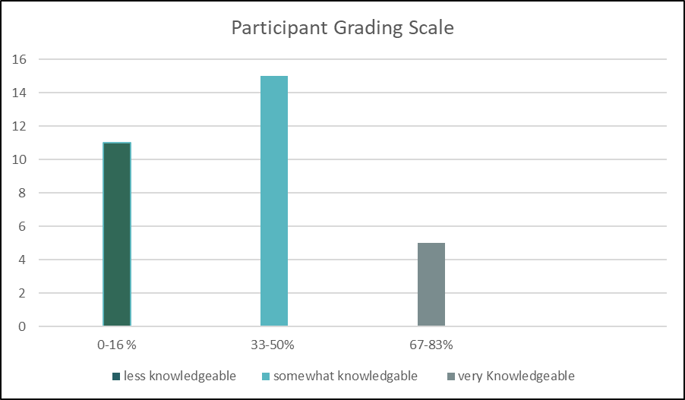
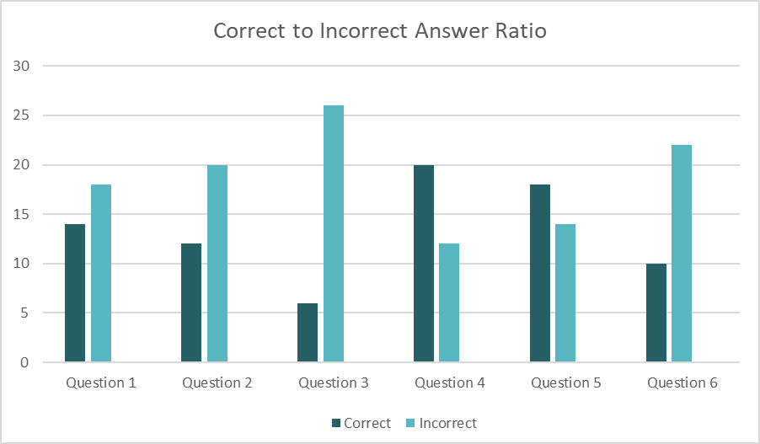
University Students Understanding of the Endocannabinoid System and its Relevance to Nutrition
Allyson Melton, Robbie Otero, Brittney Burford
Ouachita Baptist University, Jones Science Center
Abstract
Methodology
Results
Figure 2. Participant Grading Scale
Background:
The Endocannabinoid System (ECS) is a complex cell-signaling system that was identified in 1988, the ECS is the largest cell receptor system and regulator of homeostasis.
Objective:
The goal of this study was to assess the level of understanding of the Ouachita Baptist University (OBU) student populus concerning the ECS and how it pertains to other systems that are relevant to overall nutrition.
Methods:
The research was conducted in the Jones Science Center at Ouachita Baptist University. Participants had to be at least 18 years of age or older and to be currently enrolled at OBU to be eligible to participate in this study. Qualtrics, an online survey creator/analyzer, was used to organize the data collected.
Results:
There were a total of 32 participants in this study. Nine males and twenty-three females participated in this study. When excluding questions based on participant demographics, the average score of participants was 34.6%.
Conclusion:
Based on the data provided by the “Results” it can be concluded that the general student population at OBU had a limited degree of understanding of the ECS and its relevance to the human body's homeostatic status.
The research proposal was sent to the Institutional Review Board (IRB) at Ouachita Baptist University in January of 2023. The research was approved without stipulation. A review of literature was conducted before the study to establish the current research available. A questionnaire was then developed to collect data. The questionnaire consisted of nine questions. The first three questions were designed to collect demographic data. The three demographic questions consisted of gender, age, and race. The following questions, six, were designed to collect data concerning knowledge of the topic, the endocannabinoid system and the systems relevance to utrition. For the purposes of the study, only students that attended OBU were able to participate.
Before the questionnaires were administered, all participants were given an informed consent form. It included information related to the study design, its approval from the IRB, expected participation, researchers' contact information, and an area for willing participants to sign and date. The informed consent and questionnaire were given to participants in a nutrition class that took place on campus. All the students in the classes who participated in the survey were informed that the survey was optional and could choose not to participate. The participants were requested not to write their name or any other identifier on the questionnaire. Once the surveys were complete, the researchers collected the questionnaires and informed consent forms.
The collected data from the college students of Ouachita Baptist University was placed into a statistical analysis, conducted through Qualtrics to summarize all the data. Using Qualtrics, tables, graphs, and charts were created to summarize the results of the data.
When excluding questions based on participant demographics, the average score of participants was 34.6%. This average is less than 50%, showing that the OBU students do not have a good understanding of the ECS and its relevance. No participant scored perfectly. The highest scoring participant(s) answered five of six total non-demographic questions correctly displaying a generalized understanding of the endocannabinoid system. Shown below in figure one displays the participants scores on the non-demographic questions of the survey. The participants grades were classified into three categories: less knowledgeable, somewhat knowledgeable, very knowledgeable. The “less knowledgeable” category consisted of participants score equal to or less than two of the six questions. The “somewhat knowledgeable” category consisted of participants with a score equal to or less than four. The “very knowledgeable” consisted of participants with a score equal to five or greater.
Table 2. Scores of Non Demographic Questions
Participants: | Non demographic Question Scores | Non demographic Question Percentages
Participant 1 | 2/6 | 33%
Participant 2 | 3/6 | 50%
Participant 3 | 0/6 | 0%
Participant 4 | 0/6 | 0%
Participant 5 | 1/6 | 16%
Participant 6 | 2/6 | 33%
Participant 7 | 5/6 | 83%
Participant 8 | 1/6 | 16%
Participant 9 | 2/6 | 33%
Participant 10 | 2/6 | 33%
Participant 11 | 3/6 | 50%
Participant 12 | 1/6 | 16%
Participant 13 | 2/6 | 33%
Participant 14 | 2/6 | 33%
Participant 15 | 2/6 | 33%
Participant 16 | 4/6 | 67%
Participant 17 | 0/6 | 0%
Participant 18 | 1/6 | 16%
Participant 19 | 4/6 | 67%
Participant 20 | 3/6 | 50%
Participant 21 | 4/6 | 67%
Participant 22 | 3/6 | 50%
Participant 23 | 1/6 | 16%
Participant 24 | 2/6 | 33%
Participant 25 | 3/6 | 50%
Participant 26 | 2/6 | 33%
Participant 27 | 3/6 | 50%
Participant 28 | 1/6 | 16%
Participant 29 | 1/6 | 16%
Participant 30 | 3/6 | 50%
Participant 31 | 0/6 | 0%
Participant 32 | 4/6 | 67%
Conclusion
It can be concluded that the general student population at Ouachita Baptist University (OBU) had a limited degree of understanding of the ECS and its relevance to the human body's homeostatic status. It can be concluded that amounts of reliable evidence-based research concerning the ECS are limited to undergraduate students who do not specialize in the specific scope of practice. The ECS is a system discovered relatively recently and exists with limited amounts of accredited research. Therefore, there is an increased need for further endocannabinoid research to be done in order to accurately represent the ECS and its importance to future scientific literature.
Introduction
The Endocannabinoid System (ECS) is a complex cell-signaling system that was identified in 1988, the ECS is the largest receptor system and regulator of homeostasis. Endogenous cannabinoids, or endocannabinoids, are naturally occurring, lipid-based neurotransmitters. Neurotransmitters are chemical messengers in the body that send signals between nerve cells. The ECS system regulates and controls many of our most critical bodily functions such as learning,memory, emotional processing, sleep, temperature control, inflammatory immune responses, and appetite.¹ Tetrahydrocannabinol (THC) and cannabidiol (CBD) are the most known phytocannabinoids. Phytocannabinoids are plant byproducts that closely mimic cannabinoids and have adverse effects on the body
Endogenous cannabinoids better known as endocannabinoids are lipids that engage cannabinoid receptors. An important feature of these endocannabinoids is that their precursors are present in lipid membranes. ² Upon demand, endocannabinoids are liberated in one or two rapid enzymatic steps and released into the extracellular space.² This contrasts with classical neurotransmitters that are synthesized ahead of time and stored in synaptic vesicles.² Vesicles are essential for propagating nerve impulses between neurons and are constantly recreated by the cell.
The ECS has been recently recognized as an important modulatory system in the function of brain, endocrine, and immune tissues. It appears to play a very important regulatory role in the secretion of hormones related to reproductive functions and response to stress. The endocannabinoid system regulates not only the central and peripheral mechanisms of food intake, but also lipids synthesis and turnover in the liver and adipose tissue as well as glucose metabolism in muscle cells.³ Because this system also controls energy homeostasis and influences many things such as function of food intake, centers of the central nervous system, and gastrointestinal tract activity, there is an increased need for further research.
References
Table 1. Demographics
1. Peter G. The endocannabinoid system: essential and mysterious. Harvard Health. https://www.health.harvard.edu/blog/the-endocannabinoid-system-essential-and-mysterious-202108112569. ​
2. Lu HC, Mackie K. An introduction to the endogenous cannabinoid system. Biol Psychiatry. 2016;79(7):516-525. doi:10.1016/j.biopsych.2015.07.028​
3. Zou S, Kumar U. Cannabinoid receptors and the endocannabinoid system: signaling and function in the central nervous system. Int. J. Mol. Sci. 2018;19(3):833. doi:10.3390/ijms19030833​
4. Schulz P, Hryhorowicz S, Rychter AM, et al. What role does the endocannabinoid system play in the pathogenesis of obesity? Nutrients. 2021;13(2):373. doi:10.3390/nu13020373
Demographic Information | Number of participants | Percentage of participants
GENDER
Male | 9 | 28.13%
Female | 23 | 71.88%
Preferred not to say | 0 | 0%
AGE
18-20 years | 22 | 68.75%
21-22 years | 9 | 28.13%
23-24+ | 1 | 3.13%
RACE
White/ Caucasian | 28 | 87.50%
African American | 1 | 3.13%
Latino | 1 | 3.13%
Other | 2 | 6.25%
Figure 1. Correct to incorrect Answer Ratio
Application
An increase in knowledge of the ECS would benefit future research concerning human homeostasis. The ECS effects many systems within the body and plays a role within the gastrointestinal system, nervous system, endocrine system, and many more. Moving forward, it is important for an increase in knowledge and understanding of the ECS, from the perspective that systems of the body work together to maintain homeostasis. To disregard the ECS would inhibit the progression of science.

