Slide 1
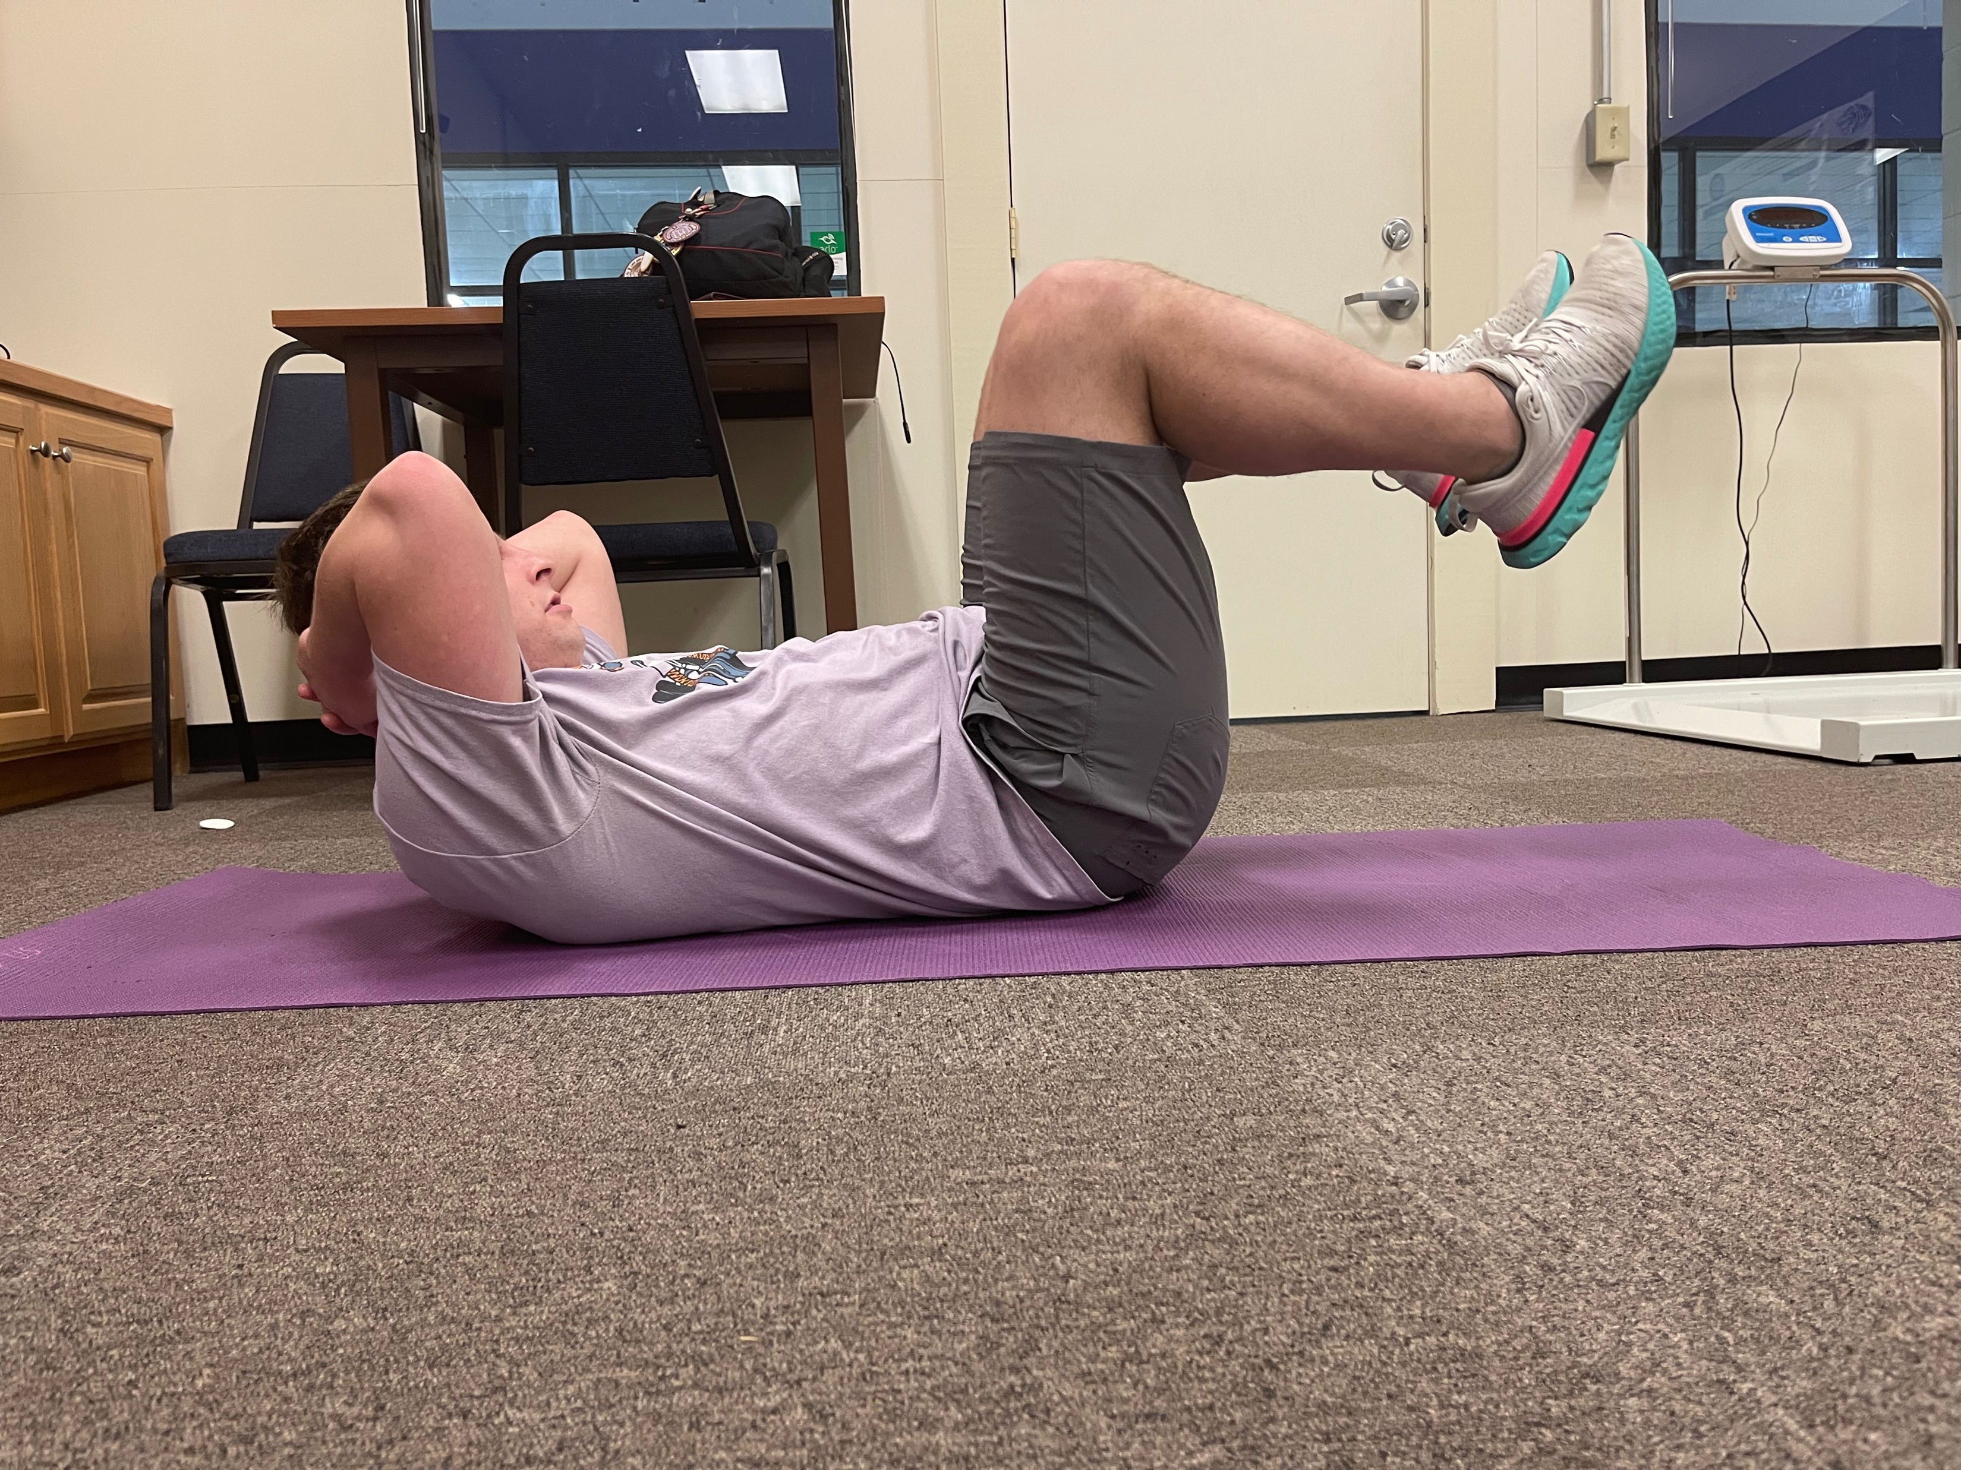
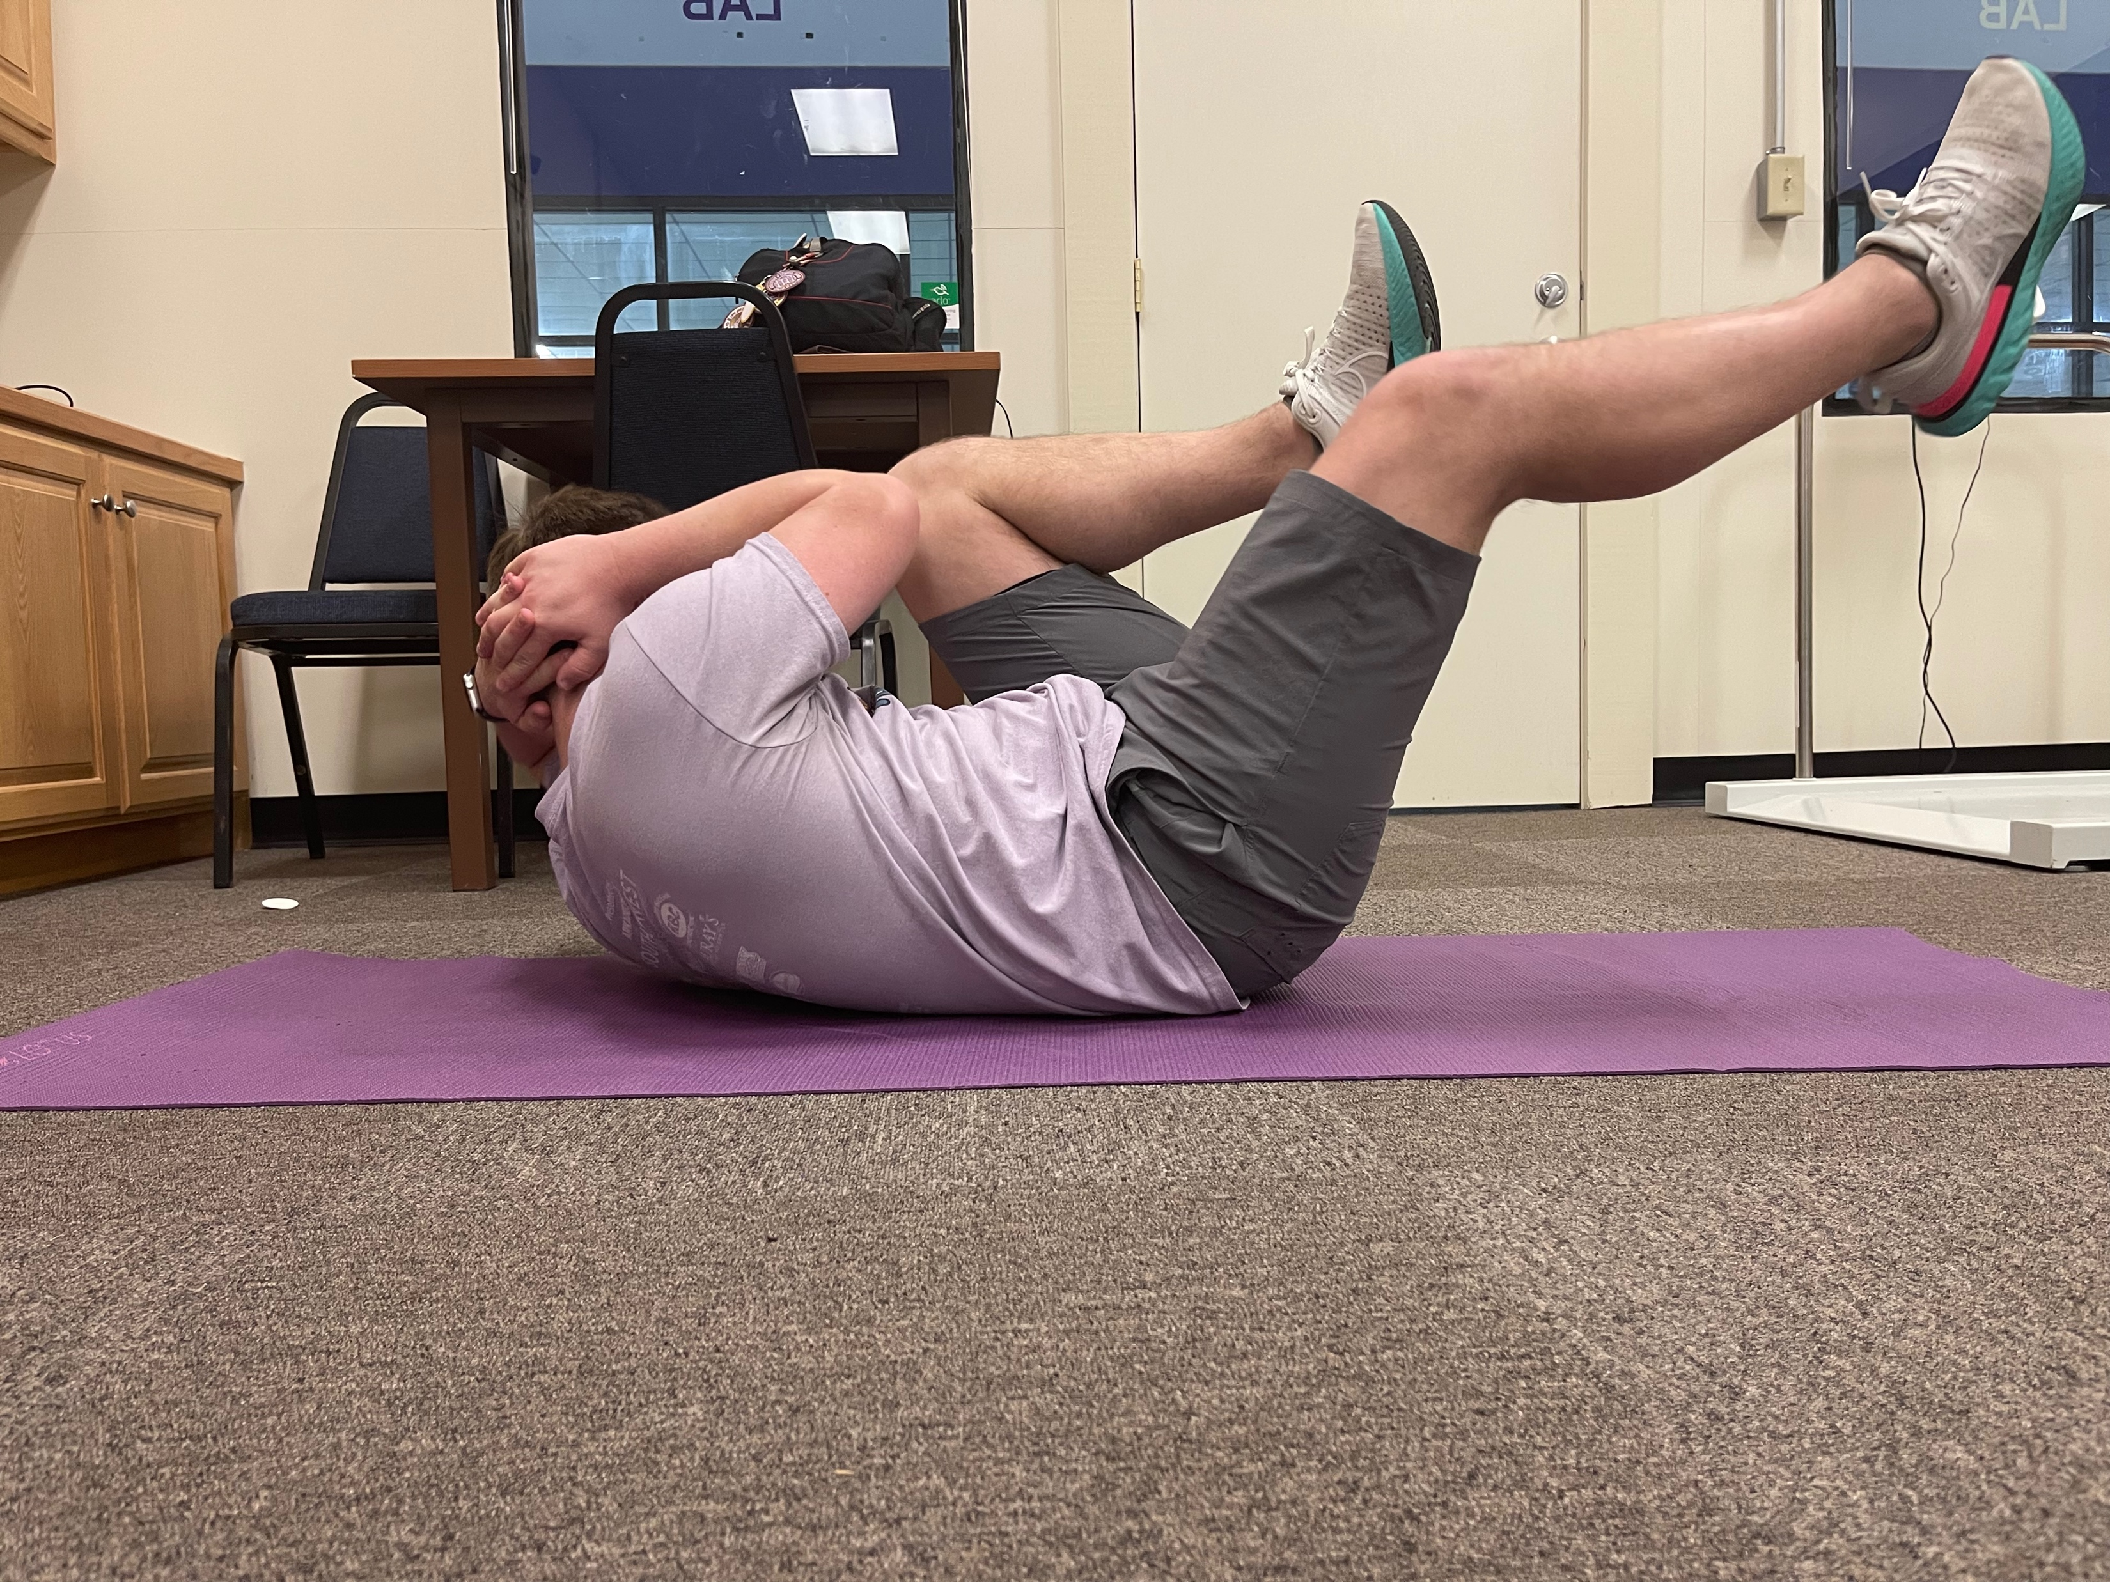
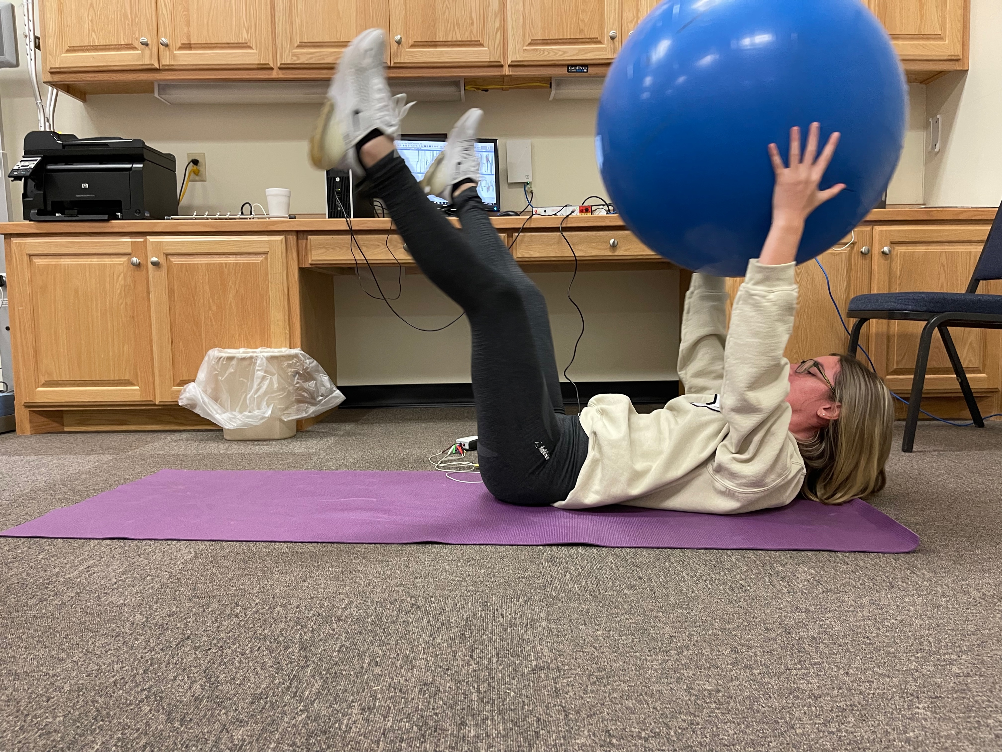
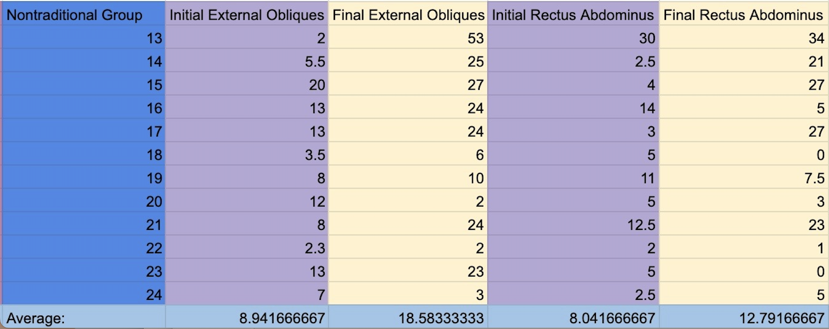
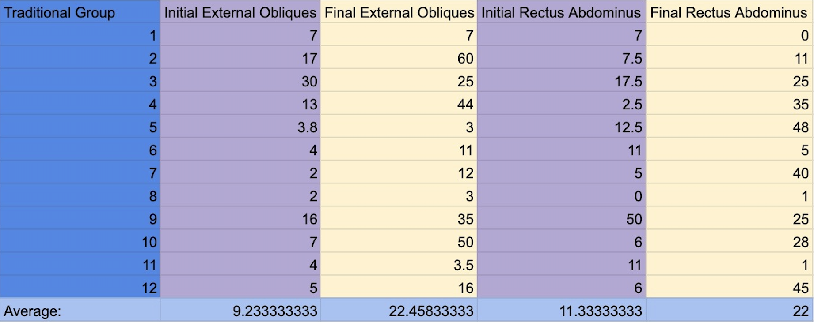
Core Activation Through the Measurement of
Traditional and Non-Tradition Core Exercises
Chris Couch, Erica Stilwell, Taylor Moran
Abstract
The purpose of this study was to compare muscle fiber recruitment between traditional core exercises and non-traditional core exercises using an Electromyography (EMG) machine. This study separated participants into a tradition or non-traditions group to perform bicycle crunches or stability ball passes.
Methods
24 college aged students participated in a three-week abdominal strengthening program. During the three-weeks participants meet twice a week to ensure data accuracy.
The participants began by answering a pre-exercise screening questionnaire, followed by performing their designated abdominal exercise. While performing the exercises, electrodes were placed on the upper rectus abdominis and external obliques. The electrodes were connected to the electromyography machine where the activation of the specific muscle were recorded.
The exercises performed were bicycle crunches and stability ball passes. The traditional group performed ten repetitions of bicycle crunches (figure 1). The non-traditional group performed 10 repetitions of stability ball passes (figure 2).
(Figure 1)
(Figure 2)
Results
Significance was found in the change of external oblique muscle activation in both the traditional and nontraditional groups, but notably with the higher significance in the traditional group which performed the bicycle crunch exercise.
Conclusion
After three weeks of data collection, one group proved to be the more effective exercise. The results show the traditional group, who performed the bicycle crunch exercise, had a higher significance. It is evident that the bicycle crunches produced better muscle fiber recruitment than the stability ball passes, this information will be helpful for the participants when planning future training programs.
References
Schoffstall, James E; Titcomb, David A; Kilbourne, Brianne F. Electromyographic Response of the Abdominal
Musculature to Varying Abdominal Exercises. Journal of Strength and Conditioning Research:
December 2010 – Volume 24 – Issue 12

