Slide 1
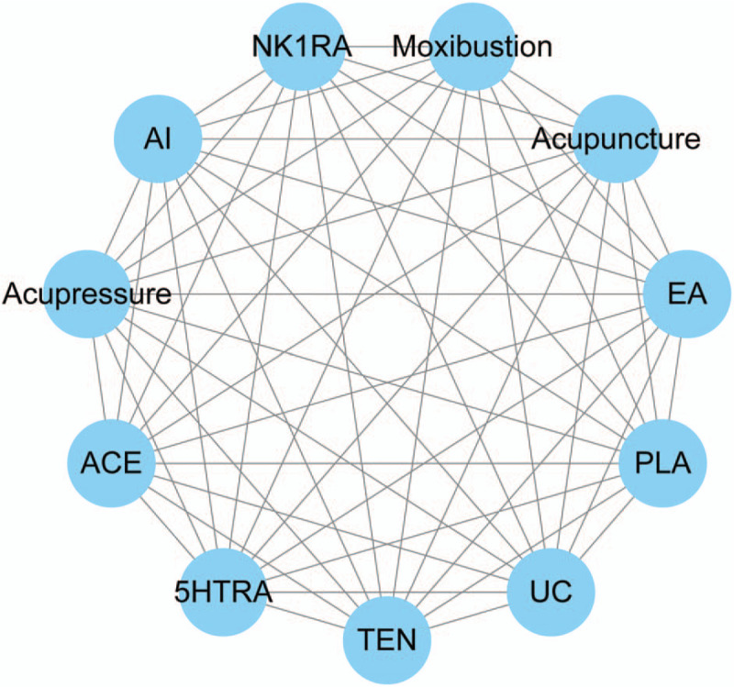
The Effects of Acupressure on Chemotherapy Induced Nausea and Vomiting
Our Research Paper
Christian M. Carney, Landen W. Hill, Paloma A. Moreno, Emily I. Watson
Ouachita Baptist University: Department of Nursing
NURS 3133.0 : Evidence Based Research
Objectives
Results
Conclusion
Patients with cancer report chemotherapy induced nausea and vomiting (CINV) remain the most debilitating side effect of chemotherapy. The incidence of CINV is prone to metabolic disorders, malnutrition, and weight loss, which will lead to an obvious negative effect on patients’ emotion, social, physical function and overall quality of life. The objective of this literature review was to find evidence to support a nonpharmacological and noninvasive intervention that can provide relief for CINV.
Preliminary Randomized Control Trial
Figure 1:
The literature review found higher levels of evidence to support the research question that Acupressure can provide relief from CINV.
Acupressure should be considered as a non-pharmacological and noninvasive action intervention for patients suffering from CINV.
Methods
A literature review was conducted using a Boolean strategy with the word “AND”.
Search Strategies
Pro-quest
Google Scholar
EBSCO
Peer-reviewed articles
Within the last five years
Abstracts were reviewed for inclusion criteria and to identify the higher levels of evidence.
Four articles were selected for this project that included meta-analysis and systematic reviews.
Background
Figure 2:
References
Auricular acupressure is a noninvasive and well-established treatment strategy in Traditional Chinese Medicine. Auricular therapy as a popular complementary health approach has been commonly adopted for managing various health conditions such as insomnia, constipation, and pain management. The underpinning theories of auricular therapy recognize the different invasive and noninvasive approaches such as acupressure and acupressure to stimulate acupoints to alleviate the targeted pathological conditions. Auricular therapy has been utilized for CINV management as a nonpharmacological and noninvasive action to provide holistic care.
E. Isenring, G. Cross, E. Kellett, B. Koczwara, L. Daniels, "Nutritional status and information needs of medical oncology patients receiving treatment at a public hospital," Nutrition and Cancer, vol. 62 no. 2, pp. 220-228, DOI: 10.1080/01635580903305276, 2019
Jing-Yu, T., Molassiotis, A., Suen, L. K., Lui, J., & Wang, T. (2022). Effects of auricular acupressure on chemotherapy-induced nausea and vomiting in breast cancer patients: a preliminary randomized controlled trial. BMC Complementary Medicine and Therapies Preview publication details, 22(1-17), 1-18. 10.1186/s12906-022-03543-y
M. Aapro, Supportive Care in Cancer: Official Journal of the Multinational Association of Supportive Care in Cancer, vol. 26 no. 1,DOI: 10.1007/s00520-018-4131-3, 2018.
Molassiotis A, Lee PH, Burke TA, Dicato M, Gascon P, Roila F, Aapro M. Anticipatory nausea, risk factors, and its impact on chemotherapy induced nausea and vomiting: Results from the Pan European Emesis Registry study. J Pain Symptom Manage. 2019;51(6):987–93
Figure 1: participants who received Auricular acupressure had less people who experienced CINV than the Pham and Standard Care Groups.
Figure 2: the True AA group had lower mean MAT scores than both the Pham and Standard Care Groups.
PICO Question: What Are the Effects of Acupressure on Chemotherapy-Induced Nausea and Vomiting?
Diagram 1:
Alternative Therapies and Correlation to Acupressure
Key Words : Chemo-therapy AND Acupressure AND Nausea AND Vomiting

