Slide 1

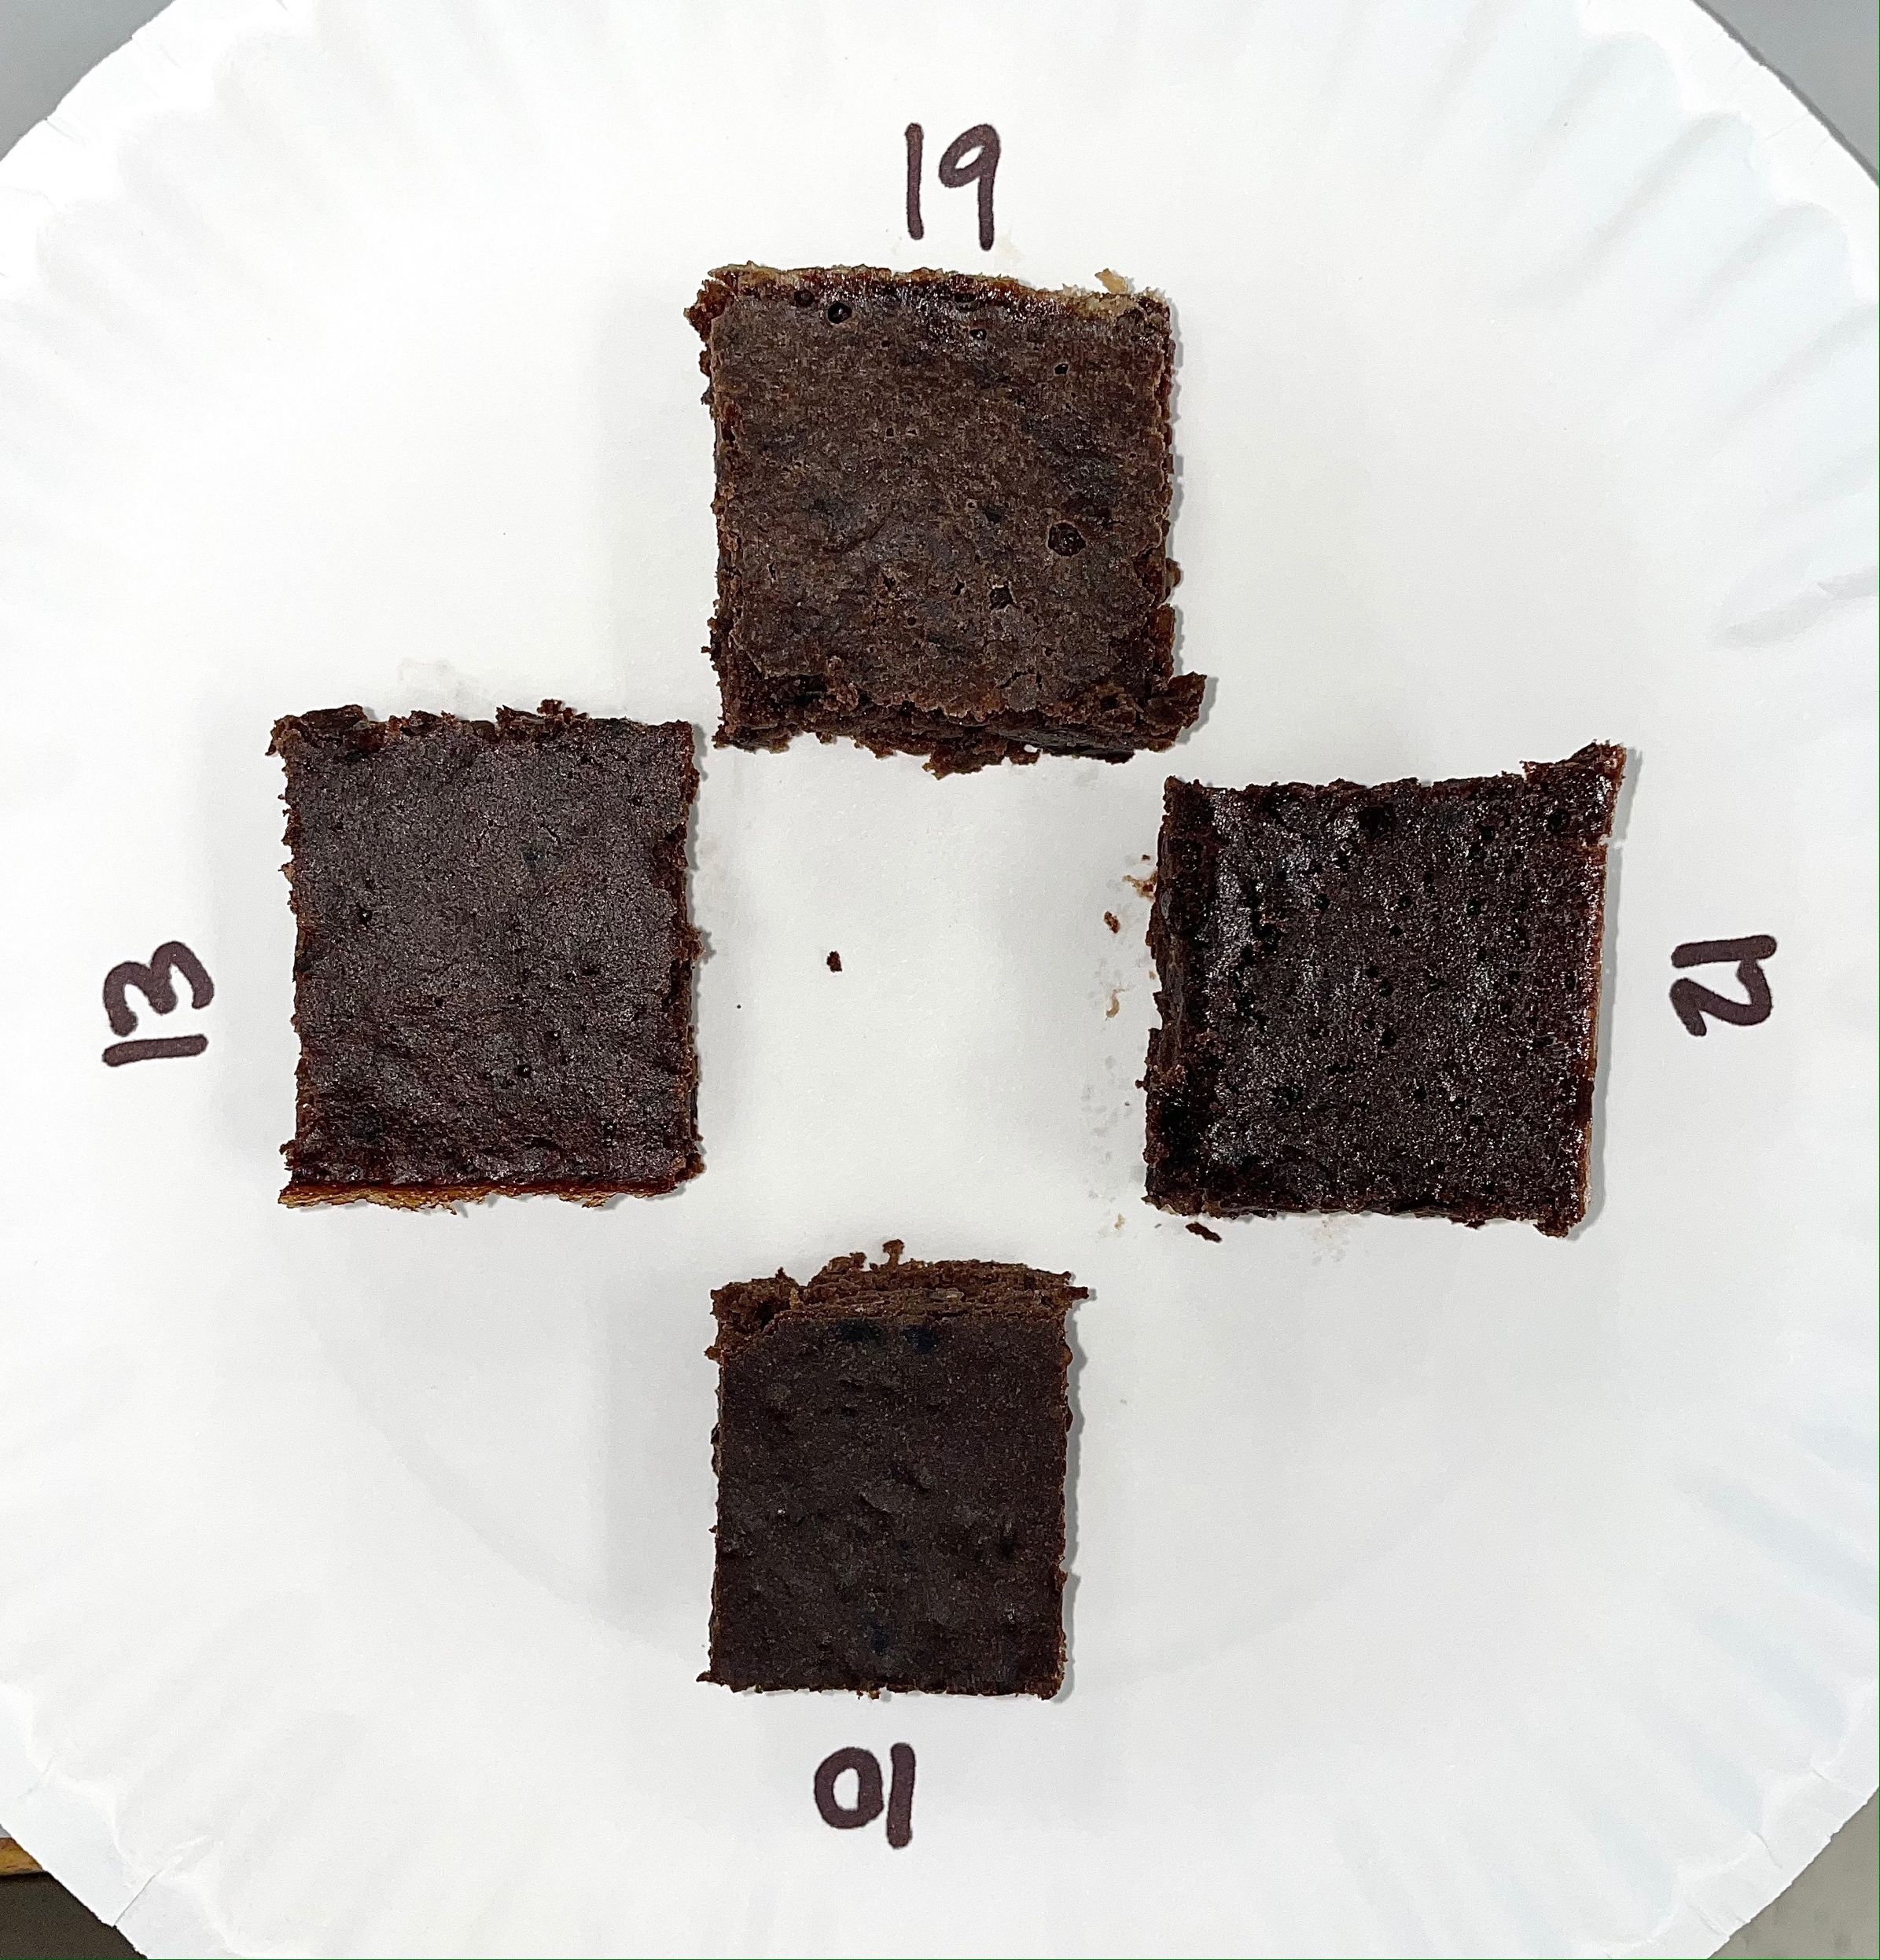
Sensory Evaluation of Black Bean Brownies Prepared with
Sugar Substitutes
Erica Gaddie
Nutrition and Dietetics Program
Abstract
Methodology
Results
Results
Introduction: Diseases such as heart disease, stroke, chronic obstructive pulmonary disease, and diabetes mellitus are some of the leading causes of death in the world; however, these life-threatening diseases can be prevented with diet. Since sugar has the potential to contribute to hyperglycemia, obesity, hypertension, and inflammation; alternatives were used to replace the potentially harmful granulated sugar. Black bean brownies are a way to reduce carbohydrate intake while increasing in protein, fiber, unsaturated fat, flavanols, and antioxidants.
Objective: To produce a heart-healthy, nutrient dense brownie with a low glycemic index, while also providing other health benefits.
Methodology: Sugar substitutes such as monk fruit sweetener, stevia, and agave were used to identify a better replacement for granulated sugar in black bean brownies but had similar sensory properties with the control. Each alternative was calculated for the appropriate exchange ratio and combined with a standard mixture for the Ouachita Baptist University students and faculty/staff. Nutritionist Pro was used to analyze the nutrient composition, and a Microsoft Excel spreadsheet was used for descriptive statistics including frequencies and averages.
Results: The control took the lead for best frequency results in density, tenderness, sweetness, flavor, aftertaste; all categories apart from moisture, which was taken by agave. Monk fruit had the greatest number of votes for no aftertaste (n=8; 33%), while stevia was voted for the strongest aftertaste. The control was the most energy and nutrient dense out of the variations with a total of 69 kcalories, 10 grams of carbohydrates, 5.5 grams of sugar with 5 of the grams being added sugar per piece. Stevia and monk fruit were both the least energy and nutrient dense providing the lowest amount of kilocalories and sugar with only 48 kcalories, 2.8 grams sugar, and 0.1 grams of added sugar per serving, and monk fruit also provided the least amount of carbohydrate (4.9 g).
Conclusion: Since the monk fruit sweetener was one of the participants’ favorites while also providing the best nutrition, it is recommended by the researcher to use as a sugar substitute rather than granulated sugar.
Experiment design
The research experiment was conducted on February 24, 2022; however, for the brownies to develop the greatest expected outcome, preparation began the day before on the 23rd. Four cans of black beans were rinsed in a colander and dried on layers of paper towels for four hours before being placed in the refrigerator overnight.
Beginning the next morning, the beans were placed into a bowl to be mashed and then transferred to a stand mixer. All 12 eggs (three for each variant) were cracked into the same bowl along with 12 tbsp. of canola oil (three for each variant) and four tsp of vanilla (one for each variant). At a low speed, the ingredients were mixed thoroughly. Next, four bowls were obtained and labeled to identify the four variants including the control. In each bowl the following ingredients were added: ¼ cup unsweetened cocoa powder, ½ tsp baking powder, and ¼ tsp salt. The following sugar or sugar substitutes were added to the assigned bowls: 2/3 cup (120 g) of granulated sugar, 80 g of agave, 14 g of stevia, and 120 g of monk fruit. Dry ingredients were mixed using a whisk.
Participants
Eight out of the 24 judges were the fellow classmates and professor as well as a previous professor for the course. The remaining participants were friends who actively volunteered or other students that were in the Jones Science Center at the time the experiment was conducted. One plate and one scorecard were given to anyone who volunteered to participant in the experiments. They were asked to judge the samples using the scorecard and to be mindful of the numbers so that the data would not be skewed. Once each volunteer was done, the scorecards were collected, and the trash was discarded appropriately. The sample scorecard is displayed in Table 2.
Data analysis
Each recipe, the control and three variants, was analyzed using the software Nutritionist Pro to determine the nutrient composition. The menu template nutrient analysis was extracted for each sample of brownies. The monk fruit sweetener was not in the software, so the standard recipe without sugar was used as it does not add a significant source of nutrients. Following the experiment, data from each scorecard was inserted into a Microsoft Excel spreadsheet where descriptive statistics were performed including frequencies and averages.
Scorecard
Density (n=24)
The monk fruit had a total of 13 votes (54%), control had 14 (58%), stevia had 10 (42%), and agave had 13 votes (54%) for the desired moderately dense, number three, score. Monk fruit had the greatest number of participants who voted light and airy (n=9; 38%), and stevia had the greatest number of participants who voted heavy and compact (n=6; 25%).
Tenderness (n=24)
Easily broken, slightly crumbly collected a total of 20 participants for monk fruit and agave (83%), 21 for control (88%), and 13 for stevia (54%). Stevia had the greatest number of participants who voted extremely crumbly and tough with little tendency to crumble (21%).
Moisture (n=24)
Moist was voted on by 11 participants for monk fruit (46%), 14 for control (58%), 10 for stevia (42%), and 21 for agave (88%). Stevia was the only sample with any votes for hard and dry (n=10; 42%); the remaining samples resulted in zero votes for hard and dry, choice one. Monk fruit had the most votes for mushy and too moist (n=11; 46%).
Sweetness (n=24)
The sweetness characteristic carried a desired score of sweet which was reported by nine participants for monk fruit (38%), 15 for control (63%), zero for stevia (0%), and 9 for agave (38%). All the participants (n=24; 100%) reported stevia as unsweet. Only one participant throughout all the samples voted too sweet, which was reported for agave.
Flavor (n=24)
Pleasing flavor was reported by 16 participants for monk fruit and control (67%), one for stevia (4%), and 12 for agave (50%). Stevia had the most votes for no flavor (n=7; 29%) and also unpleasing flavor (n=14; 58%).
Aftertaste (n=24)
No aftertaste was reported by eight participants for monk fruit (33%), seven for control (29%), six for stevia (25%), and four for agave (17%). Slight aftertaste was reported by nine participants for monk fruit (38%), 12 for control (50%), three for stevia (13%), and 10 for agave (42%). Distinct aftertaste was reported by five participants for monk fruit (21%), three for control (13%), 13 for stevia (54%), and six for agave (25%).
To determine the most popular for each characteristic, averages were taken of each characteristic for all brownie recipe variations. The goal for each characteristic other than aftertaste was a three since a Likert scale of one to five were given with a desire for the middle range. The averages that rounded up or down to three were identified. The control was the only sample to give a desired average score of 2.6 for density. All samples provided averages close to the number three for tenderness; opposingly, none of the samples provided enough sweetness. The monk fruit and control averaged out at 2.3, agave averaged out at 2, and stevia provided no sweetness with an average of 1. The agave brownies were the sample that offered a pleasing amount of moisture (3.25). Monk fruit (2.8), control (3.0), and agave (3.1) had sufficient averages for flavor. Stevia was voted for the strongest aftertaste at an average score of 3.7. Data is displayed in Figures 2 and 3 below.
Nutritional analysis
The nutrient analyses performed through Nutritionist Pro were compared by kilocalories, sugar, and carbohydrate content. Kilocalories were also compared in which the entire control recipe (24 servings) had 1,719 kcal, or 69 kcal per serving. The agave recipe resulted in 1,447 kcal, or 58 kcal per serving, and the stevia and monk fruit sweetener resulted in 1,199 kcal, or 48 kcal per serving. The control, composed of granulated sugar, had a total of 250 g (10 g) of carbohydrate. The recipe with agave had 177 g (7 g), stevia had 130 g (5.2 g), and monk fruit sweetener had 123.5 g (4.9 g) of carbohydrate. Sugar was most abundant in the control, which had a total of 137 g (5.5 g) of sugar. Regarding added sugars, which are non-natural sugars, 134 (5 g) of the 137 g of sugar was added to the control. Agave gave the recipe 57 g (2.3 g) of sugar with 54 g (2.2 g) being sugar. Stevia and monk fruit sweetener provided 2.8 g (.1 g) of sugar. Data is displayed in Figures 3 and 4 including comparisons in 5 and 6 below.
A measuring cup was used to scoop one cup of liquids at a time to each bowl. All four bowls of ingredients were mixed thoroughly using a different silicone spatula for each to avoid cross contamination until the correct consistency with few lumps was reached.
The mixtures were poured into four labeled eight-inch baking pans that were previously greased using Bakers Joy non-stick cooking spray. The black bean brownies were baked in the oven preheated at 350ºF for 25 minutes. Each variant was taken out of the oven to be cooled; however, the control remained in the oven for 10 more minutes until it was completely cooked at 35 minutes. Another timer was set for 10 minutes to allow the brownies to cool before being cut into 25 individual pieces. Paper plates (Figure 1) were labeled with the numbers 19, 12, 10, 13 which corresponded to agave, control, stevia, and monk fruit sweetener. Each sample was placed by the
Purpose Statement
Figure 3: Column Chart comparison of estimated nutrient composition per brownie sample
To produce a heart-healthy, nutrient dense brownie with a low glycemic index, while also providing other health benefits.
corresponding numbers in all 24 plates for the
participants. The recipe is listed in Table 1.
Introduction
Figure 1: Participant’s sample plate
The black bean brownie recipe used for this experiment is heart healthy and takes into consideration blood sugar and glucose levels for ones who require a lower, controlled amount due to health complications. Diabetes mellitus prevalence in the United States of America is 37.2 million (11.3%) as of 2019, and cardiovascular disease killed 360,900 people in 2019.^{1,2} Some benefits that the recipe provides are additional protein from the eggs, unsaturated fat from the oil, and flavanols as well as antioxidants derived from the cocoa. Monounsaturated and polyunsaturated fat are known to reduce serum cholesterol levels, while flavanols decrease the risk of cardiovascular disease by promoting blood vessel relaxation and in turn adequate blood flow with a reduction of blood clots.³ However, the major issue with this recipe is the last ingredient listed, sugar.
One of the six basic taste sensations in humans is sweetness. There are high caloric sweeteners obtained from natural sources and low- or non-caloric sweeteners that are usually artificial. With a rise in health complications due to increased sugar intake, it is important to find an alternative that meets the requirements to be sugar (sucrose) replacement.
Sugars provides the following characteristics: (1) they provide sweetness; (2) they are soluble in water and readily form syrups; (3) they form crystals as water evaporates from their solution; (4) they supply energy; (5) they are easily fermented by microorganisms; (6) they offer preservative characteristics by preventing the growth of microorganisms in high concentrations by reducing water activity; (7) they caramelize with heating above its melting point due to the Maillard reaction; (8) they carry out browning reactions by combining with proteins to give golden brown surfaces; (9) and they give mouth feel to solutions in addition to sweetness.⁴
The amount or presence of sugar in a recipe causes wide variations in the characteristic of products. In addition to providing sweetness, sucrose contributes to the structure, texture, and color of baked products. Therefore, using substitutions often makes it more difficult to keep the structure and flavor the same as when sucrose is used. Non- or low-caloric sweeteners give an overload of sweetness, but they do not contribute to the bodily formation of the baked product. On the other hand, energy/nutritive sweeteners can give rise to a product’s stable structure, but they tend to lack the flavor component. Nevertheless, some natural substances have the characteristics to fulfill both requirements of replacing sucrose in a healthier way.⁵
If at least one sweetener produced similar results as the control during the replacement of sugar in the black bean brownie recipe, this experiment would be considered successful, since it far exceeds the nutritional value of the control. Therefore, in this study, the aim was to investigate a healthier alternative in regard to sugar and its’ related diseases for black bean brownies. For the ones who have a sweet tooth but cannot take the risk of developing or worsening a various amount of health conditions, the targeted subjects are provided with a healthier alternative.
Figure 4: Column chart comparison of energy composition per brownie sample
Table 2: Participant’s sample score card
Characteristic | Sample
 | 19 | 12 | 10 | 13
Density 1: Light/airy 3: Moderately dense 5: Heavy/compact
Tenderness 1: Extremely crumbly 3: Easily broken, slightly crumbly 5: Tough, little tendency to crumble
Moisture 1: Dry/hard 3: Moist 5: Mushy/too moist
Sweetness 1: Unsweet 3: Sweet 5: Too sweet
Flavor 1: No flavor 3: Pleasing 5: Unpleasing
Aftertaste 1: None 3: Slight 5: Distinct
Figure 5: Comparison of sweetness and total sugar
Figure 6: Comparison of aftertaste and total sugar
Conclusion
The black bean brownie recipe used for the experiment offers a heart-healthy, low-carbohydrate dessert for individuals who struggle with diseases such as cardiovascular disease and diabetes mellitus. Every ingredient apart from sugar is deemed necessary. The canola oil provides unsaturated fats, as opposed to butter used in standard brownie recipes, and the black beans provide protein and fiber to the recipe. The control took the lead for best frequency results in density, tenderness, sweetness, flavor, aftertaste; all categories apart from moisture, which was taken by agave. Monk fruit and agave came in close second behind the control for the most favored brownie. The monk fruit sweetener was the lowest kcalorie, carbohydrate, sugar, and added sugar alternative; and the control was the alternative with the highest energy and nutrients per serving. Since the monk fruit sweetener was one of the participants’ favorites while also proving the lowest kcalorie, carbohydrate, sugar, and added sugar, it is recommended by the researcher to use as a sugar substitute rather than granulated sugar.
Figure 2: Column chart comparison of score card averages
Methodology
Ingredient | Amount
Black beans | 1 15 oz. can
Large eggs | 3
Canola oil | 3 Tbsp
Vanilla | 1 tsp
Unsweetened cocoa powder | ¼ cup
Granulated sugar Agave Stevia Monk fruit sweetener | 2/3 cup (120 g) 80 g (2/3:1 ratio) 14 g 120 g
Baking powder | ½ tsp
Salt | ¼ tsp
References
1. Statistics about diabetes. Statistics About Diabetes | ADA. https://www.diabetes.org/about-us/statistics/about-diabetes. Published February 4, 2022. Accessed April 20, 2022.
2. Heart disease facts. Centers for Disease Control and Prevention. https://www.cdc.gov/heartdisease/facts.htm. Published February 7, 2022. Accessed April 20, 2022.
3. Edelstein S. Food Science: an Ecological Approach. 2nd ed. Burlington, MA: Jones and Barlett Learning; 2019.
4. McWilliams M. Foods Experimental Perspectives. 8th ed. Upper Saddle River, NJ: Pearson Education Inc; 2017.
5. Gandhi S, Gat Y, Arya S, Kumar V, Panghal A, Kumar A. Natural sweeteners: health benefits of stevia. Foods Raw Mater. 2018;6(2). doi:http://dx.doi.org/10.21603/2308-4057-2018-2-392-402.
Table 1: Black bean brownie recipe
Figure 3: Score card averages

