Slide 1
Parent Knowledge Regarding the Relationship Between Literacy and Language Development
Emily Pankiewicz
Ouachita Baptist University

Slide 2
(Dickinson et al., 2012)

Slide 3
Introduction
It’s never too early to start reading to a child (Niklas et al., 2016).
Reading helps enrich the networks in a baby’s brain (Lewis, 2019).
The interactions that take place during reading time are important to language development (Cullinan & Bagert, 2013; ”How you Read..”, n.d.; “Why Reading…”, n.d.).
Book reading fulfills many requirements outlined in Dickinson’s 6 principles of langauge learning (Dickinson, et al., 2012).
1. Children need to hear a lot of words
2. They learn words when the meanings are clear
3. They learn vocab & grammar simultaneously
4. They learn words best when they are interested
5. They learn words best when cargivers are responsive
6. They learn words best in a positive environment

Slide 4
Survey Method
Demographic information- parental status, educational background, age of children, and number of children.
16 survey statements
6 false, 10 true
Likert scale
70 total participants

Slide 5
Research Questions
Three main questions were addressed in addition to the overall picture of parent knowledge about literacy and language development:
1. Do parents who have completed a higher level of education have more knowledge on this topic?
2. Do parents with an educational background in child development or childhood education have more knowledge on this topic than parents who do not?
3. Do parents with more than one child have more knowledge on this topic than parents with one child?

Slide 6
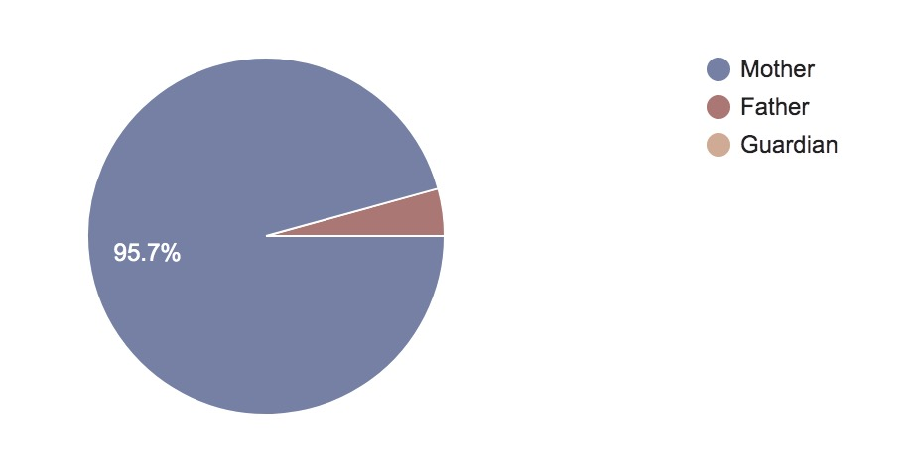
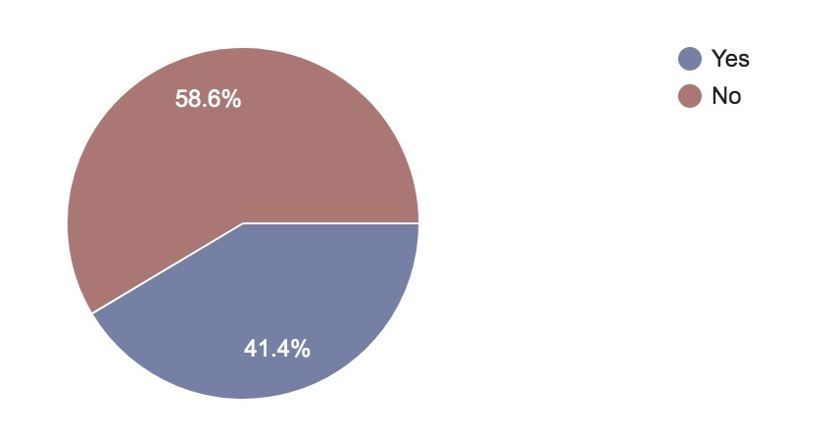
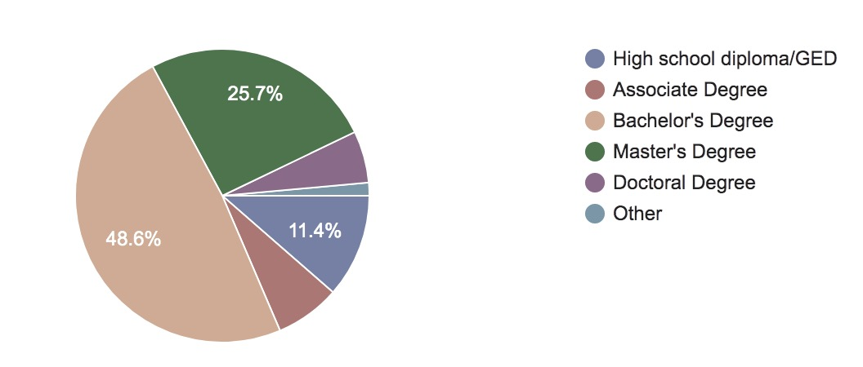
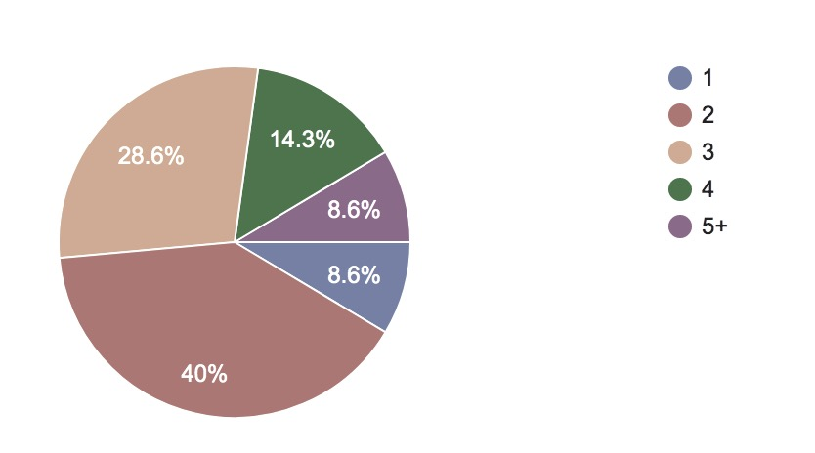
Demographics
Notes:
demographics important to my research questions.
First, participants were asked to indicated their parental status: The majority of survey participants were mothers. Only 3 were fathers.
Next, they indicated their Highest level of education: Most participants (34) completed a bachelor’s degree as their highest level of education. 22 completed either a master’s or doctorate degree. 5 participants completed an associate degree and 8 a high school diploma or GED.
Then they indicated whether or not they had an educational background in child development or childhood education. Most participants (41) indicated they did not have an educational background in this area. 28 indicated having an educational background in child development or child hood education
Lastly, participants were asked to indicate the number of children in their family. Most participants indicated either two or three children. 10 had 4 children, 6 had 5 or more children, and 6 had one child.

Slide 7
Statement 1: Even if a child cannot read yet, listening and looking at pictures helps the brain prepare for future success.

Slide 8
Statement 2: Reading the words of a book is more important to language development than the interactions that take place during shared book reading.

Slide 9
Statement 3: Reading aloud with children for 10 minutes a day is one of the best ways to provide learning tools for life.

Slide 10
Statement 4: Newspapers, cookbooks, and magazines can be effective literacy materials for parents who want to build a language and reading-rich environment.

Slide 11
Statement 5: Reading books to children can have more influence on language learning than oral conversation.

Slide 12
Statement 6: In the first 2-4 months of life, reading aloud to a child has more influence on their language development than general language experiences do.

Slide 13
Statement 7: Books encourage use of a wider range of words than may occur in everyday conversations.

Slide 14
Statement 8: Socioeconomic status is more important than frequency of reading in predicting a child’s language growth.

Slide 15
Statement 9: Maternal reading style is related to language growth.

Slide 16
Statement 10: Reading aloud to a child before they are 6 months old does not have an impact on their future language development.

Slide 17
Statement 11: The quality of reading interactions is more important than the quantity of books read over time.

Slide 18
Statement 12: Watching an age-appropriate, educational television show can have the same effect on a 2-3-year-old child’s language development as having a caregiver read aloud to them.

Slide 19
Statement 13: Children who have not been read to know the same amount of words by age 2 as children who have been read to.

Slide 20
Statement 14: Children can learn how language works by listening to the rhythm and intonation of the voice reading to them.

Slide 21
Statement 15: When reading to a child, associating the words with both the pictures on the page and real-world objects can help children learn the importance of language.

Slide 22
Statement 16: Reading aloud to a child supports their growth in both vocabulary and grammar knowledge.

Slide 23
Conclusion
1. Do parents who have completed a higher level of education have more knowledge regarding the relationship between literacy and language?
Results from this survey indicated a slight effect on the level of participants’ knowledge on this topic.
2. Do parents with an educational background in child development or childhood education have more knowledge regarding the relationship between literacy and language than parents who do not?
Results from this survey indicated no significant effect on the level of participants’ knowledge on this topic.
3. Do parents with more than one child have more knowledge on this topic than parents with one child?
Results from this survey indicated no significant effect on the level of participants’ knowledge on this topic.

Slide 24
References
Brain Development Basics. (n.d.). Retrieved April 18, 2020, from http://www.readingbrightstart.org/articles-for-
parents/braindevelopment-basics/
Bright Horizons Education Team. (n.d.). The Benefits of Reading to Babies and Infants. Retrieved April 18, 2020, from
https://www.brighthorizons.com/family-resources/the-importance-of-reading-to-babies-and-infants
Cullinan, B., & Bagert, B. (2013, November 17). Reading with Your Child. Retrieved April 18, 2020, from https://www.readingrockets.org/article/reading-your-child
Dickinson, D. K., Griffith, J. A., Golinkoff, R. M., & Hirsh-Pasek, K. (2012). How Reading Books Fosters Language Development around the World. Child Development Research, 2012, 1–15. doi: 10.1155/2012/602807
How Language and Pre-Reading Skills Develop. (n.d.). Retrieved April 18, 2020, from http://www.readingbrightstart.org/articles- for-parents/how-language-and-pre-reading-skills-develop/
How to Build a Language- and Reading-Rich Home. (n.d.). Retrieved April 18, 2020, from http://www.readingbrightstart.org/articles-for-parents/how-to-build-a-language-and-reading-rich-home/
How You Read to a Child Is Important. (n.d.). Retrieved April 18, 2020, from http://www.readingbrightstart.org/articles-for- parents/how-you-read-to-a-child-is-important/
Lewis, K. N. (Ed.). (2019, August). Reading Books to Babies. Retrieved April 18, 2020, from https://kidshealth.org/en/parents/reading-babies.html
Niklas, F., Cohrssen, C., & Tayler, C. (2016). The Sooner, the Better: Early Reading to Children. SAGE Open, 6(4), 1–11. doi: 10.1177/2158244016672715
Owens, R. E. (2020). Chapter 6: Language-Learning and Teaching Processes and Young Children. In Language Development: An Introduction (10th ed., p. 185). Hoboken, NJ: Pearson.
Why Reading with Children Is Important. (n.d.). Retrieved April 18, 2020, from http://www.readingbrightstart.org/articles-for- parents/reading-children-important/

Slide 25
Thank you!

