Slide 1
Stress and Eating Behaviors
The Eating Habits of College Females
and How Stress Affects Eating Behaviors
Abigail Fontenot and Rachel Russom

Slide 2
Introduction
Vision: To discover the prevalence of eating disorders among a small sample of college females and to learn more about the relationship between stress and disordered eating
Impact: Gaining awareness of the eating habits of women on campus, which may lead to positive changes that benefit the health of students at Ouachita Baptist University.

Slide 3
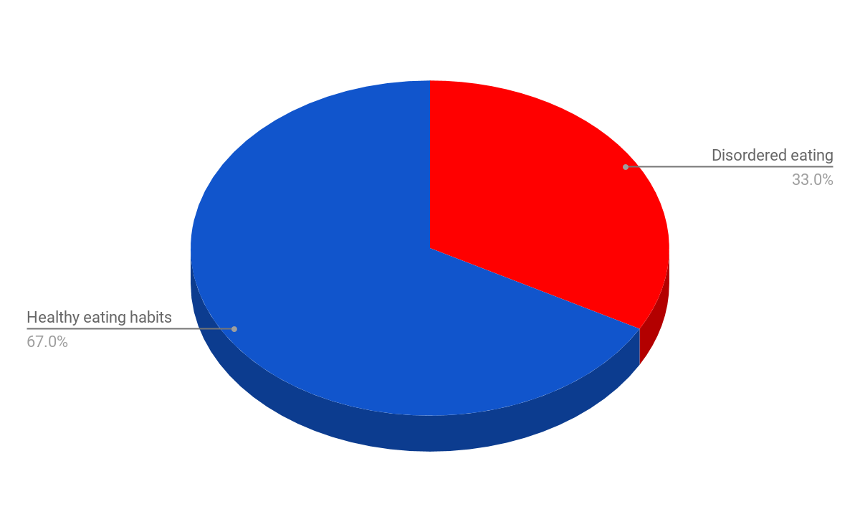
Background
Disordered eating is a problem among college students in the United States. - as many as 33% of college females engage in harmful eating behaviors¹
Disordered eating - any abnormal behaviour used to control weight²
Notes:
Disordered eating behaviors include binge eating, exercising excessively, vomiting, using laxatives. Eating too quickly, too little, or too irregularly are also aspects of disordered eating.

Slide 4
Background
Factors influencing disordered eating habits: ^{1,2,3,4,5,6} -Pressure to conform to a certain image -Unhealthy food choices -Low self-esteem/Body image issues -Depression -Family issues -Feeling a need for control -Major life changes -Social or academic stress

Slide 5
Research Questions
Does stress affect the eating habits of the college females in our study? If so, how?
2. Could the way stress makes a person feel influence or contribute to disordered eating habits?
Notes:
We developed two research questions from our review of lit

Slide 6
Methods
Developing the Research Proposal: -Reviewing related literature -Developing a questionnaire -Sending research proposal to the Institutional Review Board (IRB) -Piloting the test in the Intro to Nutrition class -Revising the questionnaire -Distributing the questionnaire to the test subjects

Slide 7
Methods
Recruiting Participants: emailed the president of Tri Chi
Sample: small sample of college females at Ouachita Baptist University -62 members of Tri Chi Social Club -Ages 19 to 22 -Sophomores, Juniors, and Seniors
Challenges: -Small sample size -Limited diversity

Slide 8
Procedures
Study conducted during Tri Chi’s weekly meeting on Monday, October 16, 2017.
Members first received an Informed Consent Form.
Once they agreed to participate and signed the Informed Consent Form, they received the questionnaire.

Slide 9
Data Analysis
We created a table to analyze the questionnaire and analyzed the data by evaluating the prevalence, mean, and mode of each question.
The responses to the questions relating to stress were compared to the results of those pertaining to eating habits.
Notes:
In order to analyze the questionnaire…….our questionnaire is represented in the following graphs

Slide 10
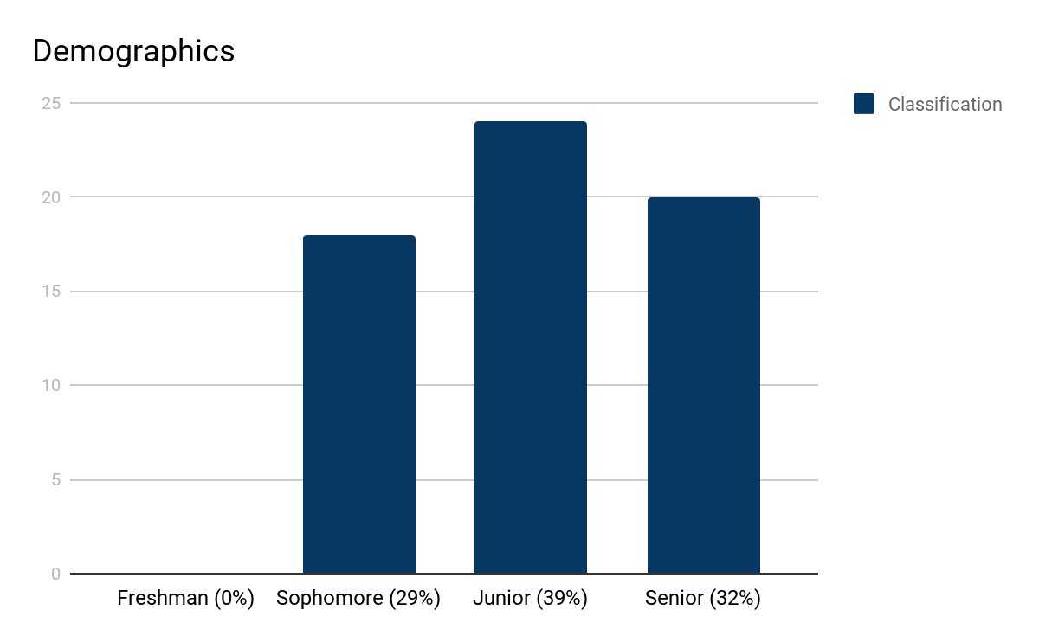

Slide 11
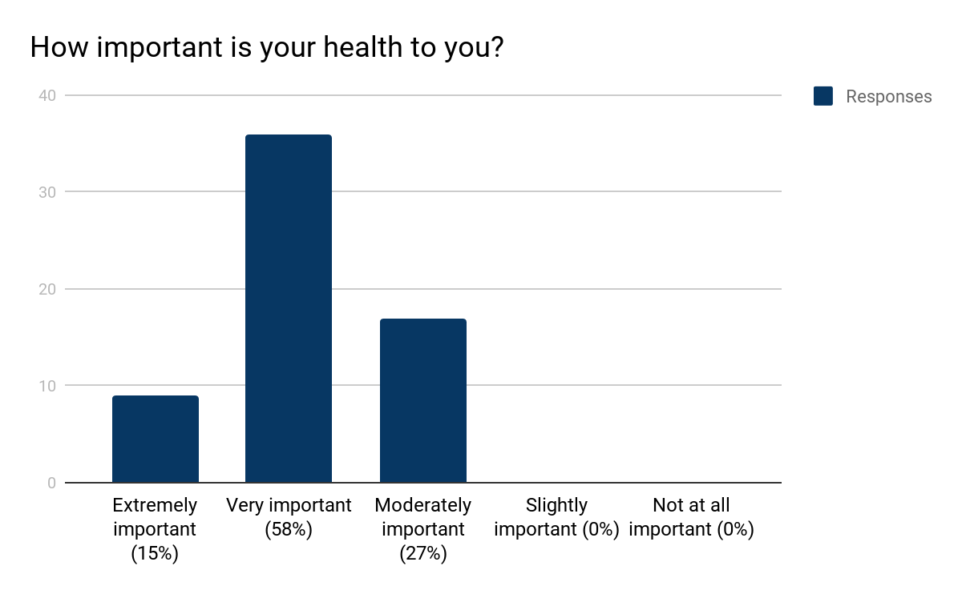

Slide 12
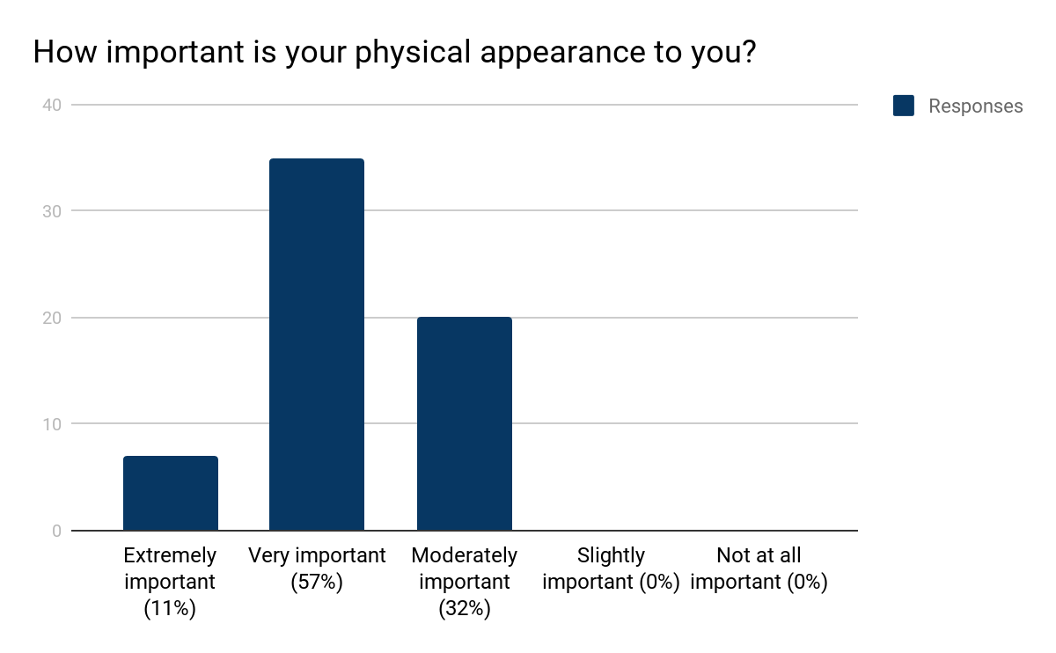
Notes:
Point out similarities to health and physical appearance

Slide 13
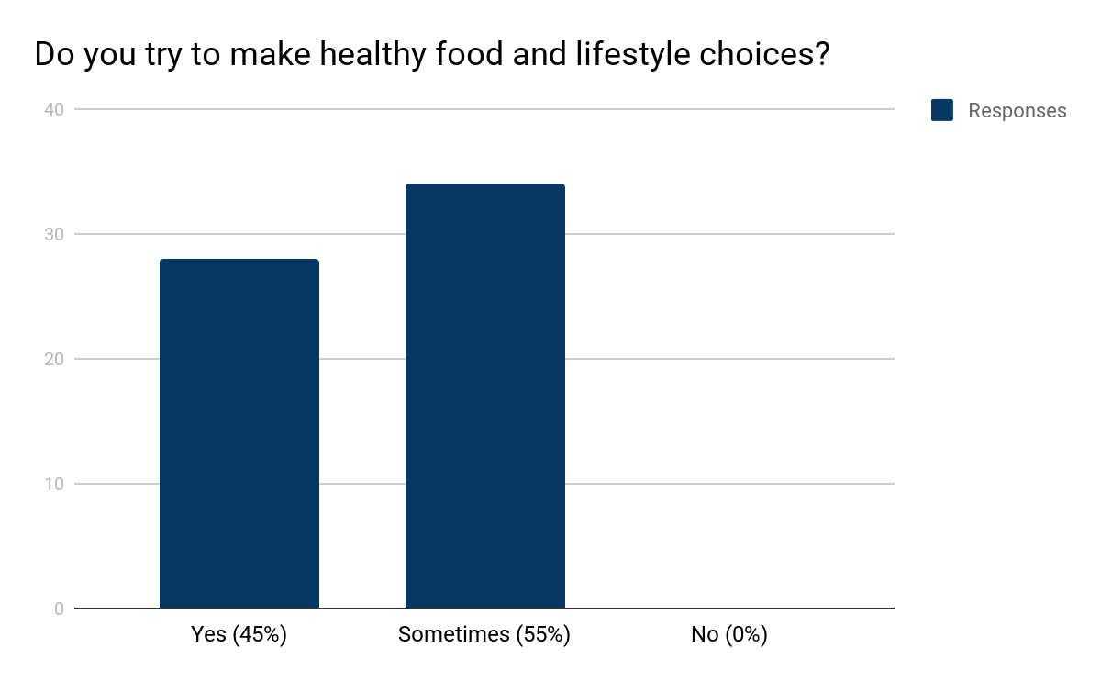

Slide 14
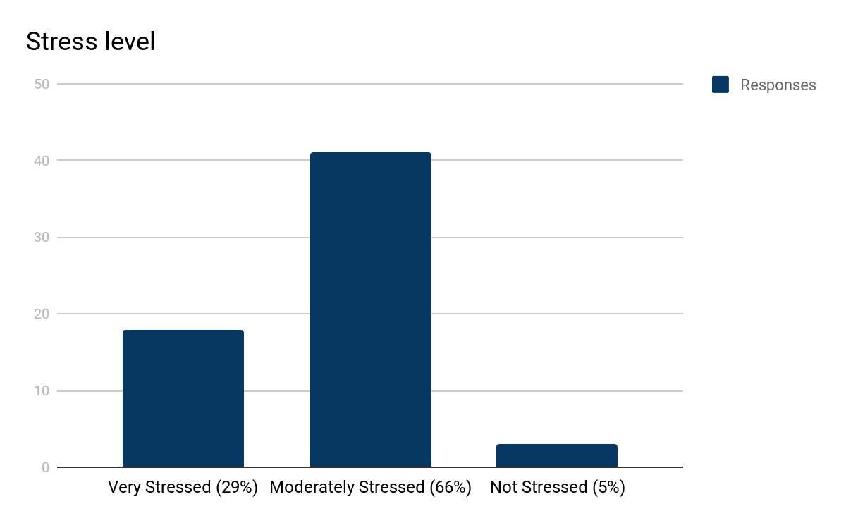

Slide 15
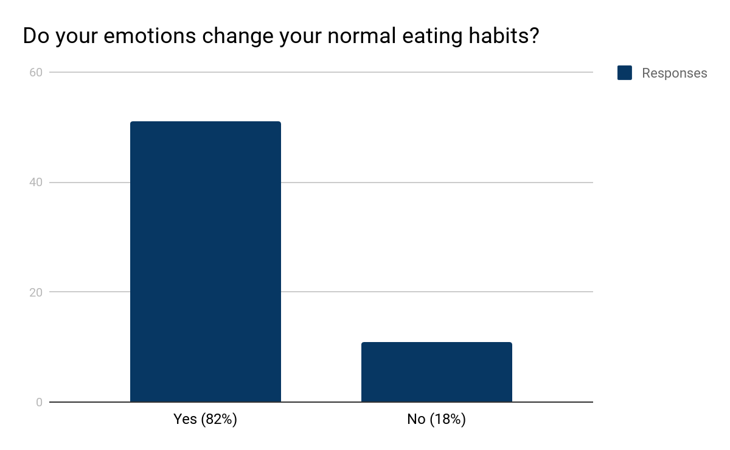

Slide 16
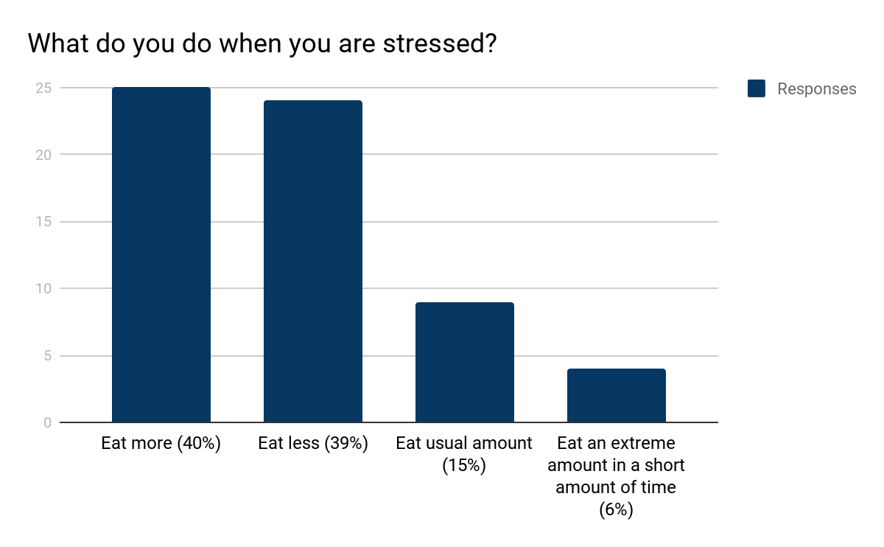

Slide 17
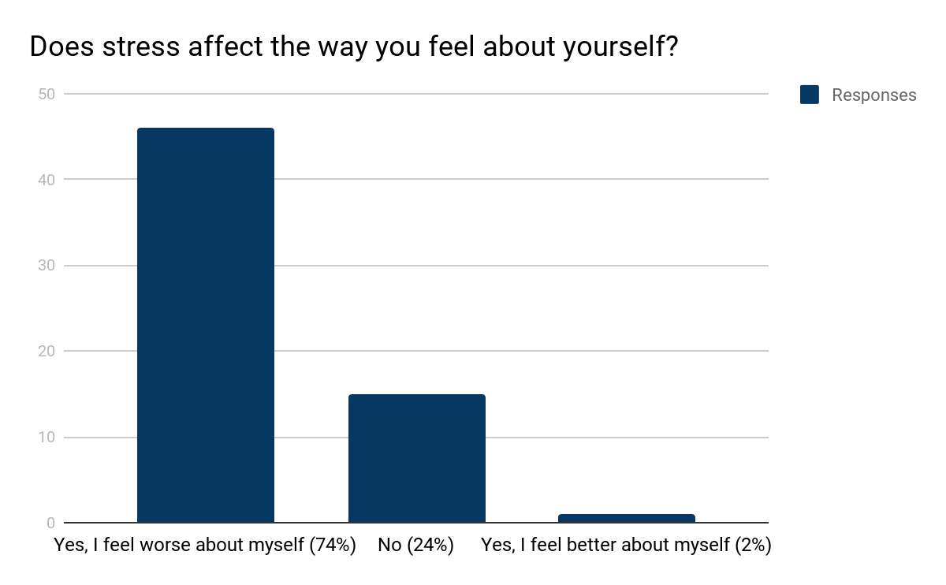

Slide 18
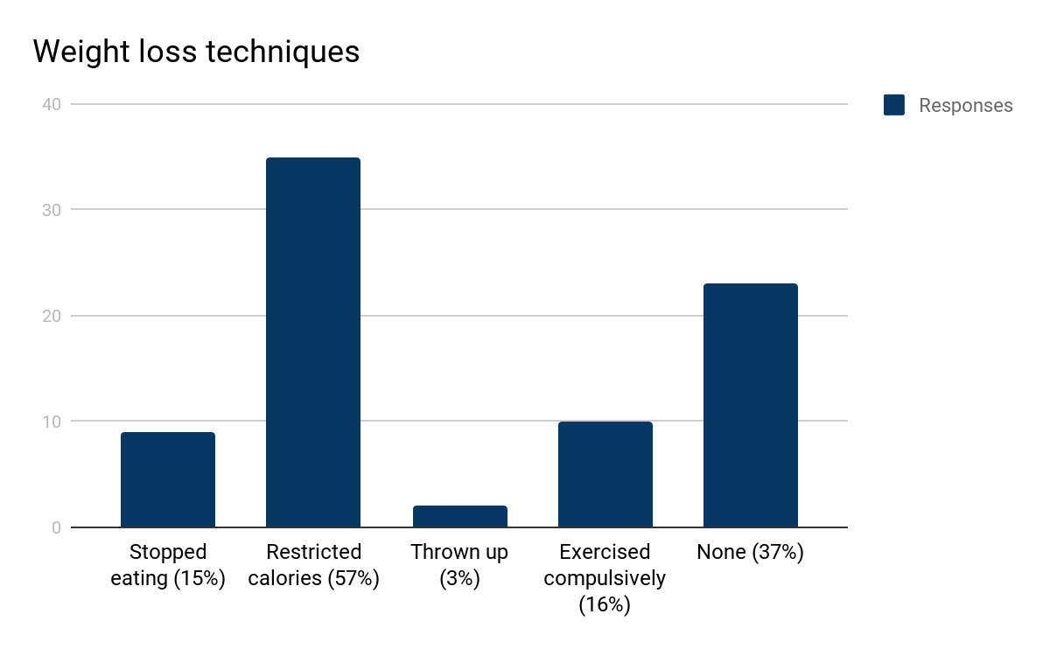

Slide 19
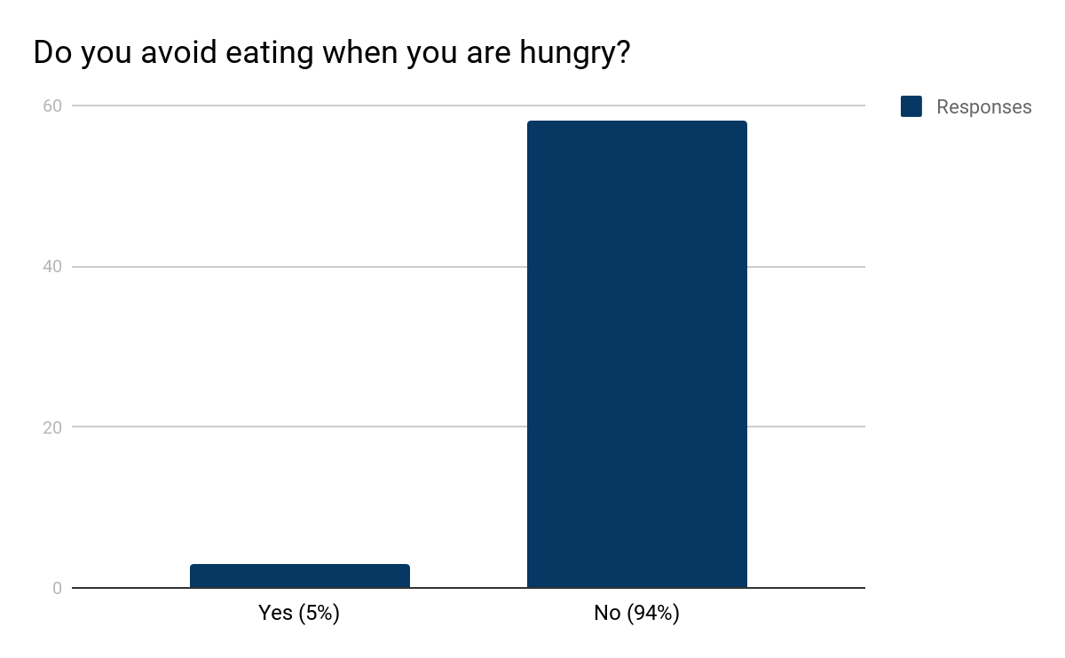

Slide 20
Stressors in participants’ lives:
-School
-Work
-The Future
-Family
-Health/ Physical appearance
-Friends
-Psychological issues (anxiety, OCD, Etc.)
-Money/Finances
-Commitments

Slide 21
Reported Eating Disorders
5 reported having eating disorders in high school
2 did not know if they had but they were aware of having normal symptoms of eating disorders

Slide 22
Results
Question: Does stress affect the eating habits of college females in our study? If so, how?
-The sample was stressed, only 5% indicated that they were not at all stressed.
-Of the stressed participants, the majority indicated that stress does affect their eating habits. *There is almost an equal amount of participants who eat more when they are stressed (40%) and those who eat less when they are stressed (39%).
Notes:
Could lead to

Slide 23
Results
Question: Could the way stress makes a person feel about themselves influence or contribute to disordered eating habits?
-Most (74%) of the participants indicated that stress makes them feel worse about themselves.
*This means that almost three fourths of this majority stressed-out sample have negative feelings about themselves and possibly lower self-esteem caused by stress. Negative feelings and low self-esteem are factors that may contribute to disordered eating habits.

Slide 24
Results
*Many of the stressors that the participants listed were linked to disordered eating in our research. Specifically the following: -Family issues -School and Homework -Social pressure -Psychological issues -Standards for physical appearance
Notes:
From our review of lit, we found that these 5 stressors that our participants listed were associated with disordered eating habits.

Slide 25
Future Research Question:
What can be done on the OBU campus and beyond
to help women, specifically college females, better cope
with stress instead of turning to disordered eating?

Slide 26
Conclusion
*The majority of the participants were stressed at some level. Major sources include family, school, and social stressors.
*The majority of participants indicated that stress does affect their eating habits.
*The way stress makes a person feel about themself may contribute or influence disordered eating habits.

Slide 27
References
Magnuson AF. Evaluation of an eating disorders prevention curriculum on eating attitudes and behaviors of female college students. [Order No. 3458751]. The Florida State University; 2010.
Matthews M, Zullig KJ, Ward RM, et al. An analysis of specific life satisfaction domains and disordered eating among college students. Soc Indic Res. 2011;107(1):55-69.
Basil M, Basil D. Factors influencing healthy eating habits among college students: an application of the health belief model. Health Mark Q. 2009;26(2):145-164.
Cook BJ, Hausenblas HA. Eating disorder-specific health-related quality of life and exercise in college females. Qual Life Res. 2011;20(9):1385-1390.
Gaines SA, Burnett TBS. Perceptions of eating behaviors, body image, and social pressures in female division II college athletes and non-athletes. J Sport Behav. 2014;37(4):351-369.
Budd G. Disordered Eating: Young women's search for control and connection. J Child and Adolesc Psychiatr Nurs. 2007;20(2):96-106.

Slide 28
QUESTIONS?

