Slide 1
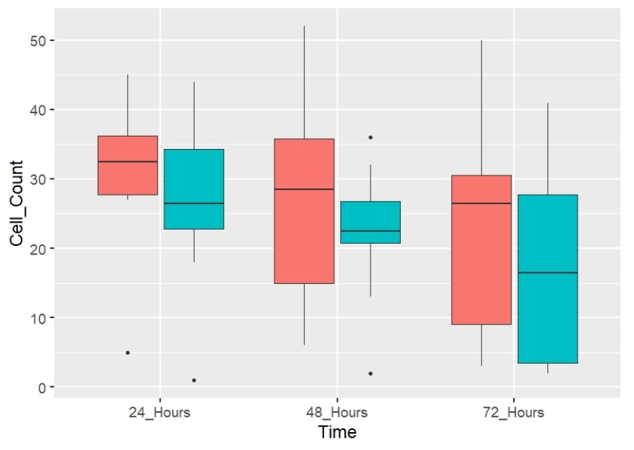
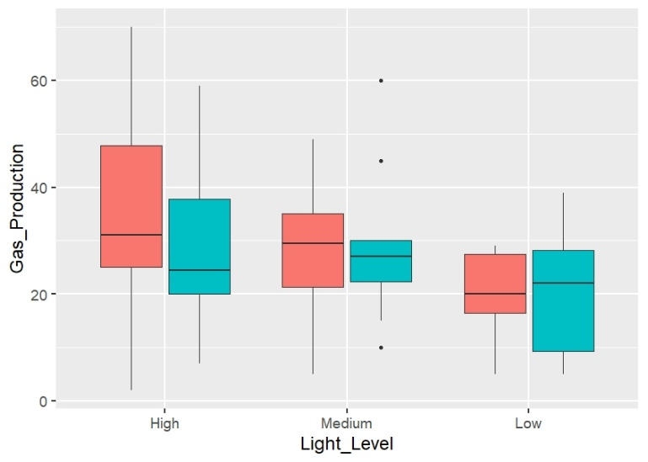
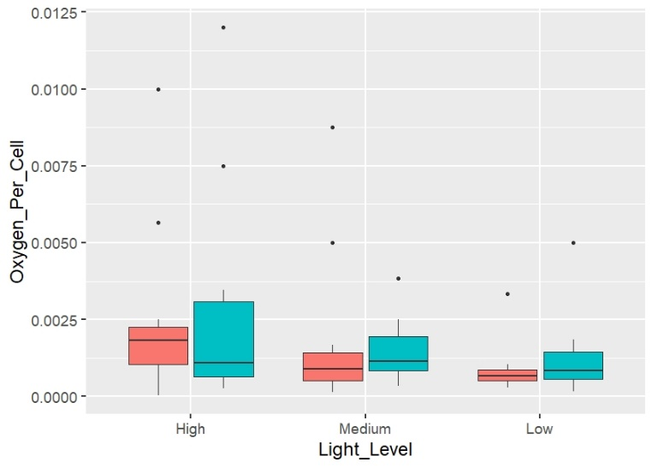
The Effects of Light Intensity on Cell Population and Oxygen Production of Arthrospira platensis Sophia Ward, Cole Turner, and Dr. Jim Taylor Ouachita Baptist University, 410 Ouachita Street Arkadelphia, AR 71998
Abstract
Methods
As space exploration becomes more advanced, scientists look to find new ways to create nourishment and oxygen to maintain long-term space travel. Arthrospira platensis, commonly known as Spirulina, could be a possible solution to these problems. This cyanobacterium converts carbon dioxide into pure oxygen and the cell structure (coiled or straight) appears to trigger different oxygen and cultivation responses. Mixed (coiled and straight, Fig. 4) and coiled (Fig. 5) Spirulina cultures were transferred into 2.5 L containers and placed in white light boxes with varying intensities of light: 15 µmol/㎡/s, 7 µmol/㎡/s, and 3 µmol/㎡/s. Each experiment lasted 72 hours and Spirulina’s oxygen production and cell concentration in the cultures were measured at the 24h, 48h, and 72h marks.
The higher-intensity light produced a significant amount of oxygen and oxygen per cell as compared to low-intensity light. As the experiment progressed, the higher amount of time produced a reduction in the cell counts. Although the coiled Spirulina produced more gas and had a higher cell count on average, the mixed culture in the medium and low light levels were found to have a higher oxygen per cell average.
- Original cultures were maintained at 30°C at a pH of 10 and given 50 mL of Zarrouk’s media daily
- Cell counts were taken from both cultures to determine the ratio needed to make the cell counts even and to determine the amount of media that would be added
- Containers were filled completely with media and nutrients and placed in three different light intensities:
- 15 µmol/㎡/s, 7 µmol/㎡/s, and 3 µmol/㎡/s
- 3 mL of nutrient media was added to the oxygen-monitoring containers daily. The containers were then filled up again using appropriate additions from the original cultures
At the experiment’s 24, 48, and 72-hour marks, the cultures were removed from the incubators to record oxygen production and measure cell concentration (cells/mL) based on a media sample. Three-way ANOVA (In R) ran to analyze data.
Fig. 4 Fig. 5
Coiled
Mixed
Differences were found among the number of cells counted each day (F=3.13, P=0.05, Fig. 8) with 72 hours having significantly less cells than 24 hours (P=0.039).
Fig. 8
This chart shows that a higher intensity light resulted in a greater population increase per 48 hours (15,972 cells/cm³) and a lower intensity light resulted in 23% less population increase (12,290 cells/cm³).
The coiled Spirulina cultures had higher cell counts, but the initial concentration started higher. The coiled spirulina cultures showed a slow decline looking at the averages, whereas the mixed cultures showed a larger decline over the 72 hours.
Fig. 3 Incubator
Discussion
Mixed
Coiled
Results show that there is a significant difference in oxygen production between high and low light intensities. In higher light intensities, more light energy is available to Spirulina for converting carbon dioxide into sugar/energy and releasing the byproduct of oxygen. Because the oxygen production averages for the medium and low light levels were not too far behind the higher intensity, a smaller amount of light could be used (perhaps 10 µmol/㎡/s). The mixed Spirulina culture produced more oxygen at a lower cell concentration than the coiled culture which could be beneficial in long-term space travel.
Future researchers will need to take cell counts after filling up the containers with Spirulina cultures and nutrients to ensure that the cultures are at similar densities. The difference in cell counts at the beginning of the experiment was a variable that was hard to account for in the analysis. Also, an analysis of Spirulina’s protein composition and photosynthetic activity could better determine how the genetic content determines the mixed culture’s ability to produce more oxygen.
Materials
Results
Two differently structured Spirulina cultures: (Fig. 1)
- Mixed Culture containing both coiled and straight Spirulina with roughly a 50/50 ratio
- Coiled culture made up of mostly coiled Spirulina
Zarrouk’s nutrient medium
Six oxygen-monitoring containers: (Fig. 2)
- Two 50 mL collection tubes & a clear plastic straw adhered to a clear, round 2L plastic container with lid
Three different light intensities:
- 15 µmol/㎡/s, 7 µmol/㎡/s, and 3 µmol/㎡/s
Coiled
Mixed
Significant difference in oxygen (F=3.84, P=0.0266, Fig. 6) and log transformed oxygen per cell (F=3.93, P=0.0245 Fig. 7) among light levels was found. Spirulina produced more oxygen (P=0.0228) and oxygen per cell (P=0.019) in high light than low light.
Fig. 6
Coiled
Mixed
Acknowledgements
Fig. 2
J. D. Patterson School of Natural Science
Ouachita Baptist University
NASA/ASGC & INBRE
Dr. Christin Pruett
Mixed
Coiled
Fig. 1
Original Cultures
Monitoring Container
Fig. 7

