Slide 1
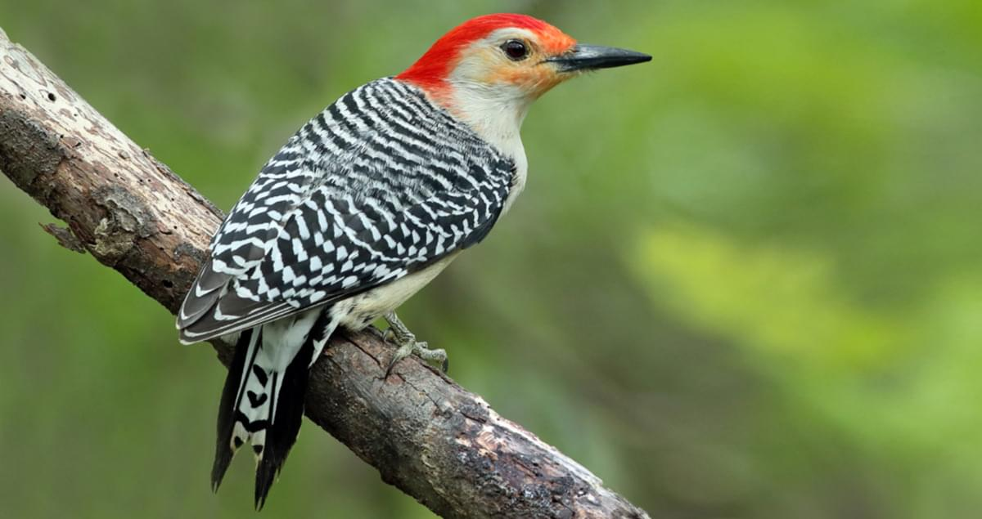
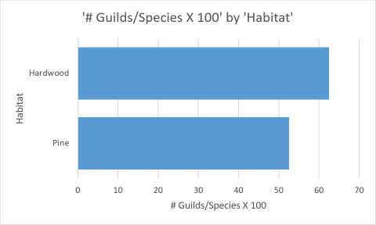
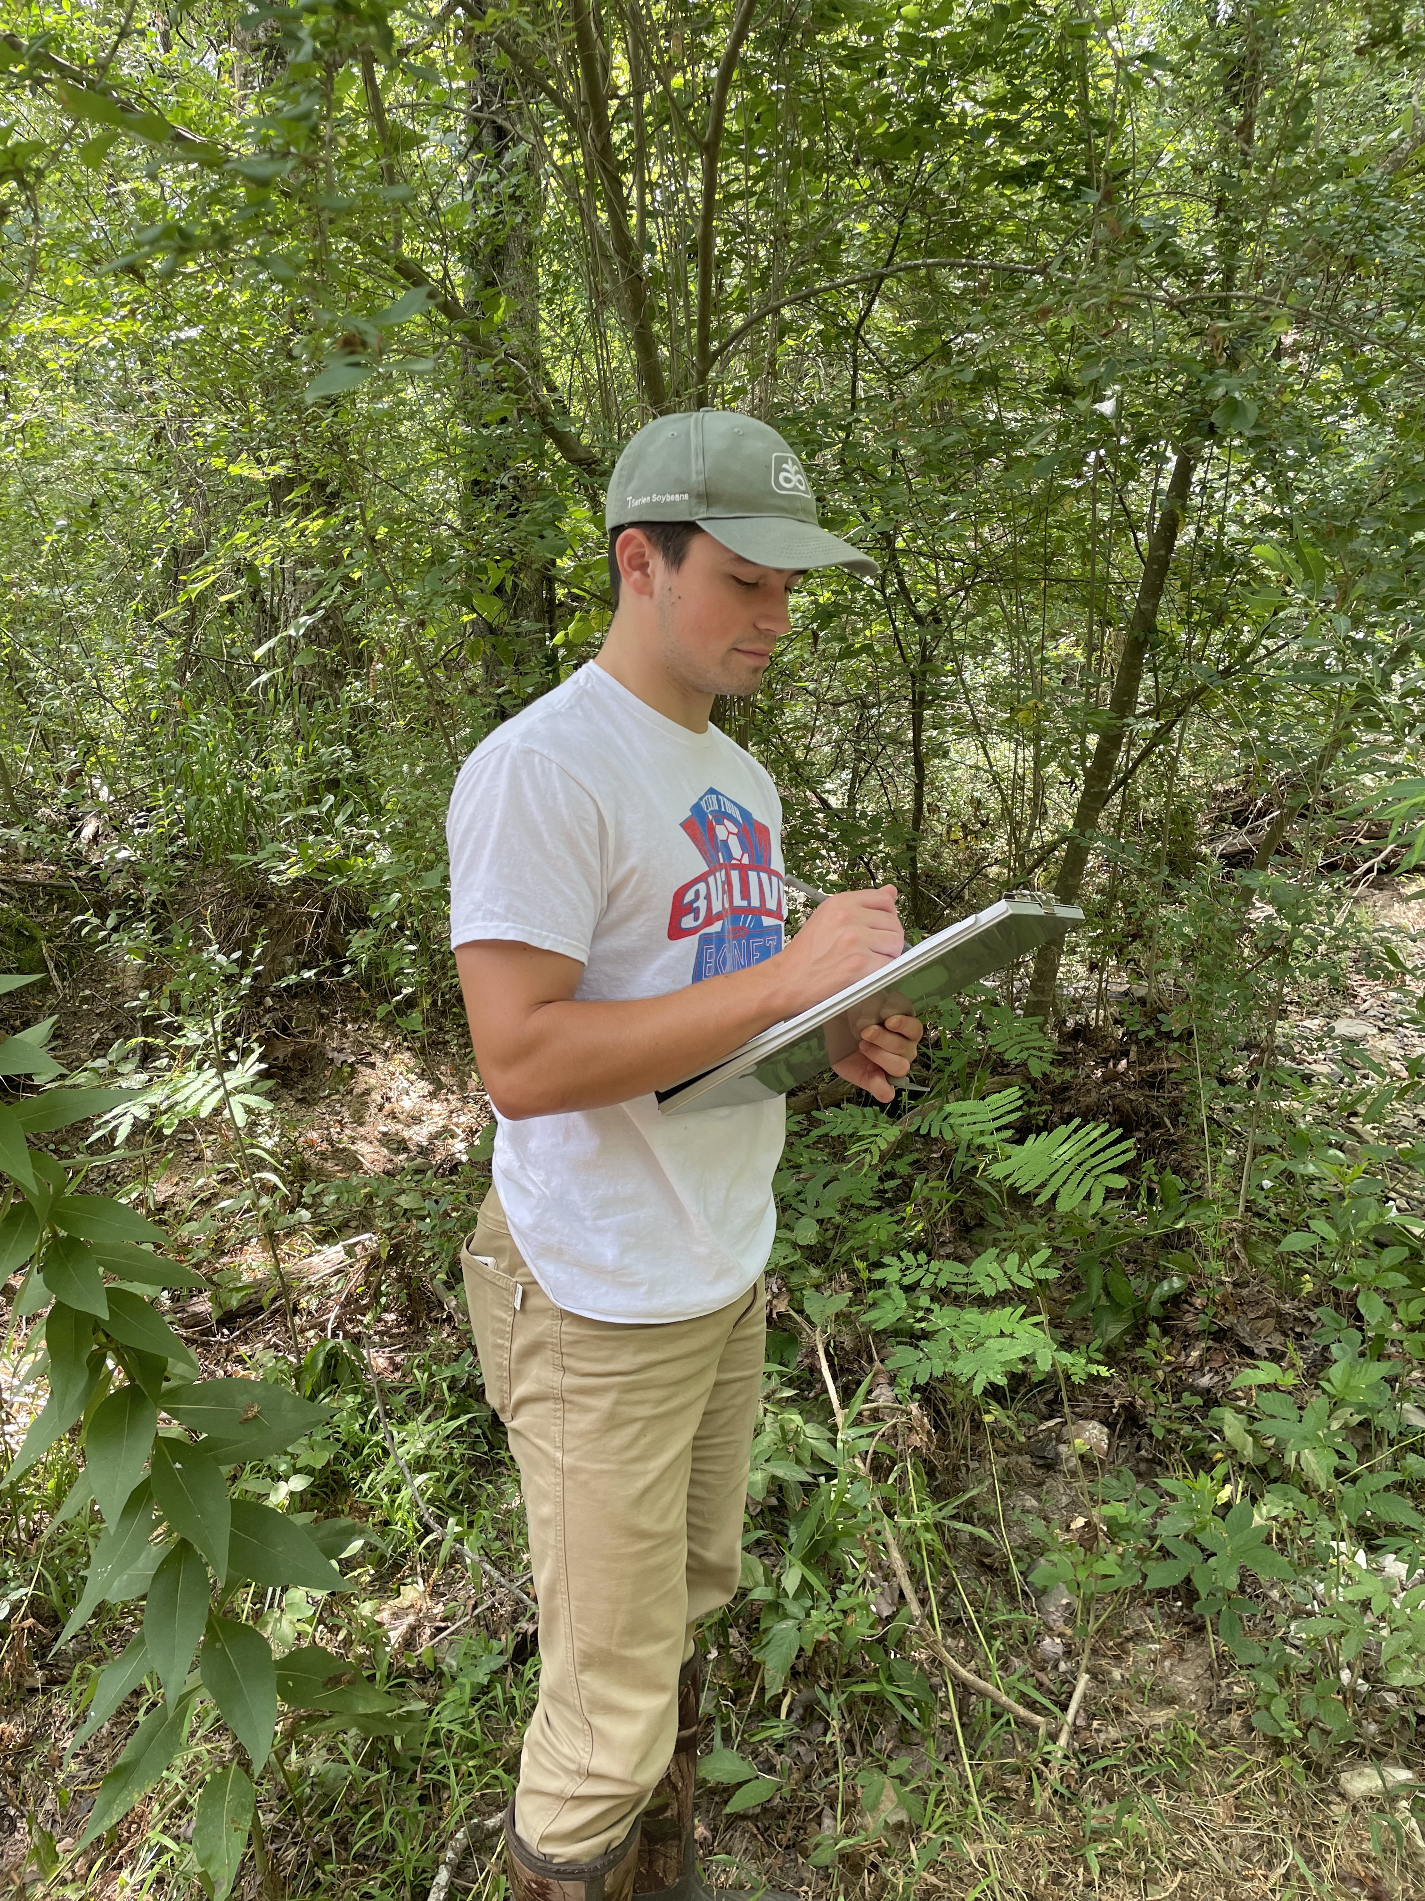
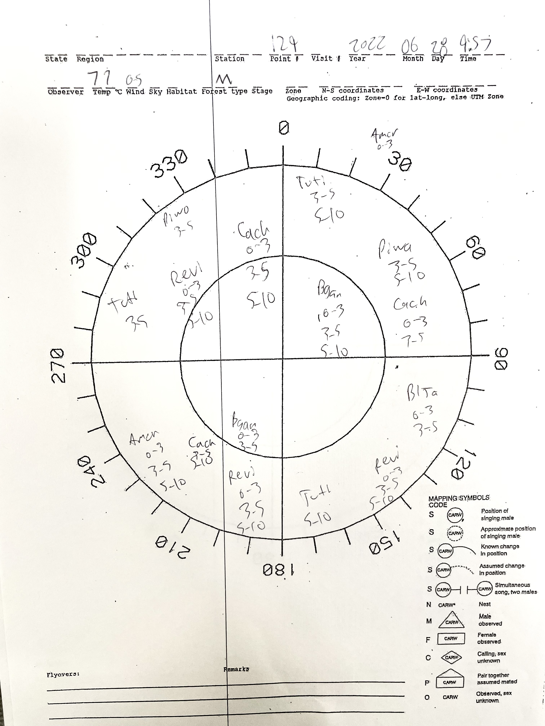
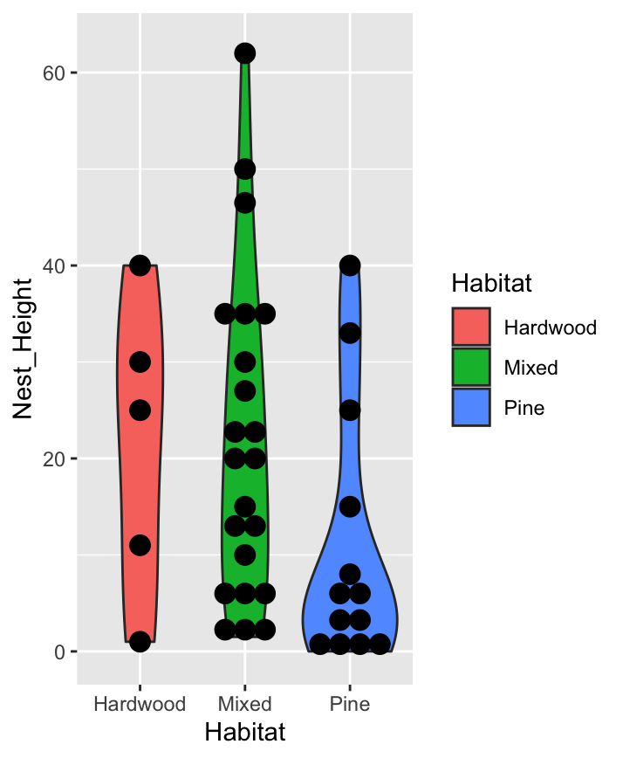
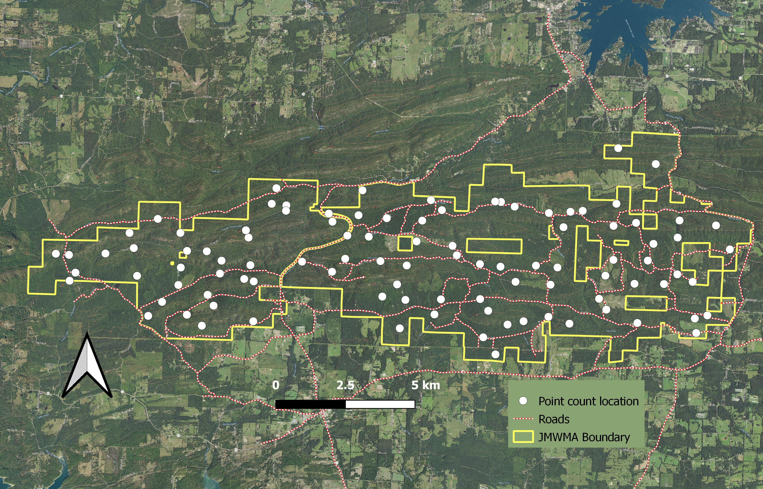
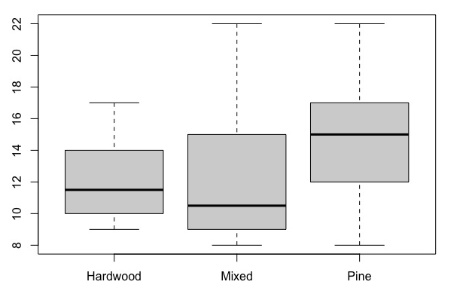
Assessing patterns of habitat use by breeding birds at Jack Mountain Wildlife Management Area
Caden Pulliam, Luke Jeffus, Christin Pruett PH.D
Comparing Guilds in Pine and Hardwood
Figure 7: Red Bellied Woodpecker, One of the many beautiful woodpeckers found in Jack Mountain, and throughout Arkansas
Insectivores:
- Bark Gleaner
- Air-Hawk Under canopy
- Upper-Canopy Foliage Gleaner
-
- Ground-Hawker
- Bark-Excavator
Carnivores:
- Ground Hawker
Insectivores:
- Air-Hawk Under Canopy
- Bark-Gleaner
- Ground-Gleaner
- Ground- Hawker
Granivores
Ground Undergrowth-Gleaner
Carnivores:
Air-hawker
Ground Hawker
Nocturnal
Herbivore:
- Ground Forager
- Lower-Canopy Foliage Gleaner
Nectarivore
Birds in North America show declining numbers, even for the most common birds breeding at Jack Mountain Wildlife Management Area in south-central Arkansas. Previous studies have shown that forests with >60% pine cover and lower canopy density have greater bird diversity and abundance but that these habitats do not have higher numbers of insects. We sought to further examine this interesting pattern by determining each bird species’ life history characteristics (feeding guild, nest substrate, and nest height) in relation to most preferred habitat. One hundred random points within the Jack Mountain Wildlife Management Area were surveyed in June 2022 (Figure 1) and all the birds seen or heard were recorded. As in previous years’ research, pine-dominated forests had a greater abundance of birds compared to deciduous and mixed forest types (Figure 2, F = 13.3 , P < 0.001 ). Of the 54 species observed at points in summer 2022, most species were found across habitat types, but a few species were more commonly found in pine or deciduous woodlands. Comparisons among habitat types in relation to feeding guild and nest characteristics were analyzed using, “A hierarchical classification of trophic guilds for North American Birds and mammals” (Gonzalez-Salazar, Martinez-Meyer). It was hypothesized that the greater abundance of birds found in the pine habitats was due to more abundant nesting sites at different heights, and more available guilds. However, it was found that there was no significant difference in number of available guilds between pine and hardwood habitats, 5 found in hardwood and 9 found in pine (Figure 3, p = 0.356 ). There was also no significant difference in available nesting heights (Figure 4, P = .705). We have come to the consensus that more data needs to be collected, and a survey needs to be done regarding the available feeding areas in each habitat type.
Figure 3: Comparison of available guilds in Pine and Hardwood habitats after correcting for the difference in the number of Birds Found . This was done by dividing the number of guilds by the number of species and multiplying by 100 to show the ratio as a percentage. A Chi square test was performed on the percentages (P= 0.356) that showed no significant difference. The Guilds are listed inside the bars of the graph for each habitat.
Abstract
Figure 5 above: Student Performing Bird survey, each point was surveyed for 10 minutes facing north, every bird seen or heard was recorded
Figure 6 Right: Each bird was recorded on one of these pages at each point, The page also includes time of day, temperature, wind, and habitat type
Average Number of Birds in Each Habitat
Number of Birds
15
11.5
10.5
Figure 4: Available Nest Heights Found in Each Habitat. Although there were more available nesting heights in Pine (13) than hardwood (5), when a Bartlett test was performed, it was shown that there was no significant variance. Each dot represents a species that preferred that habitat.
(P= .705)
Figure 1: Map of 100 points
Surveyed- Each Point was randomly placed throughout the wildlife management area and was surveyed one time for ten minutes between
sunrise and 11 a.m.
Habitat Type
Figure 2: Average abundance of birds per point in each habitat type (P = < 0.001). The average is the dark line in the middle of each category. Pine habitat is shown to have the most abundance of birds (15), followed by Hardwood(11.5), then Mixed(10.5). These findings further support studies done in previous years. To determine what is causing this difference, Further analyses were done (Figures 3 and 4)
González-Salazar, Constantino, et al. “A Hierarchical Classification of Trophic Guilds for North American Birds and Mammals.” Revista Mexicana De Biodiversidad, vol. 85, no. 3, 2014, pp. 931–941., https://doi.org/10.7550/rmb.38023.
“Home.” Audubon, https://www.audubon.org/.
Naeem, Shahid. The Birder's Handbook: A Field Guide to the Natural History of North American Birds: Including All Species That Regularly Breed North of Mexico. Simon & Schuster, 1988.
Patterson Summer Research Program

